Slide 1
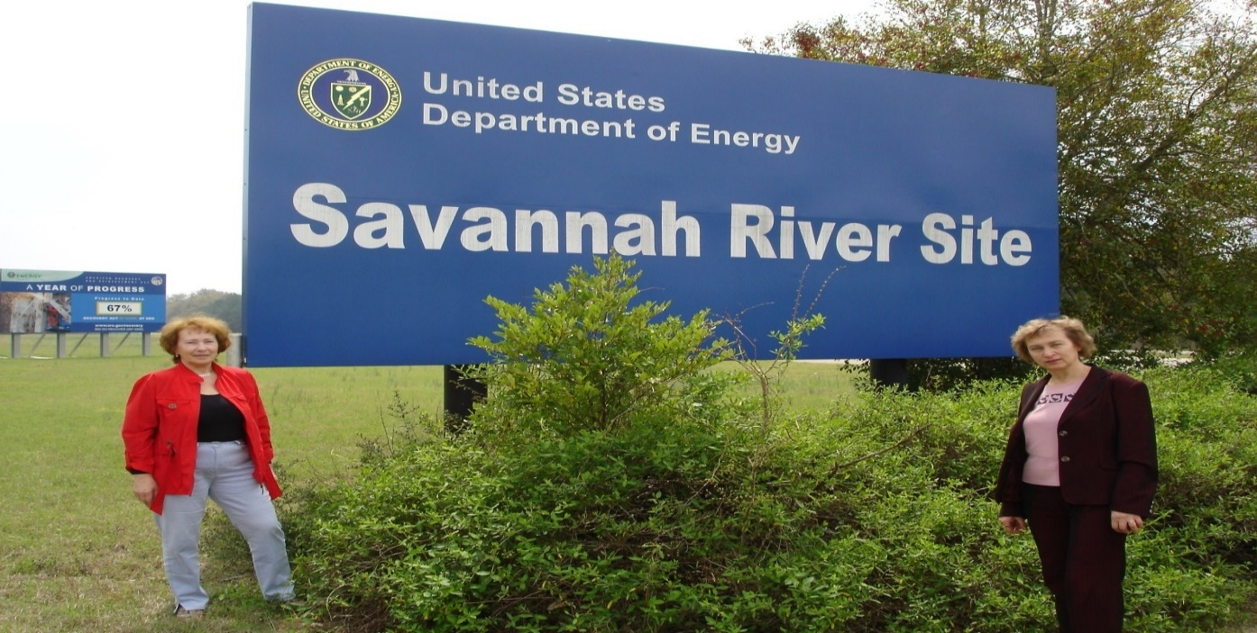
Challenges at DOE’s Savannah River Site
CPRC’s “Power to the Peaceful”
February 4, 2017
Tom Clements, Director, Savannah River Site Watch, Columbia, SC tel. 803-834-3084, srswatch@gmail.com www.srswatch.org, https://www.facebook.com/SavannahRiverSiteWatch
Notes:
SRS sign at entrance on the west side of the site, nearest to Augusta, GA. Originally called “Savannah River Plant,” and referred to as “The Bomb Plant.”

Slide 2
Key SRS Issues
Congress - fully fund clean-up activities to reduce environmental threat;
Halt reprocessing of nuclear materials and dumping more waste into aging tanks;
No import of foreign nuclear waste;
Halt pursuit of unsustainable plutonium fuel (MOX) project;
Curtain nuclear weapons mission - tritium - at the site;
Pursue clean missions for future of the site.

Slide 3
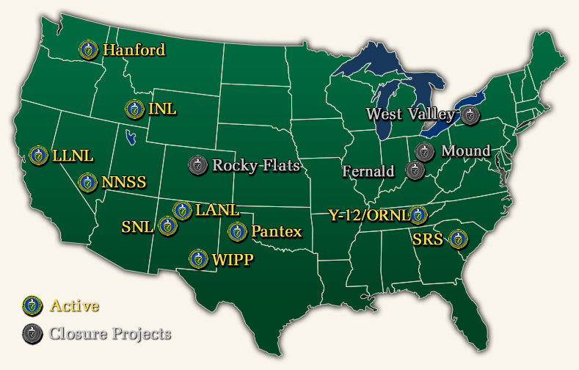
11 major DOE weapons/waste sites in 9 states

Slide 4
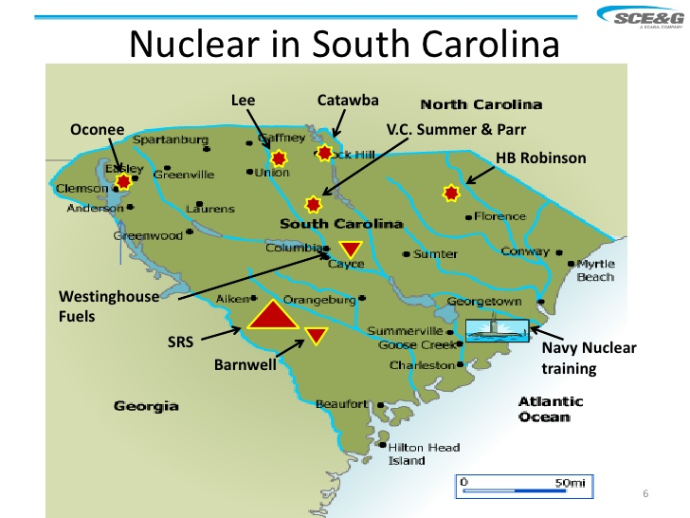

Slide 5
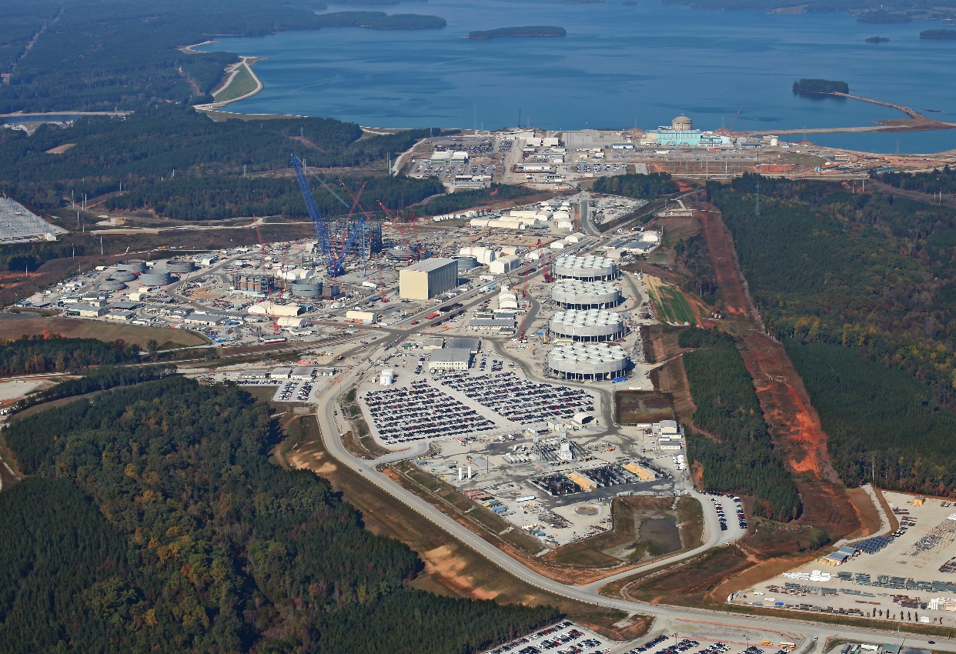
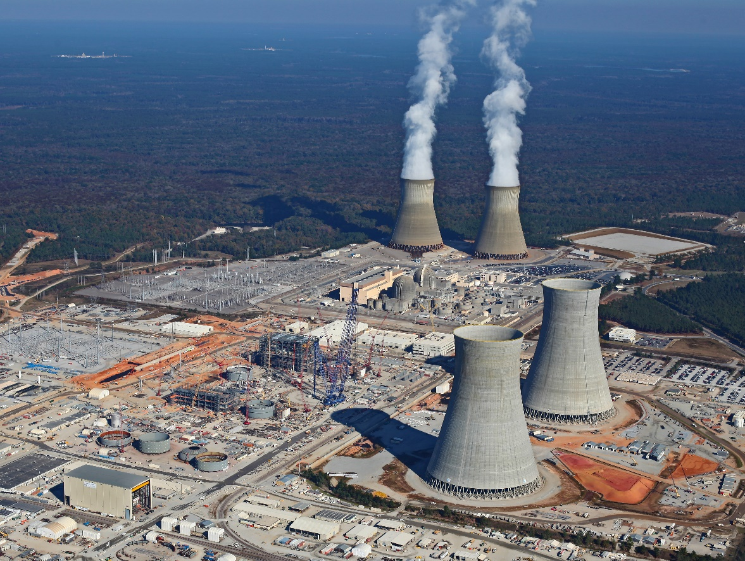
Four new nuclear power reactors under construction near us – at VC Summer & Vogtle

Slide 6
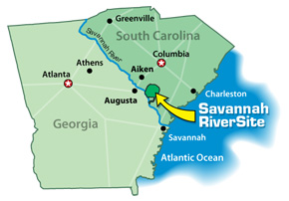
SRS, 310-square miles in size, was founded in the early 1950s to produce plutonium and tritium for US nuclear weapons – in
5 “defense” reactors; still employs 11,000
Notes:
Over 5000 people were moved off the site and some families still claim that they were not properly compensated. The book “Cold War Dixie” goes into details on establishment of the site and how dreams by many of a bi-racial work force were not realized as racism in hiring prevailed. At the height of the Cold War, SRS employed 25,000, now it’s around 10,000.

Slide 8
Though plutonium production stopped in the mid-1980s, the site continues to process nuclear materials, with the main focus on nuclear waste management (“clean-up” of Cold War waste)
Notes:
This is the current flow diagram of nuclear materials and nuclear waste. The many round shapes in the largest box are the 51 high-level waste tanks, 6 of which have been largely emptied and have been filled with concrete. May of the tanks sit in the ground water and pose contamination risks.

Slide 9
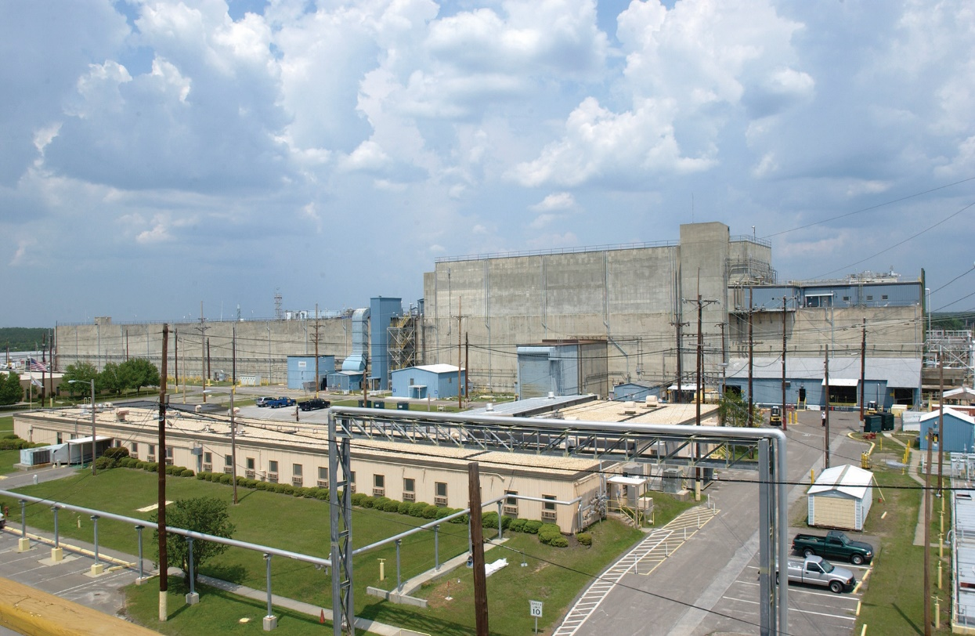
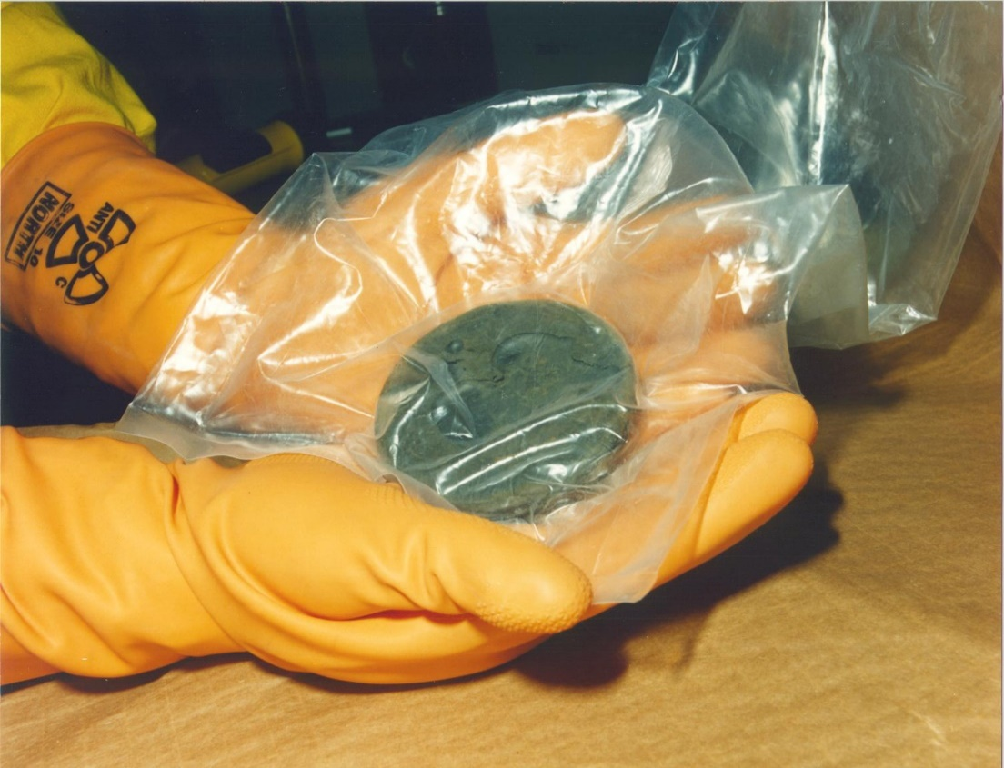
Two reprocessing plants separated weapons materials from reactor “targets,” yielding millions of gallons of high-level waste – 35 millions gallons of HLW remain, with 43 large holding tanks active and 8 “closed”
Notes:
The H-Canyon reprocessing plant is shown o the left; it is still in operation (costing about $150 million/year) but should be closed but contractors are using it to make money reprocessing various materials. On right, plutonium “puck” made at SRS was shipped to another DOE site to be fabricated into the core of a nuclear weapon.

Slide 10
SRS faces a host of urgent “clean-up” issues, running to 2042 or later
Notes:
Note headings in each area – these are the main clean-up issues now facing SRS – dates like to be extended as budget shrinks

Slide 11
Budget request for “environmental management” (EM) at SRS – about $1.3 billion for Fiscal Year 2016; the nuclear weapons and proliferation side of the SRS budget adds about another $500 million
- nearing $2 billion/year for the total site budget

Slide 12
Of the overall DOE “environmental management” budget of $5.6 billion, SRS gets about ~23%; DOE budget via the “National Nuclear Security Administration” is about $12.9 billion for nuclear weapons and nuclear non-proliferation; DOE total budget is ~$32.5 billion

Slide 13
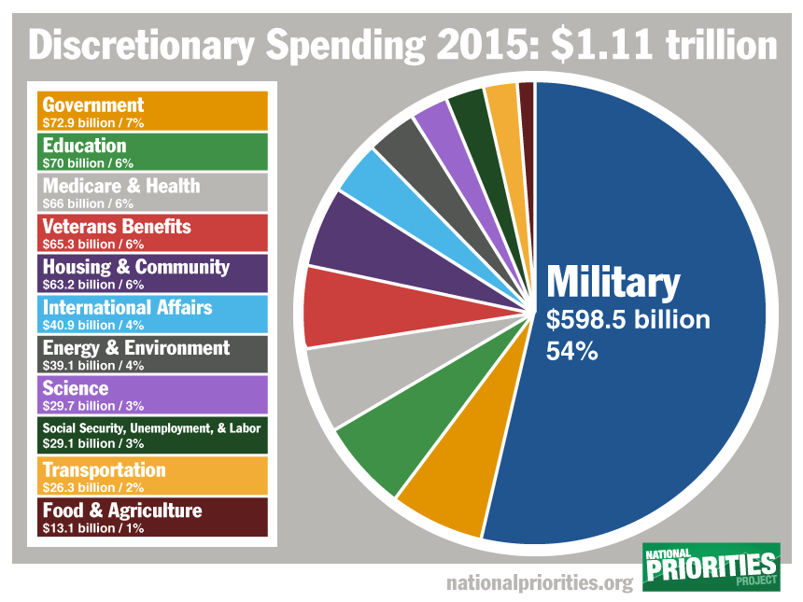
Department of Nuclear Weapons & Cold War Waste
(aka DOE) is a small % of the national budget

Slide 15
In 2015, total “clean up” cost of SRS projected to increase by $25 billion, to $91 billion to $109 billion & pushed to 2065;
“clean-up” remains king of the SRS budget

Slide 16
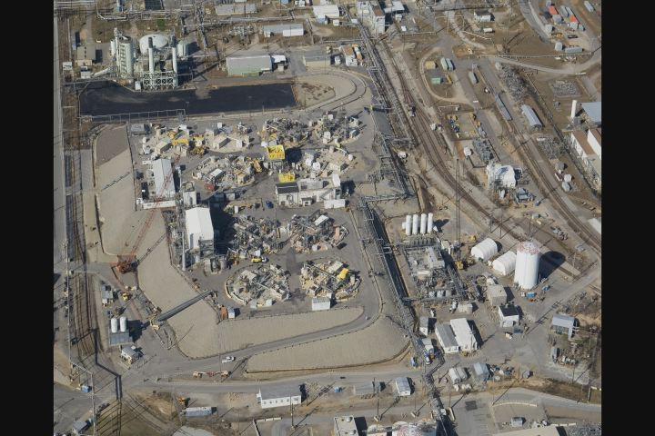
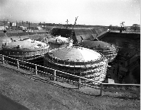
“The thirty-seven million gallons of highly radioactive and toxic waste, stored in aging and degrading tanks at SRS, is the single largest environmental threat in South Carolina.” – South Carolina Department of Health & Environmental Control; of the 51 waste tanks on the site, 8 tanks have been “emptied” and filled with concrete to be left forever as a monument to the insanity of the Cold War
Notes:
Photo on left is of tanks under construction. On right – top of tanks now at surface, with various types of equipment to transfer waste between tanks and make measurements. Waste in the tanks is highly radioactive and poses a threat to the environment and human health in case of leaks or accidents.

Slide 17
Highly radioactive liquid waste from the reprocessing facilities went into “tank farms,” with little plan for how it would be managed – highly radioactive waste is still being added to the tanks, needlessly magnifying risks and slowing tank closure

Slide 18
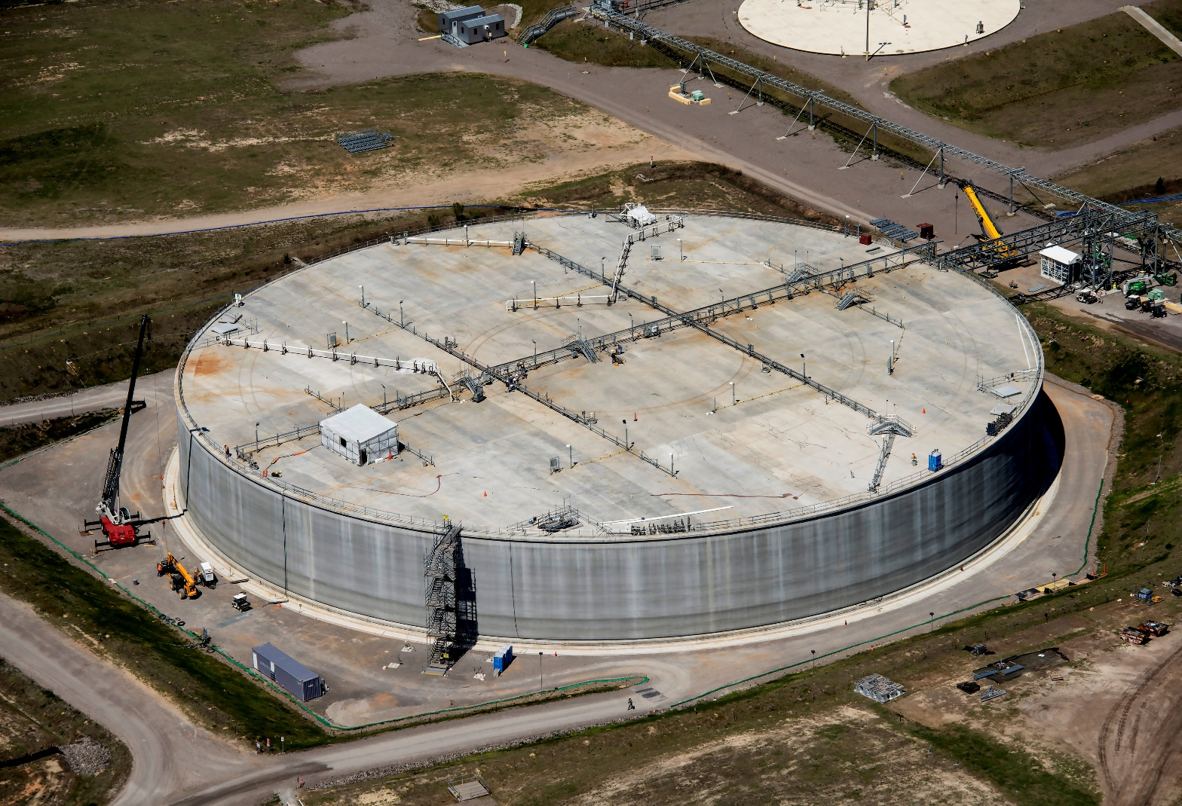
High-level waste byproduct being mixed with grout and poured into “vaults” that will be covered with soil and left forever

Slide 19
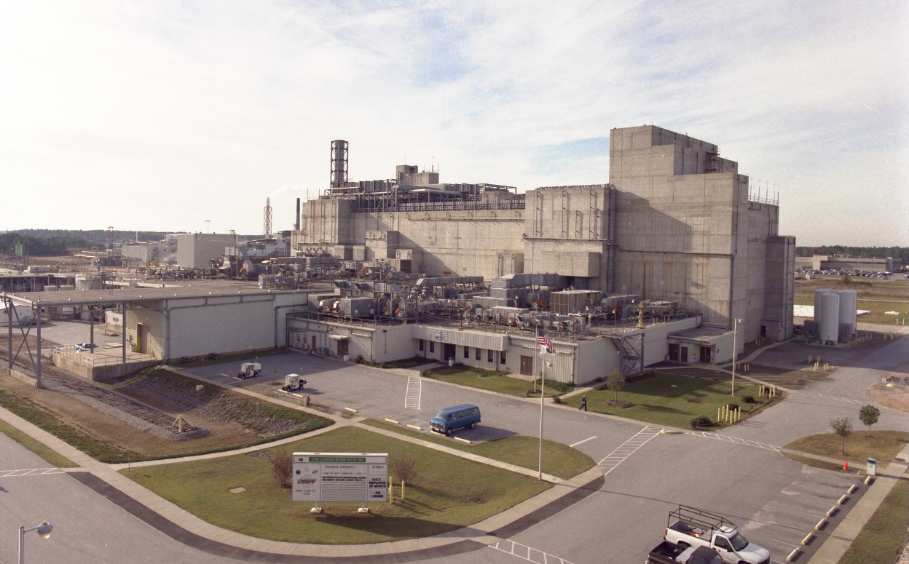
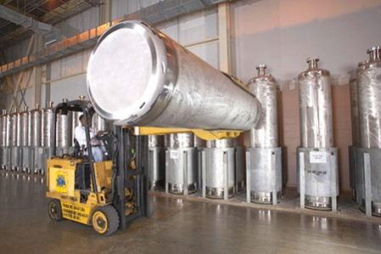
Tanks are being emptied and large casks are being filled with vitrified waste – about 4150 have been filled (out of about 8500 projected); current rate is about 100/year; German waste may cause the need for an additional 100 canisters so would slow down the urgent emptying of the tanks; canisters have no destination (i.e. geologic repository)
Notes:
Left photo – Defense Waste Processing Facility (DWPF), where liquid waste from tanks is being mixed with glass and “vitrified” in large casks. Photo is of empty casks; full casks emit deadly amount of radiation and must be isolated from contact. Two large storage buildings hold the casks and plans are for more storage as there is no place to take them.

Slide 20
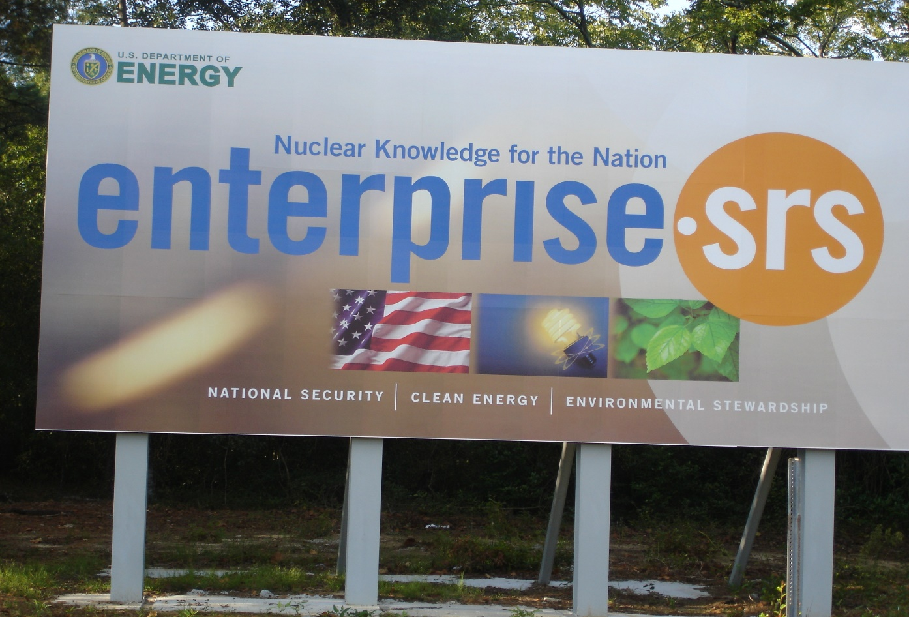
What is the future of SRS? DOE and contractors formed “Enterprise SRS” and their abandoned “vision” was focused on waste management, including waste import and “small modular reactors”

Slide 21
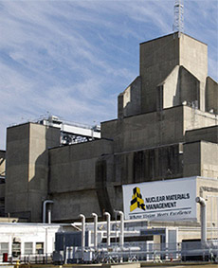
SRS stores 13 metric tons of weapon-grade plutonium stored in the old K-Reactor – unclear fate of this material - to be managed as waste or for plutonium fuel (mixed oxide fuel – MOX) for unknown reactors? Plutonium is being imported from other countries.

Slide 22
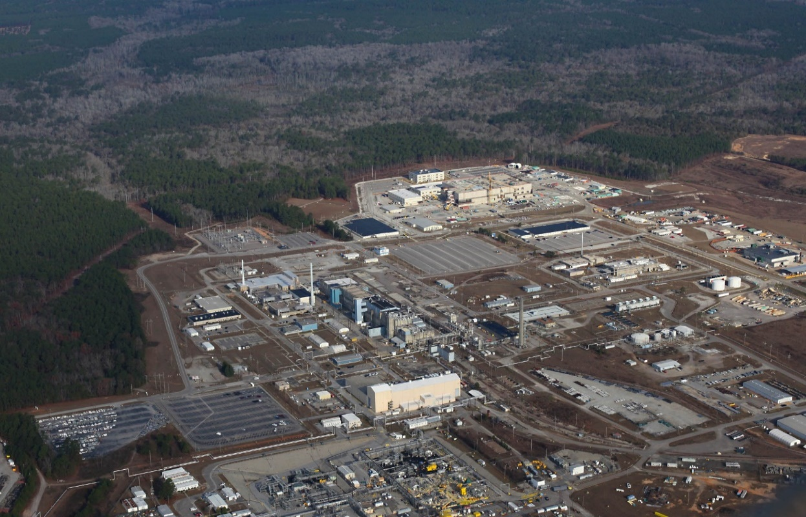
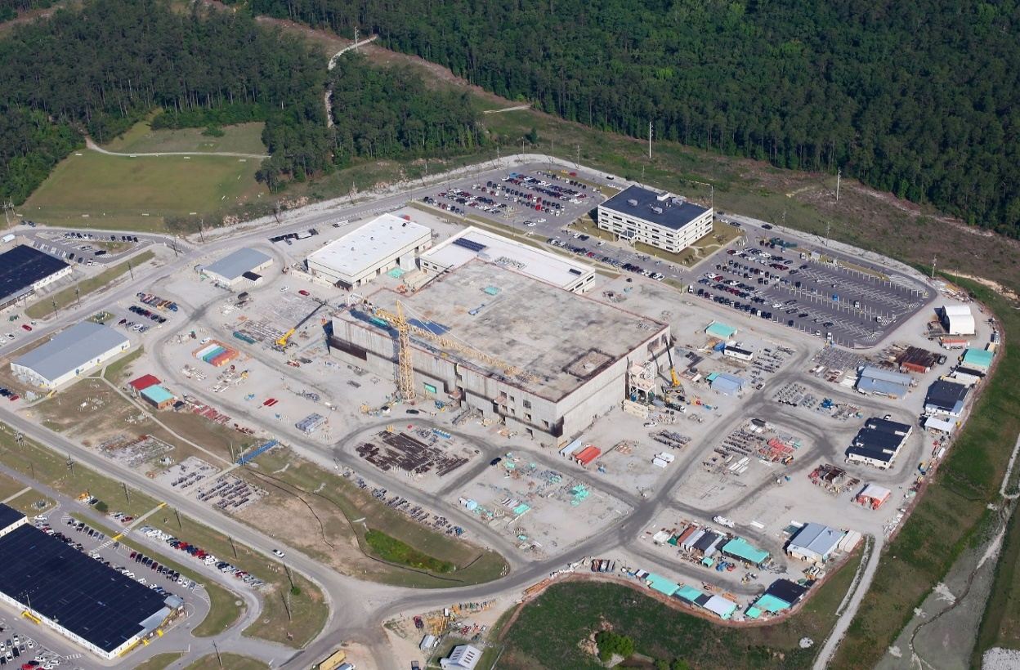
MOX plant under construction – massively over budget; cost estimate $17 billion just for construction; overall program $30+ billion for next many decades; no utilities want to use MOX & DOE has stated that the project not financially sustainable, but it’s the “pet boondoggle” of Senator Lindsey Graham and Rep. Joe Wilson

Slide 23
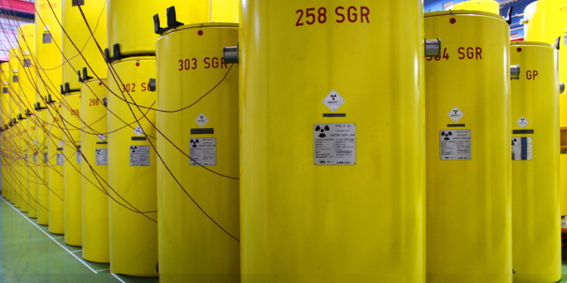
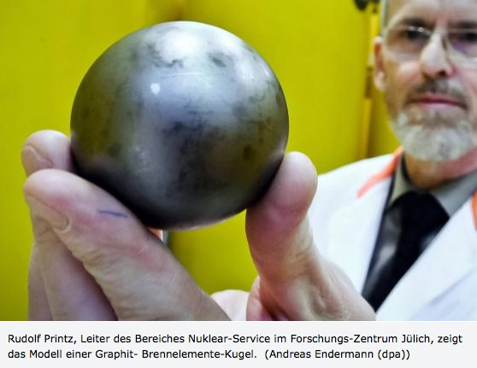
Some SRS officials and SRS contractors are pushing to import gas-cooled reactor spent fuel from Germany for reprocessing. This commercial spent fuel, made from 900,000 graphite used in two reactors closed 25 years ago and stored in 507 casks at 2 sites in Germany, would increase waste-management problems. Contractors are eyeing a deal worth $100s of millions. EA stalled.
Notes:
Tom Clements toured Germany for a week at end of September to oppose the import. Many public interest groups in Germany are working against the export and some Bundestag members are challenging the German government to halt the deal. A draft “environmental assessment” is being prepared by SRS and may be out for public comment in December.

Slide 24
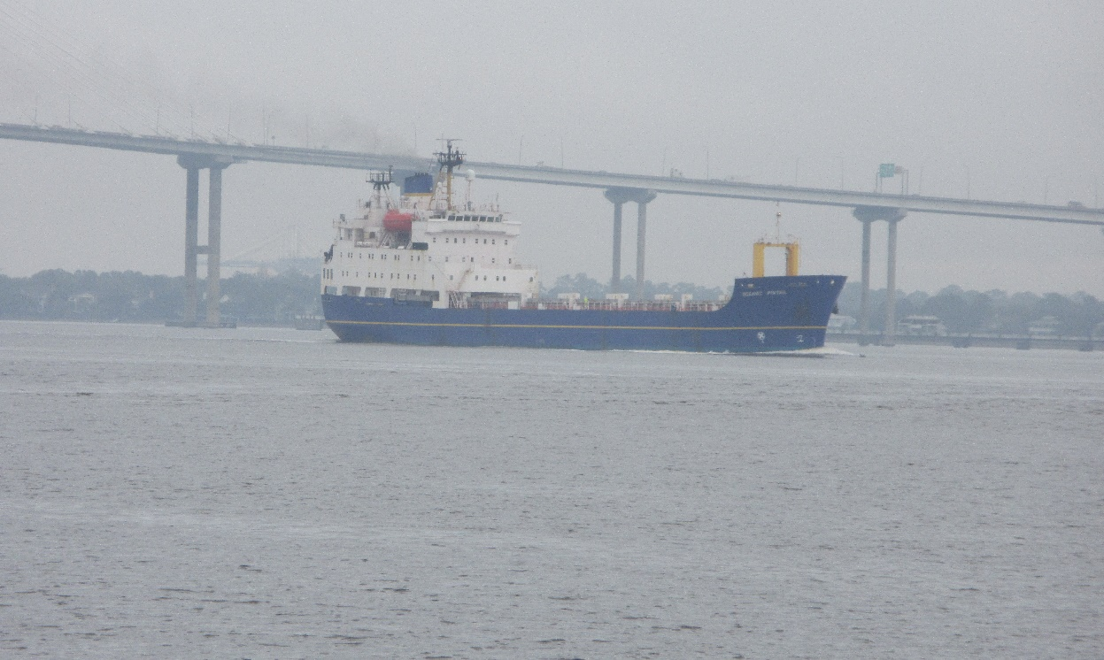
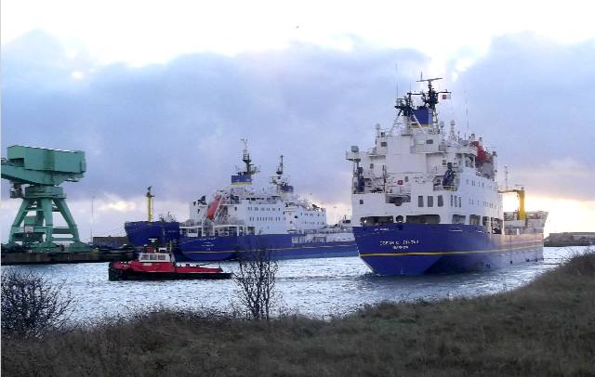
UK-flagged ships used to transport nuclear waste and plutonium to SRS, via naval port in Charleston, SC

Slide 25
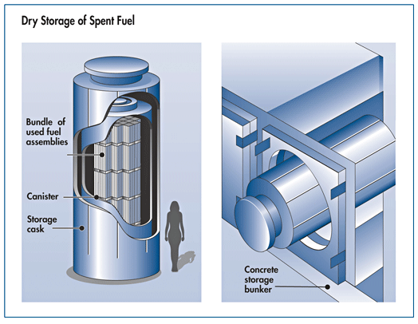
The SRS Citizens Advisory Board (SRS CAB), a duly embodied federal panel on SRS clean-up, has opposed “consolidated interim storage” of commercial spent fuel at SRS as it may never leave and some would use it to advocate for reprocessing (plutonium removal, with many hard-to-manage waste streams).
Notes:
Nuclear Regulatory Commission graphic is of two types of “dry storage” of spent fuel. SRS is not an appropriate site for such storage and the waste could get stranded in South Carolina,

Slide 26
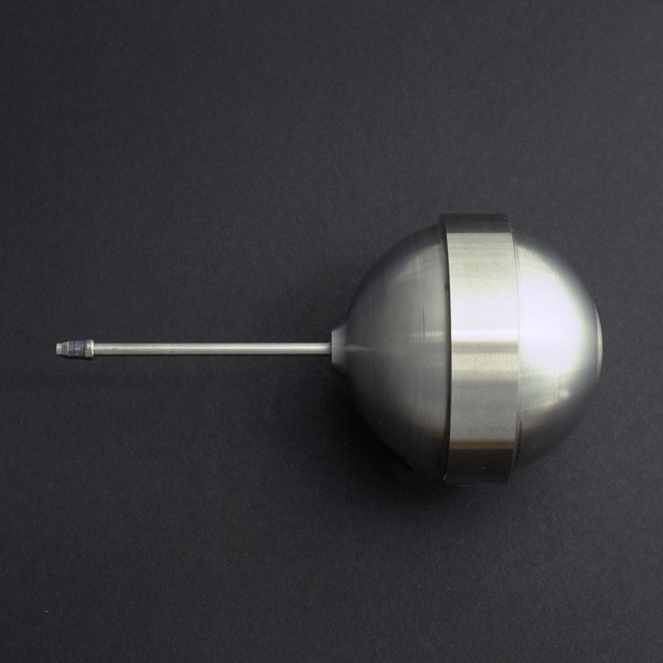
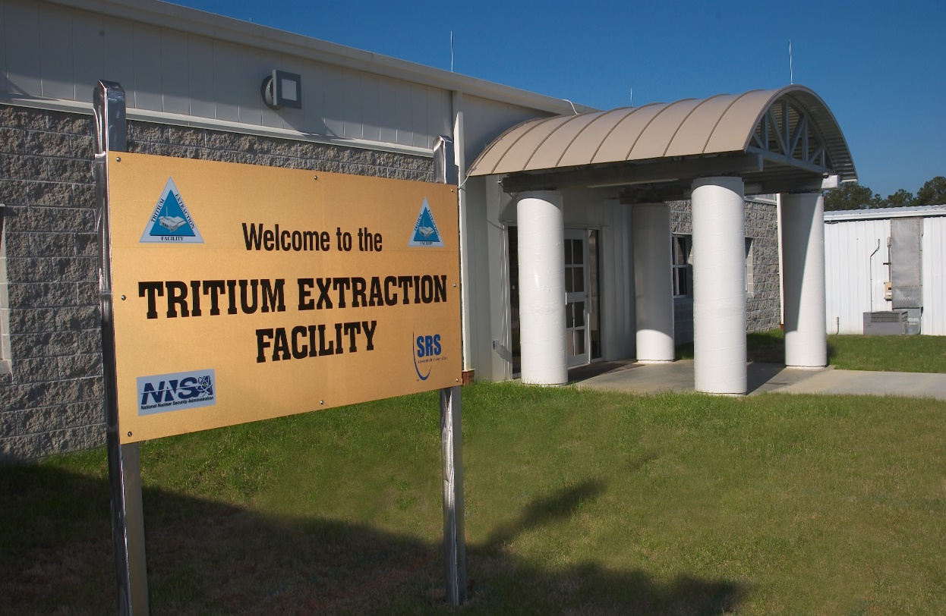
SRS process and packages all tritium for all US nuclear weapons, meaning SRS is still “The Bomb Plant”

Slide 27
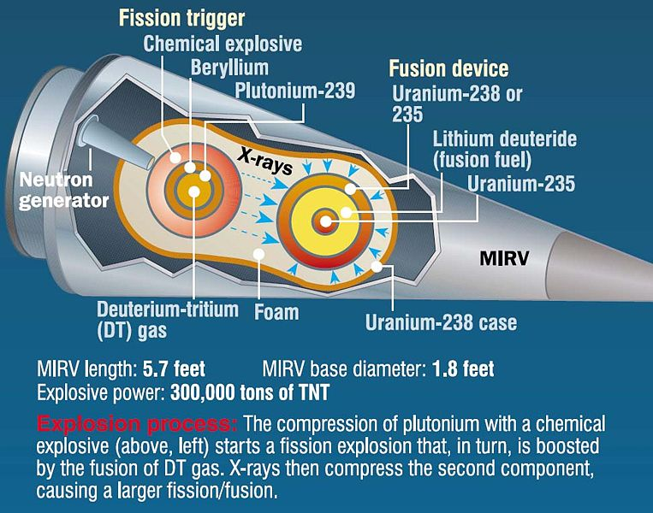
Canister of tritium gas inserted into nuclear warhead

Slide 28
Conclusions
Congress - fully fund clean-up activities to reduce environmental threat;
Halt reprocessing of nuclear materials and dumping more waste into aging tanks;
No import of foreign nuclear waste;
Halt pursuit of unsustainable plutonium fuel (MOX) project;
Curtain nuclear weapons mission - tritium - at the site;
Pursue clean missions for future of the site;
Who will carry on as SRS watchdog???

Slide 29
Action Request
Sign letter to Gov. McMaster & Contact SRS site manager, Mr. Jack Craig, and tell him that you are opposed to import of commercial spent fuel from Germany and liquid high-level nuclear waste from Canada. Tell him that you do not want foreign nuclear waste to be imported to SRS as it complicates and delays the urgent clean-up of the site. No dumping-for-profit by DOE and its clients.
Jack.Craig@srs.gov
Cc: Maxcine Maxted, Spent Nuclear Fuel Program Manager: maxcine.maxted@srs.gov

Slide 30
Tom Clements
Director, Savannah River Site Watch
1112 Florence Street
Columbia, SC 29201
cell 803-240-7268
tel. 803-834-3084
srswatch@gmail.com
www.srswatch.org
https://www.facebook.com/SavannahRiverSiteWatch
Who will carry on with the work of SRS Watch?

