Slide 1
Rocky Flats Disaster: Red Light for SRS Plutonium Bomb Plant (PBP)
PBP = More Plutonium, More Risk, More Nuclear Waste in South Carolina for Fabrication of “Pits” Not Needed for a New, Provocative Nuclear Weapon
Public Forum, Aiken Public Library
November 12, 2019
Sponsored by Savannah River Site Watch, with representatives of the Rocky Mountain Peace and Justice Center, Boulder, CO
Tom Clements, Director, SRS Watch, srswatch@gmail.com, www.srswatch.org

Slide 2
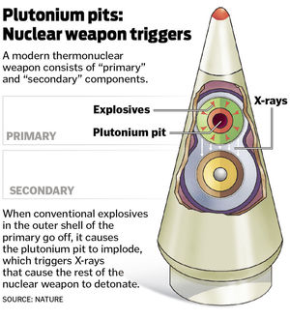
We’re here because DOE has proposed expanding pit production to the Savannah River Site (SRS), a new mission, and lessons can be learned from DOE’s pit-production experience in the past, at the plutonium-contaminated Rocky Flats site

Slide 3
Congress directed the National Nuclear Security Administration (NNSA) in the NDAA for FY 2015 to “demonstrate” production of 80 pits/year by 2027

Slide 4
DOD “Nuclear Posture Review” 2018 – No “need” given for the new weapon (W87-1-like) for which new pits would be used & which could stimulate a new nuclear arms race – How could we possibly need more nuclear weapons?

Slide 5
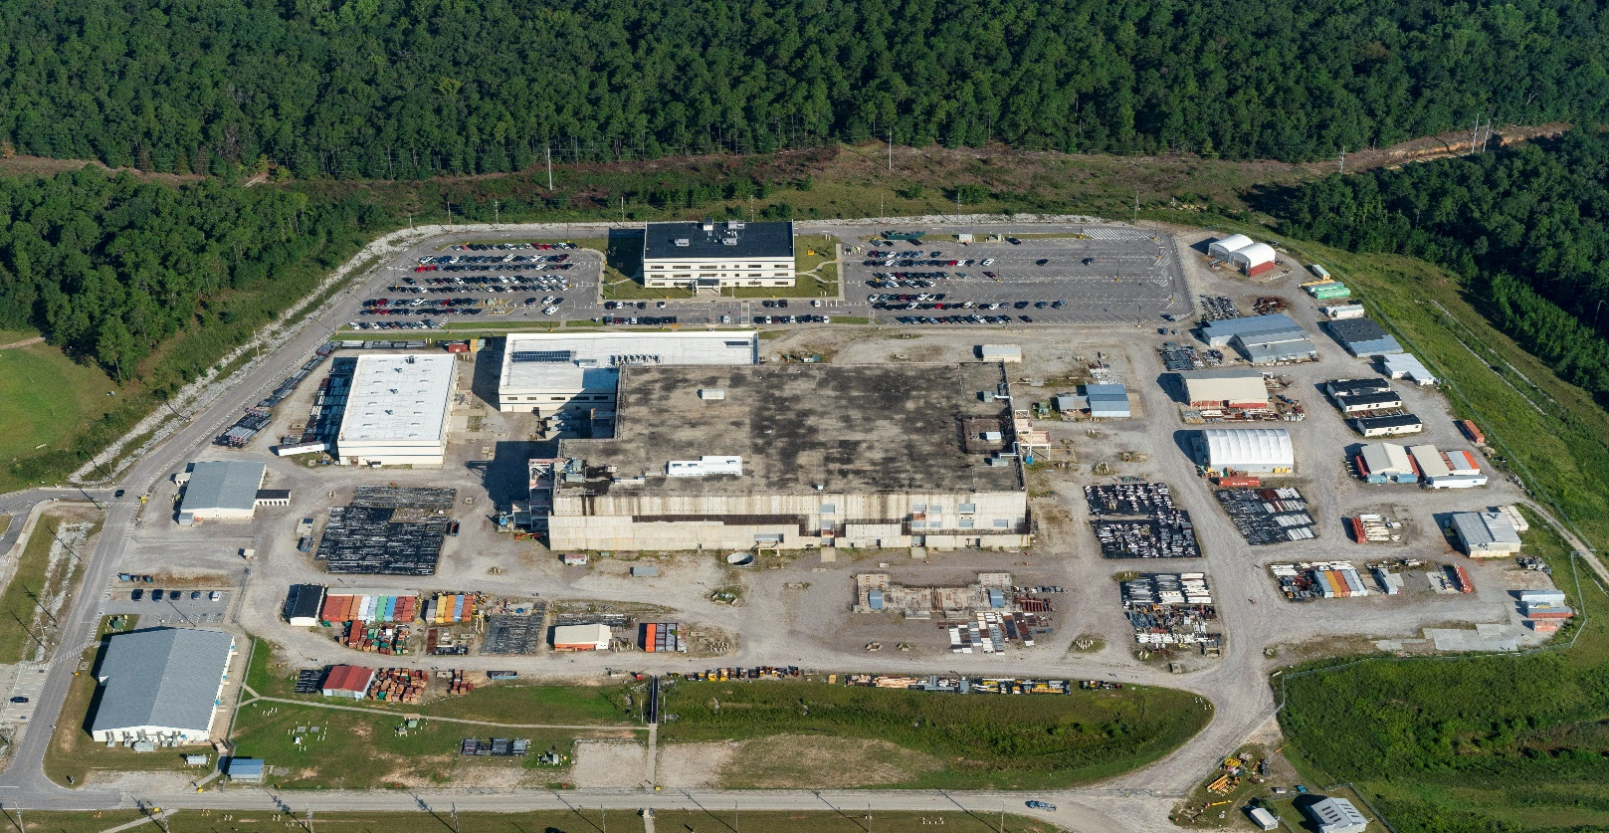
Goal: 80 or more pits produced per year by 2020 - 30 or more pits per year at Los Alamos, 50 or more pits per year at Savannah River Site in abandoned MOX facility

Slide 6
House language in NDAA for FY2020 repeals 80 ppy requirement – Now in Conference Committee; “Skinny NDAA” or “Continuing Resolution” May Leave PBP Unauthorized & Unfunded
House – Requires production of 30 pits per year by 2027, and cuts funds of $241.1 million for pit production beyond 30 pits, leaving $471.3 million in the plutonium sustainment fund. (In comparison to the Senate, the House reduces the pit production requirement by 50 and reduces funding by 34%.)

Slide 7
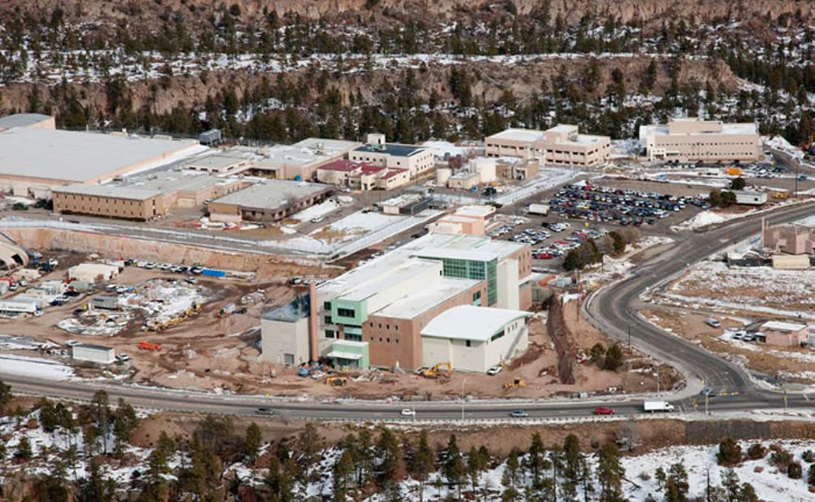
Los Alamos – “Plutonium Center of Excellence” (?!) - has a 20 ppy capacity that has never been reached; Plutonium handling halted from 2013-2016 so where’s the proof that Los Alamos can make 30+ ppy?

Slide 8
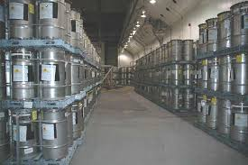
Starting from scratch has high risks: SRS has no pit production no capacity or experience & no plutonium casting experience; plutonium production halted in late 1980s; recent experience has been plutonium storage, plutonium downblending and some plutonium oxide production (now halted)

Slide 9

Proposed Plutonium Bomb Plant (PBP) would be located in the partially constructed MOX facility; NNSA has given no proof that the ill-designed, problem-plagued facility can be “repurposed” – NNSA is stonewalling a FOIA request on “repurposing” plans

Slide 10
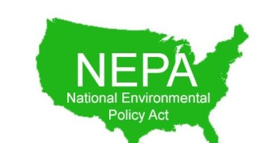
NNSA refusing to prepare required Programmatic Environmental Impact Statement (PEIS) on pit production in the DOE complex and is thus risking a lawsuit; EIS on PBP not enough to meet law and earlier settlement agreement

Slide 11
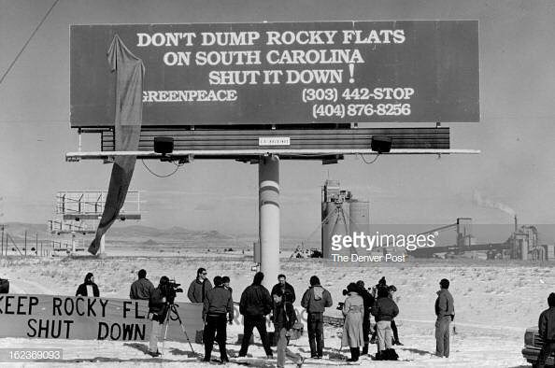
When Rocky Flats closed, the fear of pit production being dumped on South Carolina was raised and opposed.
Photo is at main gate, 1991

Slide 12
Pursuit of the Plutonium Bomb Plant (PBP) and expanded pit production must be halted, at least until:
1. Authorized and funded by Congress.
2 “Need” for W87-1-like warhead presented.
3. Nuclear proliferation risk assessment on PBP and the new warhead is prepared.
4. FOIA for documents on MOX “repurposing” released.
5. Legally mandated PEIS prepared.
6. MOX debacle has been fully investigated for fraud, waste, abuse and mismanagement by contractors and NNSA.
7. Special Grand Jury documents concerning Rocky Flats released and the cover-up ended.

Slide 13
Now, we will hear from our guest from Colorado, who have deep knowledge about Rocky Flats and the harm it continues to cause and the threat plutonium pit production has to our area.
Ms. Patricia Mellen, Esq.
Dr. LeRoy Moore
Representing the Rocky Mountain Peace & Justice Center in Boulder, CO

Slide 14
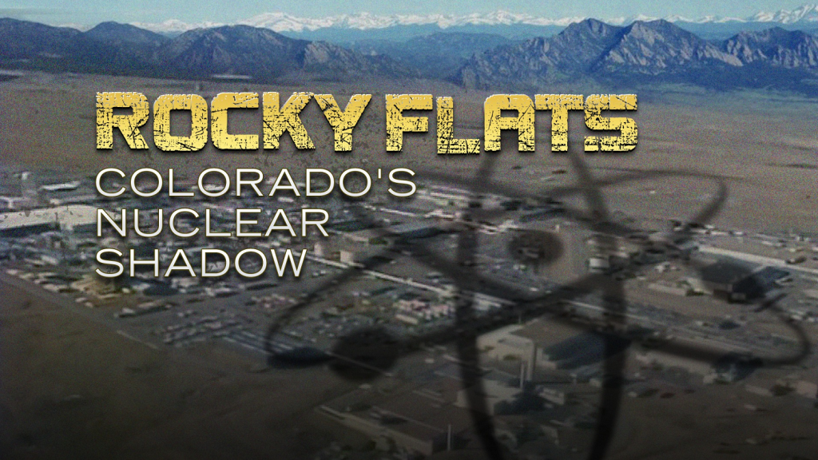
Rocky Flats Plutonium Disaster: Hard Lessons for South Carolina and Georgia

