Slide 1
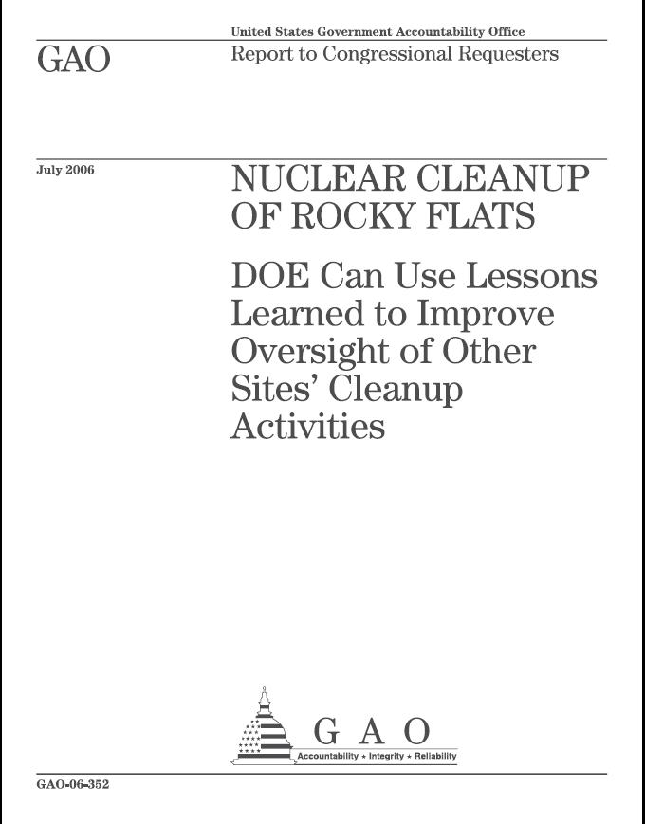
The Lessons of Rocky Flats
Savannah River Site Forum
Aiken Public Library
November 12, 2019
Patricia Mellen, Attorney at Law
www.patmellenlaw.com
Pat Mellen Law LLC 1

Slide 2
Perspective
Professional Involvement
Grand Jury Documents Suit 2019
Refuge Lawsuit Summer 2017
Counsel for several concerned Rocky Flats community groups
Issue-related research
Related Experience
National Security Clearance BIs
DOD, DOE, DOI
Los Alamos, Livermore
Education
BS IOE – U. of Michigan
MA Journalism – U. of Missouri
Juris Doctorate – U. of Denver
Pat Mellen Law LLC 2

Slide 3
Rocky Flats/CDPHE Normalizing “Big Truths”
Rocky Flats once was highly contaminated.
Environmental crimes committed during Plant Operations.
Some on and off-site residual contamination remains.
Will persist a long time.
Pat Mellen Law LLC 3

Slide 4
Context “Truth 1: The Rocky Flats Plant was once highly contaminated”
Acknowledged Accidents
Major plutonium fires – 1957, 1969
Misguided waste storage/disposal decisions
903 Pad
East Trenches
Pondcrete/Saltcrete
Solar Ponds
Other Anecdotal Events
Waste incineration
Experiment-related criticalities
Undocumented dumping/spray irrigation
Great Western Reservoir and Standley Lake Projects
1994 – ABC Nightline “The Most Dangerous Building in America.”
Building 771
Pat Mellen Law LLC 4

Slide 5
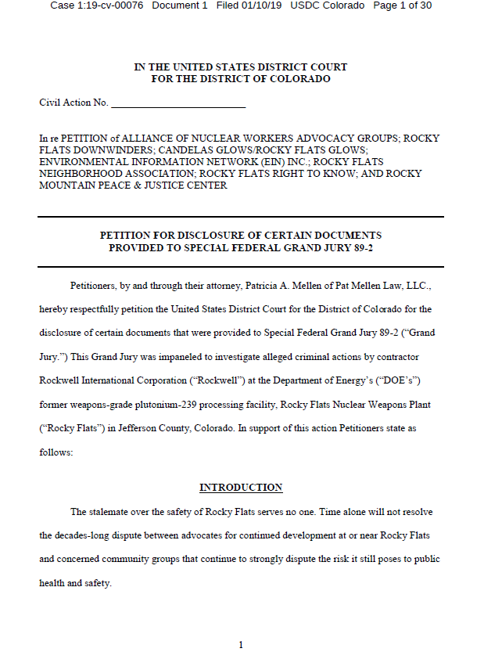
Context “Truth 2: Environmental Crimes were committed at the Plant”
June 6, 1989
FBI/EPA Raid
Rocky Flats Special Grand Jury
Empaneled August 1, 1989
Discharged March 24, 1992
US Attorneys refused to issue indictments
returned by Grand Jury
Rockwell pled guilty to ten (10) charges in a
plea agreement
Total fine: $18.5 Million
Indemnified by US DOE – paid by taxpayers
Plant annual budget estimated: $500 Million
Rockwell lost suit to breach DOE contract based on impossibility
DOE terms forcing it to break environmental laws
Pat Mellen Law LLC 5

Slide 6
Context “Truth 2: Environmental Crimes were committed at the Plant”
Crimes admitted in plea agreement – Felonies and Misdemeanors
Knowing Storage of Mixed Hazardous Wastes (Pondcrete & Saltcrete)
Knowing Storage of Mixed Hazardous Wastes (Pondcrete & Saltcrete) without a Permit or Interim Status
Knowing Treatment and Storage of Mixed Hazardous Wastes (Concentrated Salt Brine) without a Permit or Interim Status
Knowing Storage of Mixed Hazardous Wastes (Vacuum Filter Sludge) without a Permit or Interim Status
Negligent Violation of CWA Permit Conditions (Industrial Wastes to the Sewage Treatment Plant
Negligent Violation of CWA Permit Conditions (BOD Violations, March 1988)
Negligent Violation of CWA Permit Conditions (BOD/Fecal Coliform Violations, April 1988)
Negligent Violation of CWA Permit Conditions (BOD Violations, May 1988)
Knowing Violation of CWA Permit Conditions (Spray Irrigation)
Negligent Violation of CWA Permit Conditions (Chromic Acid Spill)
What was not charged? Who was not charged? Why not?
Pat Mellen Law LLC 6

Slide 7
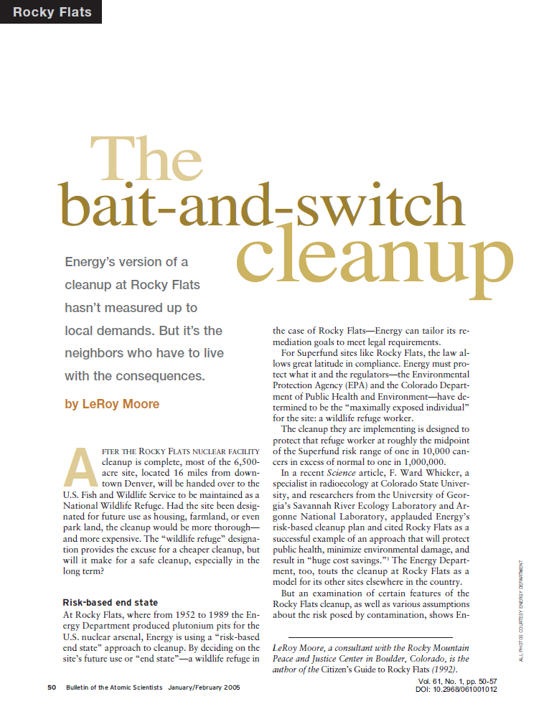
Context “Truth 2: The Superfund Cleanup”
Cleanup-Related Agreements
July 30, 1986 – Compliance Agreement (CEARP)
June 7, 1989 – Compliance Order
January 22, 1991 – Interagency Agreement
July 7, 1994 – Settlement Agreement & State
Compliance Order
July 19, 1996 – Rocky Flats Cleanup Agreement
Cleanup Metrics
Original Estimate – $37 Billion, 65 Years
“Accelerated Cleanup” – $7 Billion, 10 years
Kaiser-Hill Awarded Clean-up Contract – January 2000
Contractor’s proposed approach v. MARSSIM
Incentive-based contract with performance bonuses
Non-Standard Cleanup Methodology
Comprehensive Risk Assessment (RI/FS) after not before
Individual Hazardous Substance Sites (“IHSS”) Identification Basis
Pat Mellen Law LLC 7

Slide 8
Context “Truth 2: The Superfund Cleanup”
Cleanup Challenges
Competition with other cleanup sites for huge funding needed
Controversial disposal options – WIPP, Yucca, Hanford, Savannah
Early-stage development of cleanup technology
Cleanup Compromise Disputes
End State Use(s)
Cleanup Standards v. Money v. Time
ATSDR 2005 Public Health Report
“The on-site contamination levels will continue to pose no public health hazard to residents in the future, so long as site access is restricted. Any future changes to site access must be carefully reviewed (see Section VIII), based on the contamination levels that remain at RFETS after remediation is completed and the proposed land uses.”
Pat Mellen Law LLC 8

Slide 9
Context “Truth 2: The Superfund Cleanup”
No cleanup actions were taken on Refuge property
No Superfund cleanup actions were taken off site
Local Communities sought and received $$$ for separate clean-ups
Broomfield received DOE funds to replace Great Western Reservoir in drinking water supply
DOE financed Woman Creek Reservoir & Managing Authority
Woman and Walnut Creeks diverted from drinking water supplies
September 2006 Corrective Action Decision/Record Of Decision
Established boundary lines between the COU and POU (“Refuge”)
COU – Institutional Controls
POU – Pronounced “Safe” for “Unlimited Use, Unrestricted Exposure”
Pat Mellen Law LLC 9

Slide 10
Context “Truth 2: Now”
September 2006 Corrective Action Decision/Record Of Decision
Drew the boundary lines between the COU and POU (“Refuge”)
COU – Institutional Controls
POU – Safe for “Unlimited Use, Unrestricted Exposure”
COU
October 2004 - LSO Established 118 Stat. 2164 Sec. 3118
February 2006 - IGA Establishing Rocky Flats Stewardship Council
February 2007 - Rocky Flats Legacy Management Agreement
POU
December 2001 – Rocky Flats National Wildlife Refuge Act
April 2005 – Revised Comprehensive Conservation Plan
July 2007 – Rocky Flats National Wildlife Refuge established
December 2011 – JPPHA Easement & Section 16 swap begins
Pat Mellen Law LLC 10

Slide 11
Context “Truth 2: Now”
COU Institutional Controls
Active Monitoring
Ground-water Sampling
Surface-water Sampling
Discontinued Monitoring
Air Quality
Soil
COU Ongoing Issues
Original Landfill Slumping
Periodic Points of Compliance Exceedances
Fate of the Terminal Ponds
Soil Erosion Mitigation
Water Treatment/Testing Facility Maintenance
Pat Mellen Law LLC 11

Slide 12
Context “Truth 3: There is on and off-site residual contamination”
On Site Residual Contamination
Example – three Pu standards established
Surface – 3’: 50 pCi/g
3’ – 6’: 1,000 pCi/g
6’ – Unlimited
Acknowledged
COU Waste Buried in Place
Sampled Hotspots – COU and Refuge
Surface residue – solar ponds, burns
Anecdotal
Undocumented, un-remediated waste disposal
Spray fields
Host of non-Pu special nuclear, hazardous, and toxic wastes
Pat Mellen Law LLC 12

Slide 13
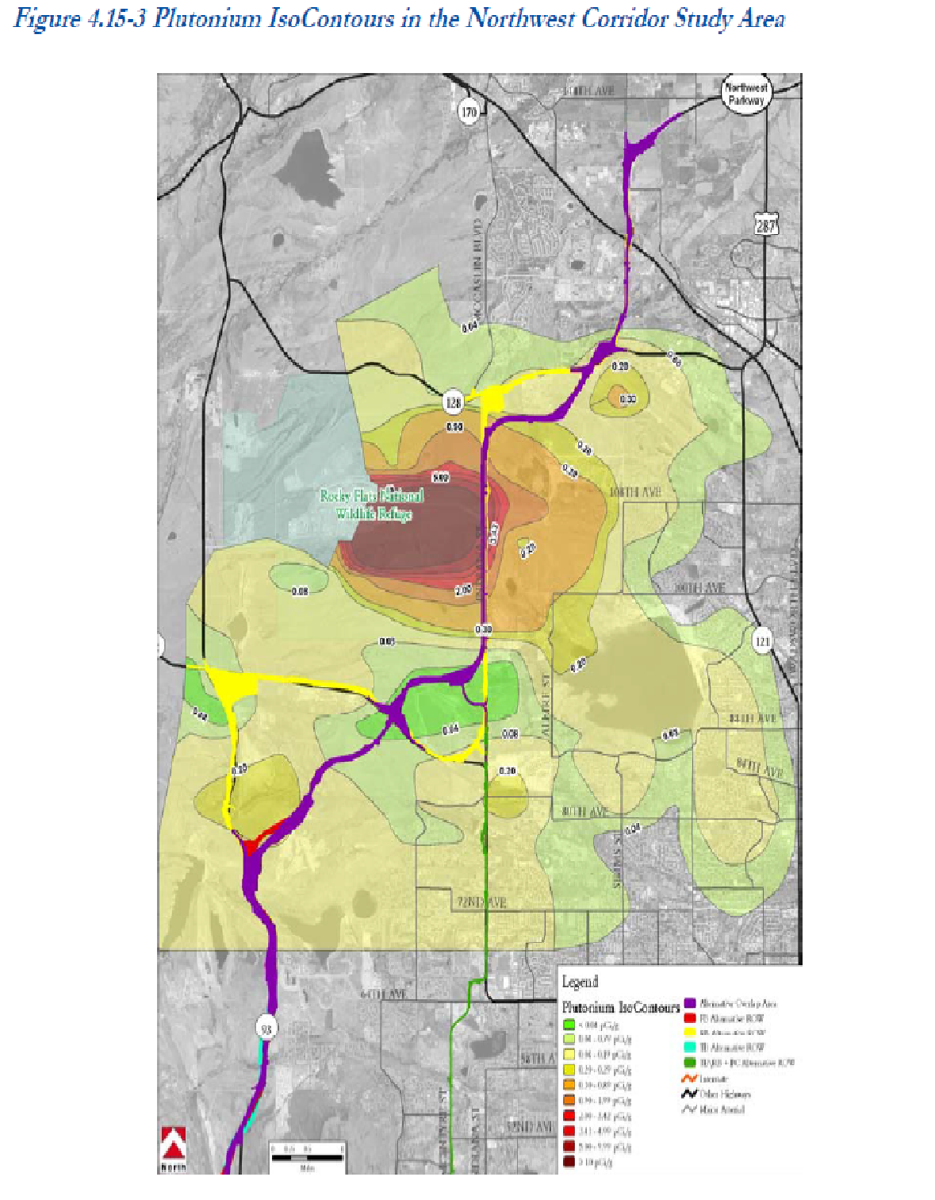
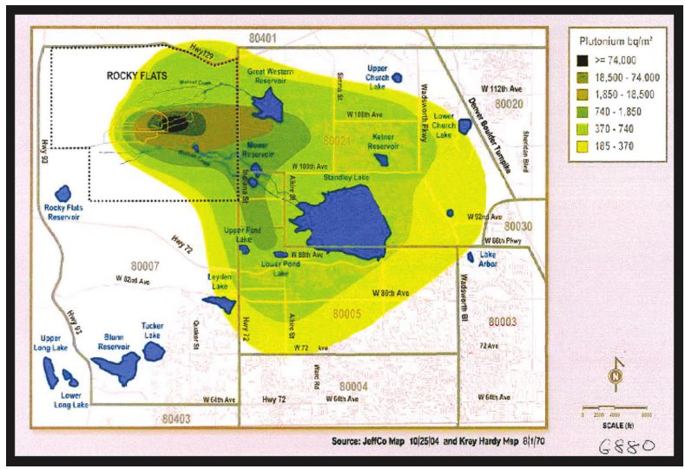
Context “Truth 3: There is on and off-site residual contamination”
Off-Site Residual Contamination
Krey-Hardy Map (AEC)
Cook v. Rockwell
Verdict form
Class Action Map
CDOT Northwest Corridor EIS
Iggy Litaor PhD
Pat Mellen Law LLC 13

Slide 14
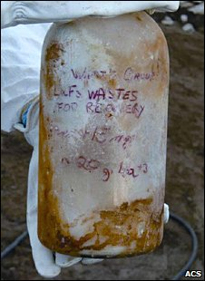
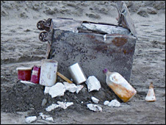
Context “Truth 4: Residual contamination will be there for a very long time.”
Half-lives of Special Nuclear Materials:
Pu 239 24,100 years
Pu 240 6,560 years
Pu 238 87.7 years
Am 241 432.2 years
Uranium Six figures
Challenges of long-life waste sites
Effective containment technologies
Markings/communication strategies
Safe discovered excavating a trench at Hanford in 2004
Pat Mellen Law LLC 14

Slide 15
What obligations exist at Rocky Flats to assess, educate, and warn the public of hazards that are not obvious and not “acute?”
Empower the public to protect itself from non-obvious dangers
The “government” says it’s safe, it must be safe
Risk assessment and justification based on “secondary signs” rationale
Incomplete longitudinal health studies
POC monitors/sampling is limited
Legal challenges posed by delayed or latent causation
It’s not just plutonium
Other special nuclear, toxic, and hazardous wastes
Americium, uranium, beryllium, mercury, arsenic, chromium, etc.
Risk of confirmation bias – Geiger counters v. Alpha emitting Pu
Pat Mellen Law LLC 15

Slide 16
Embracing Evolving Risk and Decision-making
Lessons Learned
Love Canal I & II
“New residents, attracted by promises of cleaned-up land and affordable homes, say in lawsuits that they are being sickened by the same buried chemicals from the disaster in the Niagara Falls neighborhood in the 1970s,” the Associated Press reported this month.
In the article, E.P.A. officials insist that the cleanup and containment of the pollution succeeded.
A central question, for residents old and new, is whether the passage of time has bolstered or undermined initial health concerns related to the more than 80 chemicals buried at the site, including 11 that state officials at the time said were carcinogens.
A persistent challenge in such studies is that ailments of greatest concern, like cancers, are rare enough that it is often impossible to detect a statistically significant indication of cause and effect amid the many other factors, like smoking, that can play a role. Another issue is that many cancers take decades to unfold.
- “Love Canal and Its Mixed Legacy,” New York Times, November 2013
Pat Mellen Law LLC 16

Slide 17
Embracing Evolving Risk and Decision-making
Lessons Learned
Flint Water Crisis
The scale of government neglect in the water crisis in Flint, Mich., could place the city alongside some of the most infamous environmental disasters in U.S. history, from New York’s Love Canal to the Hinkley, Calif., saga of Erin Brockovich fame.
Local, state and federal officials — including the top Environmental Protection Agency administrator in the Midwest and Michigan’s Republican governor, Rick Snyder — are accused of ignoring, denying or covering up problems that left thousands of children exposed to toxic lead in their drinking water for about 18 months.
“Nobody was owning the problem, not the [state Department of Environmental Quality], not the EPA, not the governor’s office,” said Kary L. Moss, executive director of the American Civil Liberties Union of Michigan, which revealed that damning passages had been removed from a government specialist’s report on Flint’s water contamination.
- “Flint’s water crisis reveals government failures at every level,” The Washington Post, January 2016.
Pat Mellen Law LLC 17

Slide 18
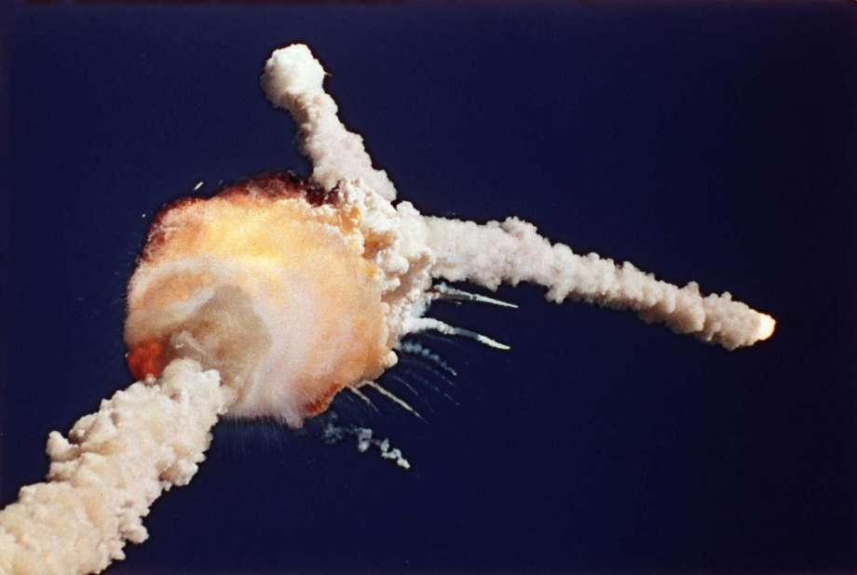
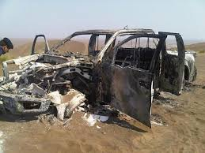
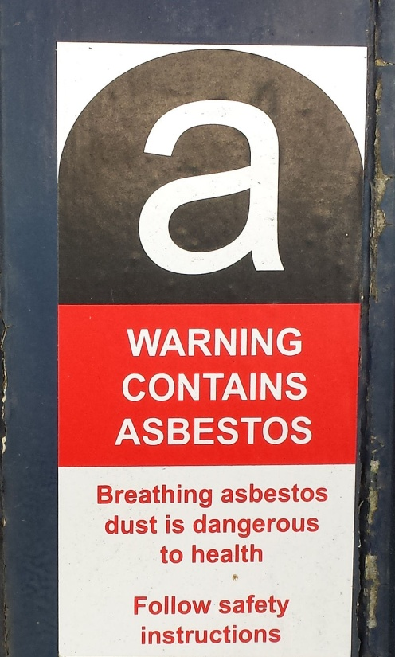
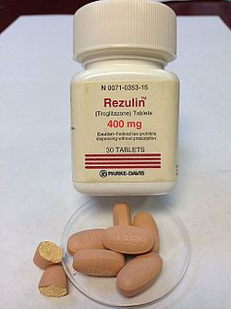
Embracing Evolving Risk and Decision-making
Mistakes Were Made
Government Proclamations of “Safe” Not a Guarantee
Pat Mellen Law LLC 18

Slide 19
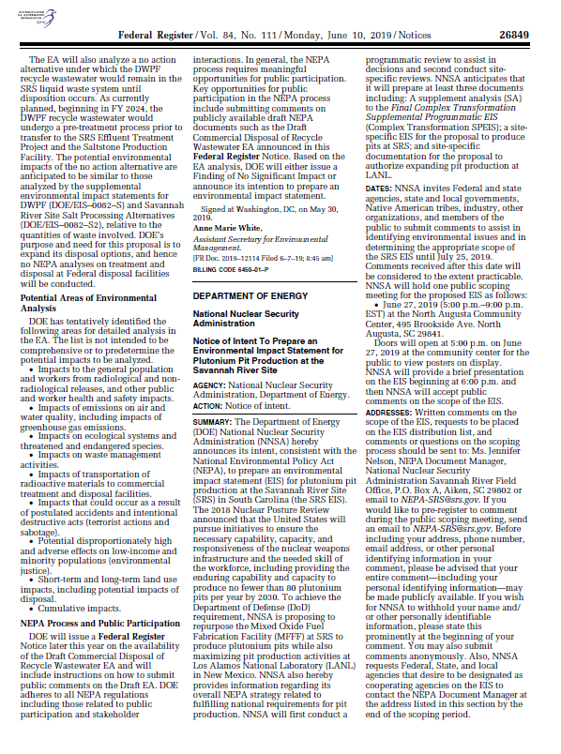
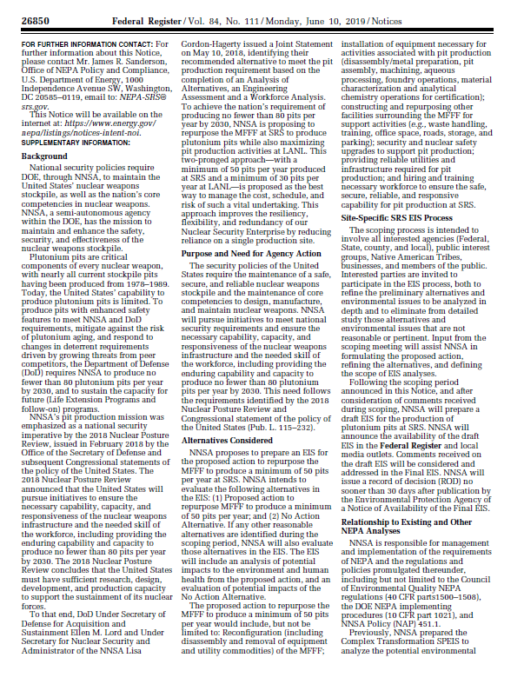
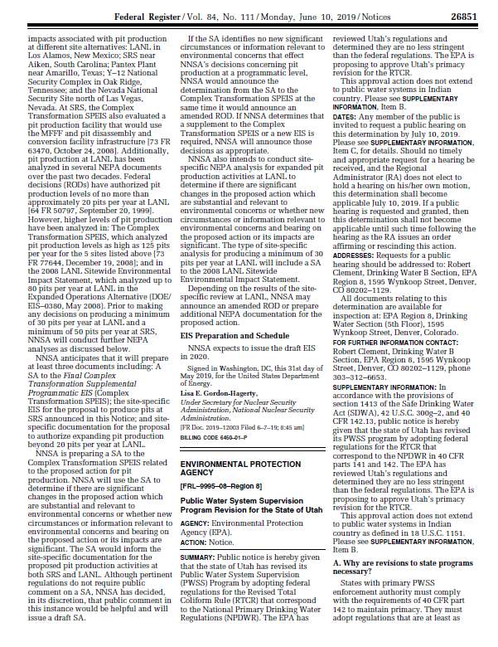
DOE Decision Making
What is Different?
Site - SRS vs Rocky Flats
Technology Improvements
Transparency/Activism
What Hasn’t Changed….
Human Health Risks
Mission/Profit Motivation
Human Nature
Pat Mellen Law LLC 19

