Slide 1
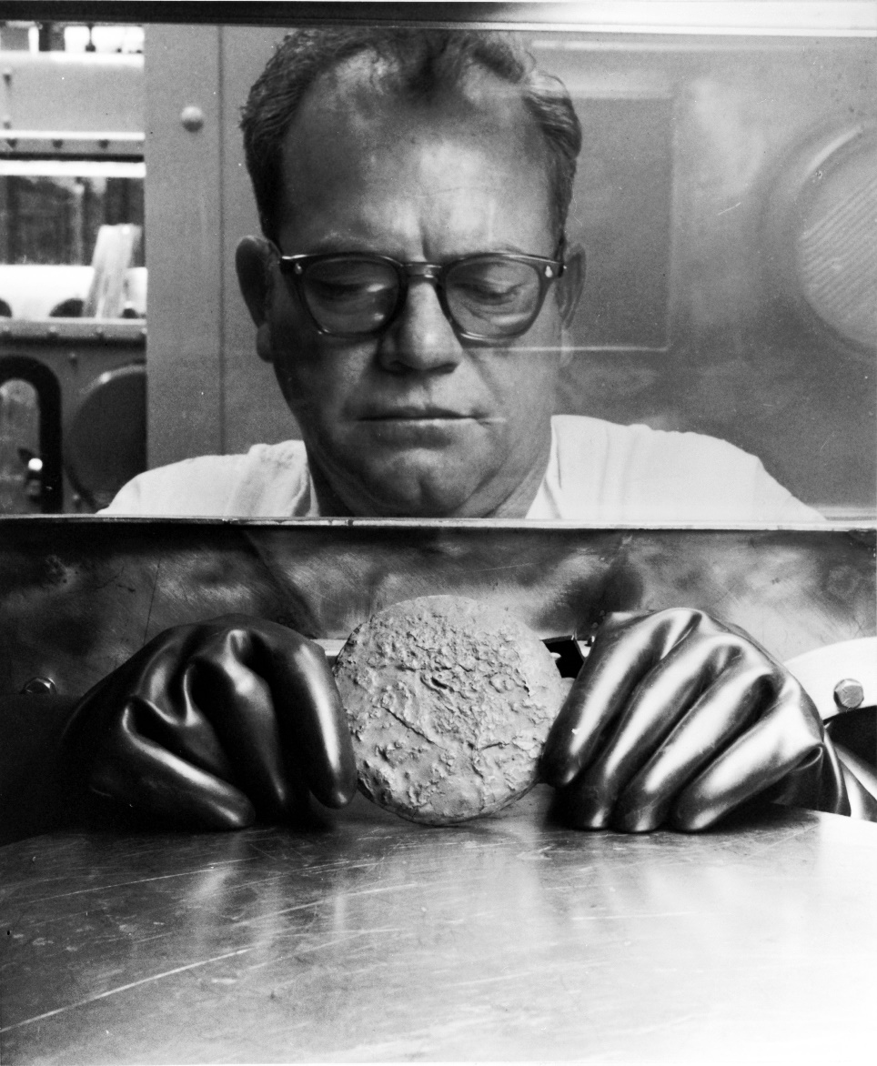
Message to Aiken: You don’t need what we got at Rocky Flats
Dr. LeRoy Moore
Rocky Mountain Peace & Justice Center
Boulder, CO
“Rocky Flats Disaster: Red Light for Plutonium Bomb Plant at SRS” Forum
Aiken, SC
November 12, 2019

Slide 2
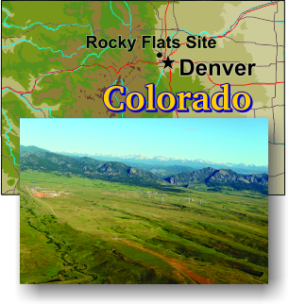
DOE’s now closed Rocky Flats plutonium pit fabrication facility – near Boulder, Colorado and upwind from Denver

Slide 3
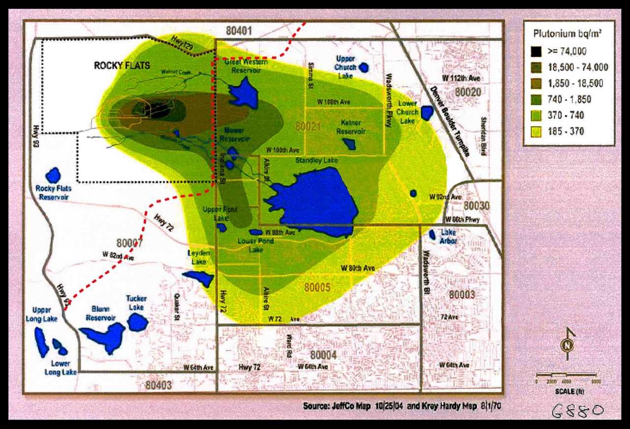
Map by P. W. Krey and E. P. Hardy showing plutonium contamination in 1970. Red line shows route of proposed Jefferson Parkway

Slide 4
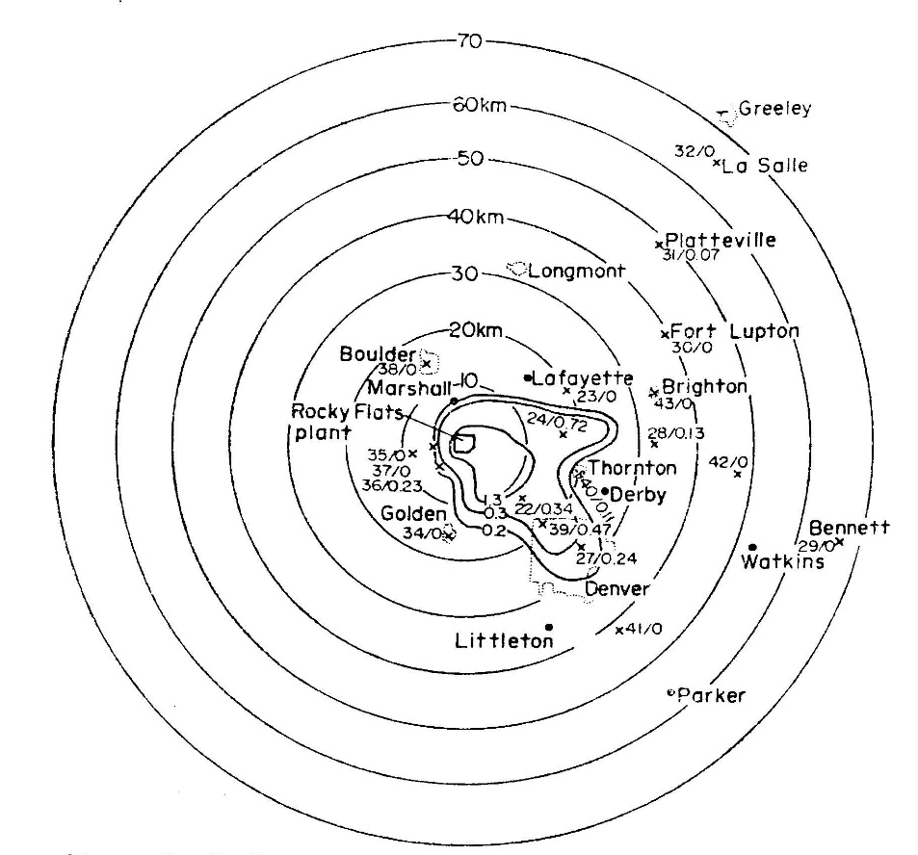
P. W. Krey, “Remote plutonium contamination and total inventories from Rocky Flats,” Health Physics, 1976, Vol. 10. 209-214.

Slide 5
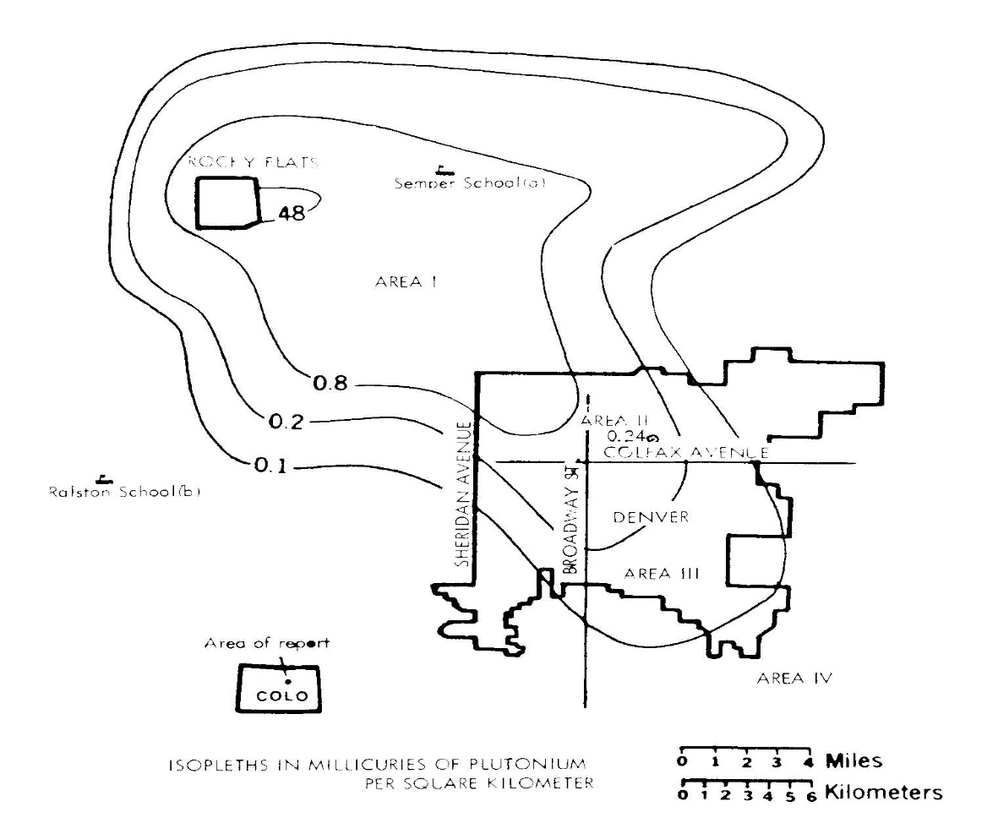
Carl Johnson, “Cancer incidence in an area contaminated with radionuclides near a nuclear installation,”
AMBIO, October 1981, vol. 10, 4, p. 177.

Slide 6
Estimated plutonium emissions from Rocky Flats, 1953 to 1977. The image shows annual emissions, not what accumulated in the environment.

Slide 7
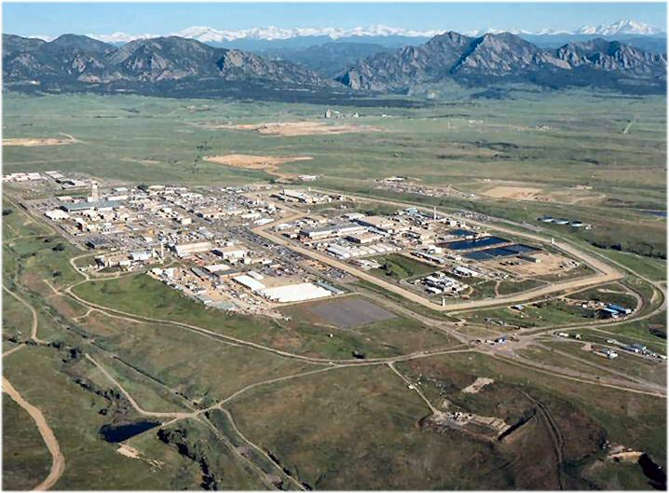
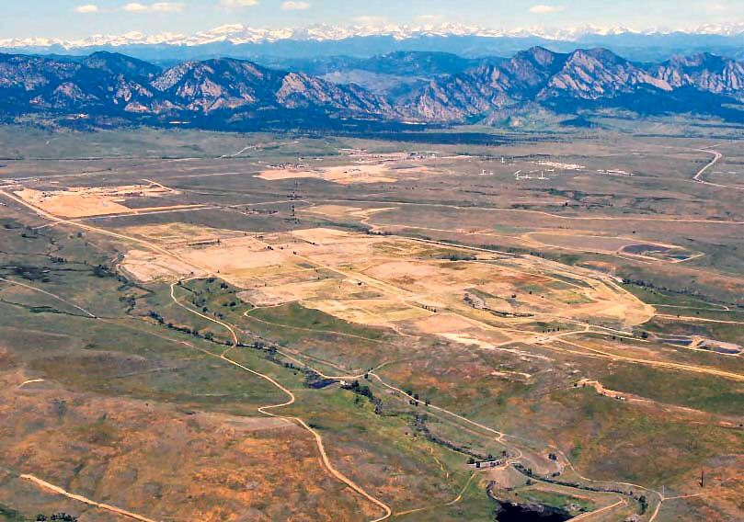
Rocky Flats Site: Before and After Cleanup
During Operations
After “Cleanup in 2006

Slide 8
Wildlife Refuge & DOE Superfund Site

