Slide 2
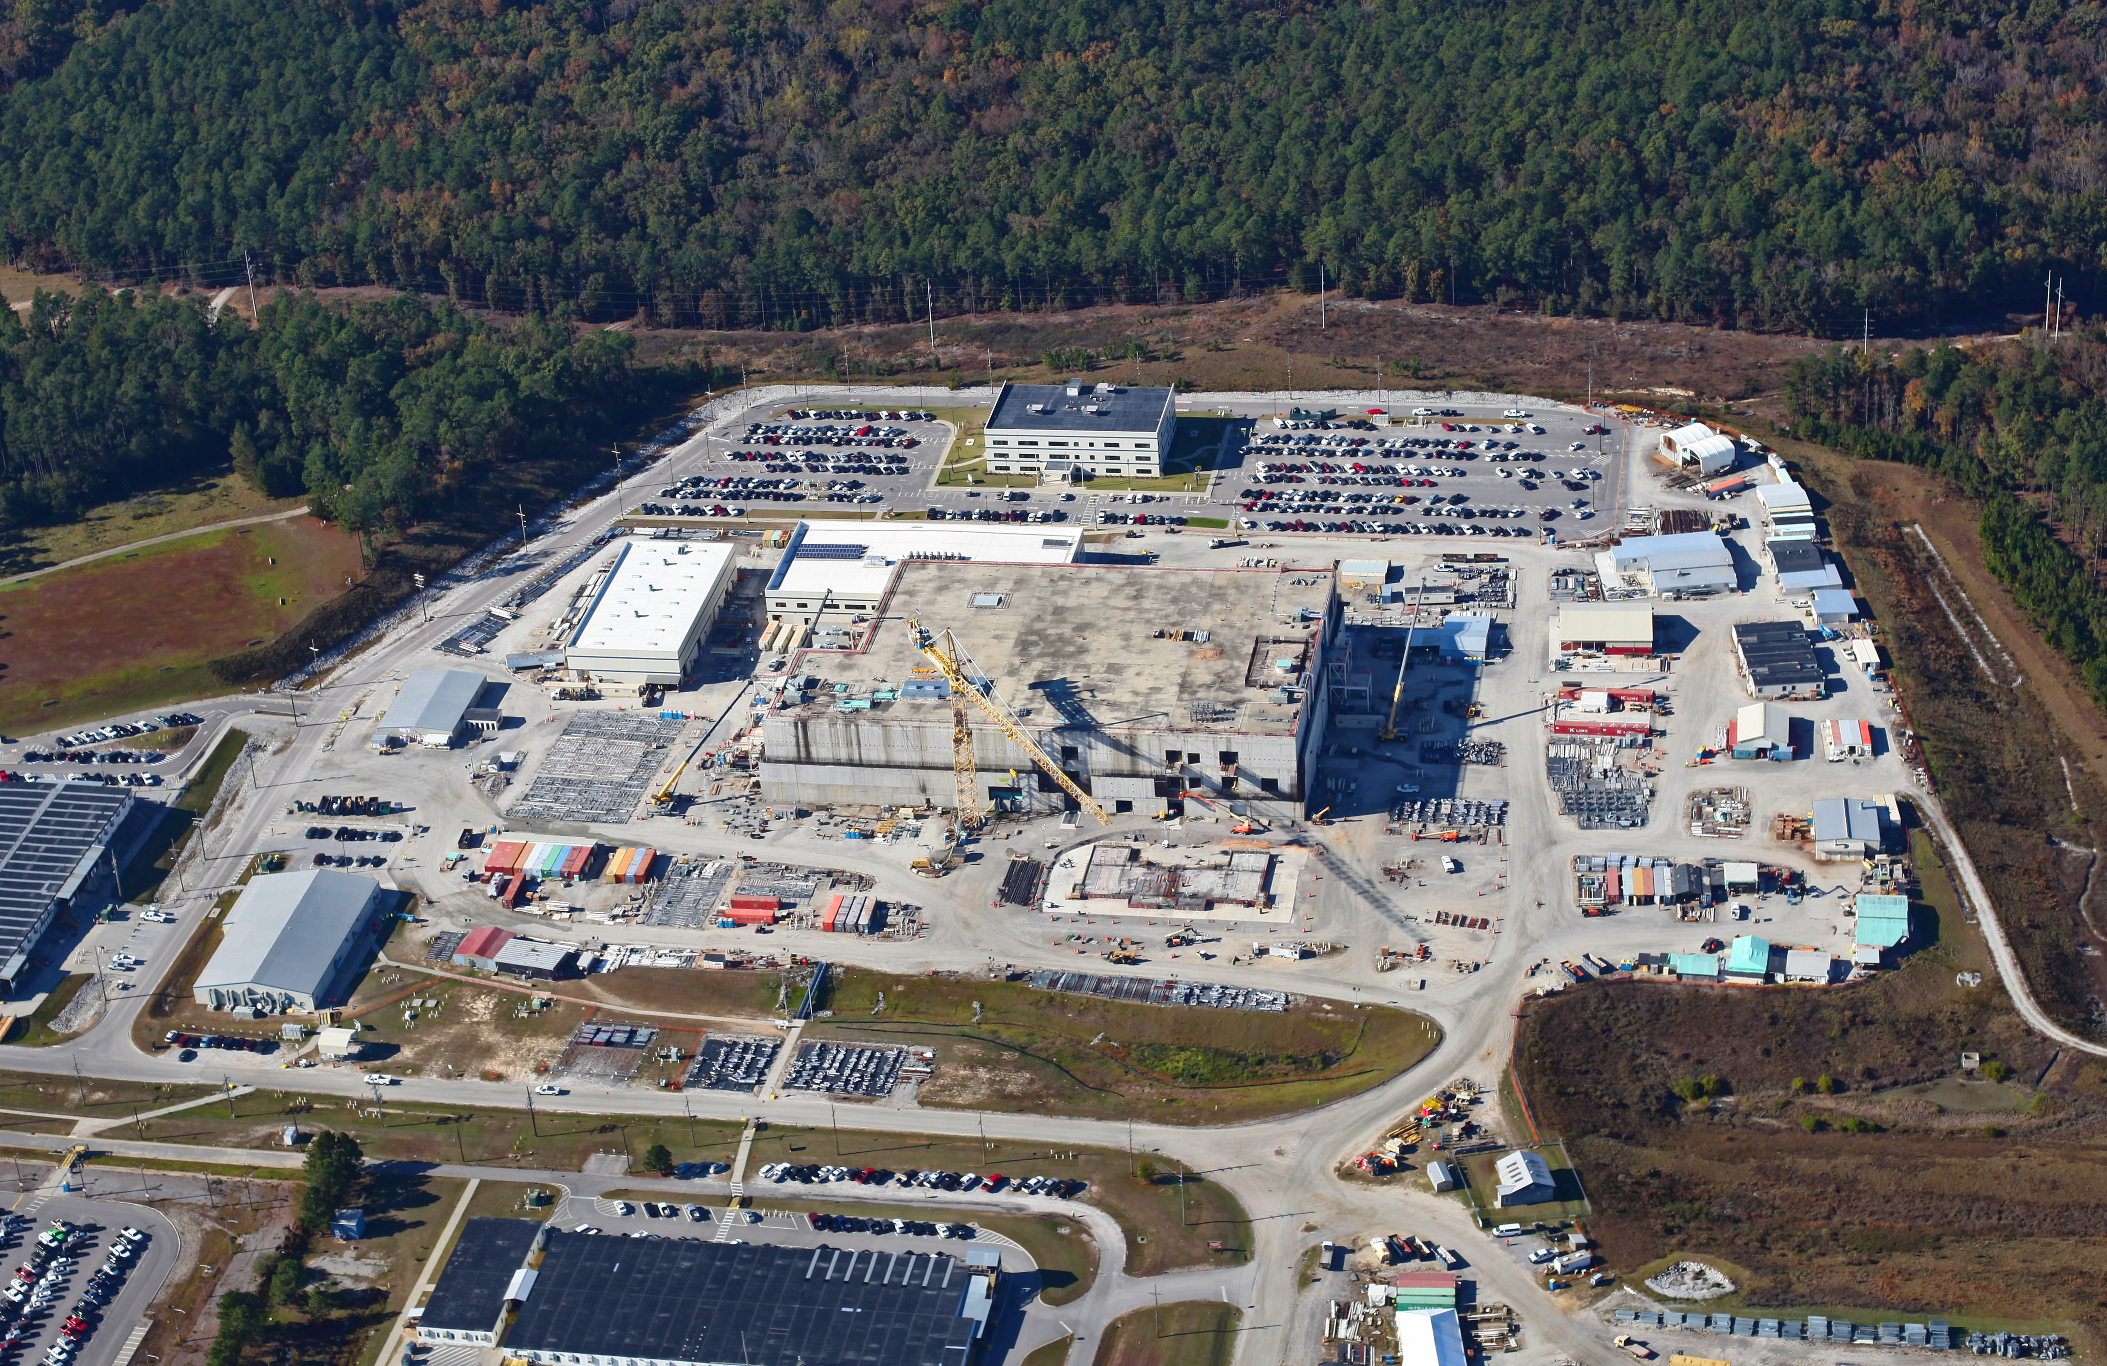
A PROJECT IN DISARRAY: MOX
Chronic Funding Problems, Construction Challenges and the Project’s Fate
Tom Clements, Savannah River Site Watch, Columbia, SC, www.srswatch.org

Slide 3
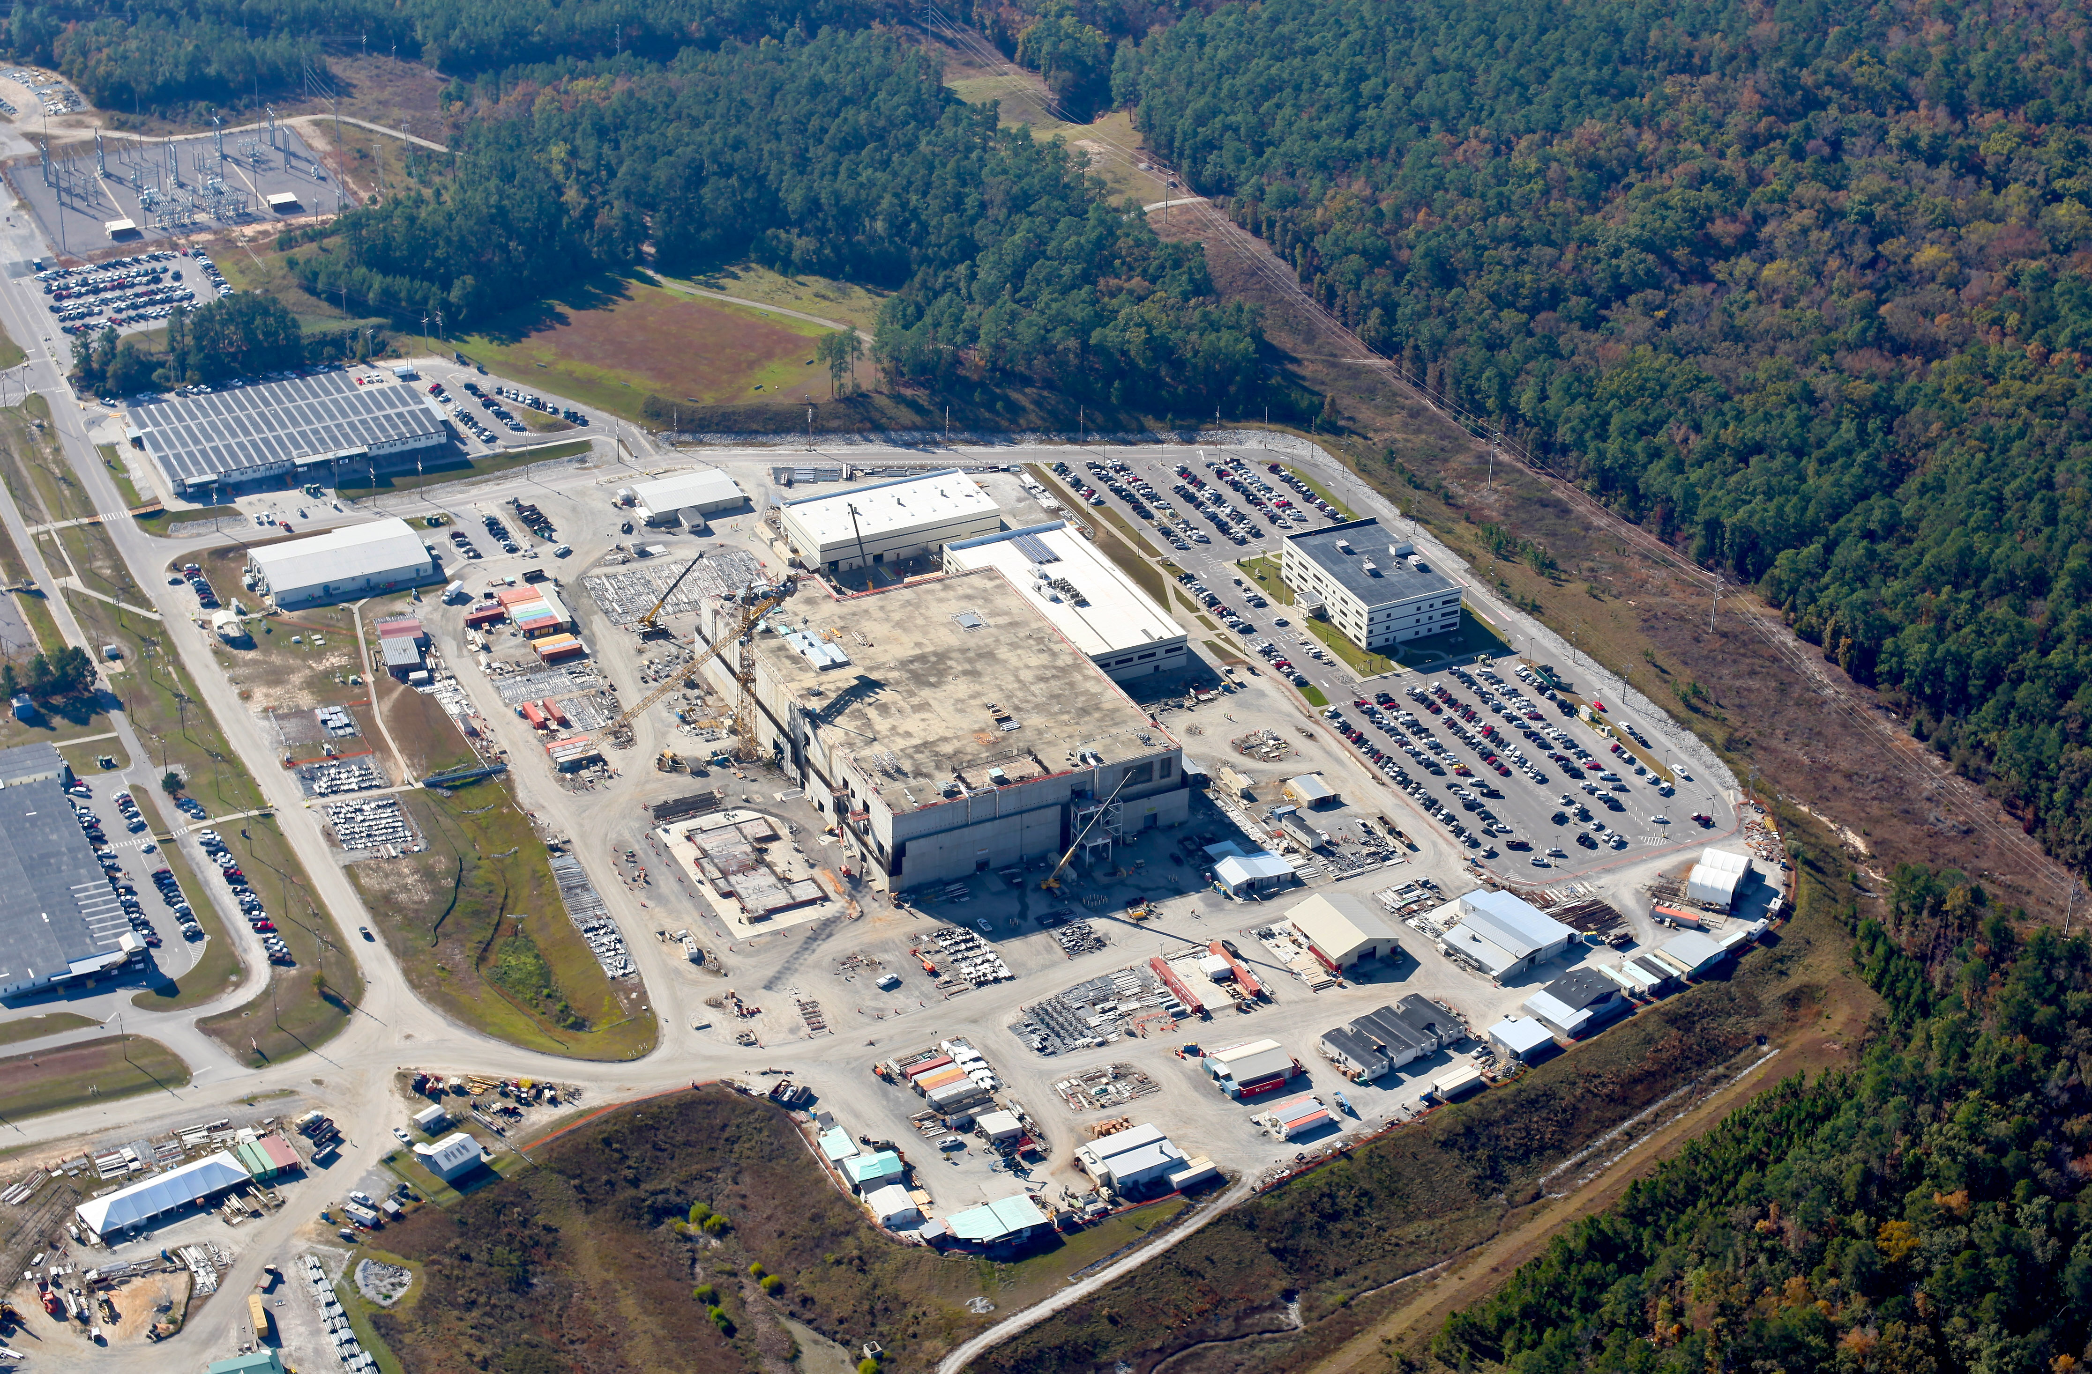
Mixed Oxide Fuel Fabrication Facility (MFFF), cornerstone of surplus weapons plutonium disposition, construction began at DOE’s
Savannah River Site (SRS) in South Carolina in August 2007

Slide 4
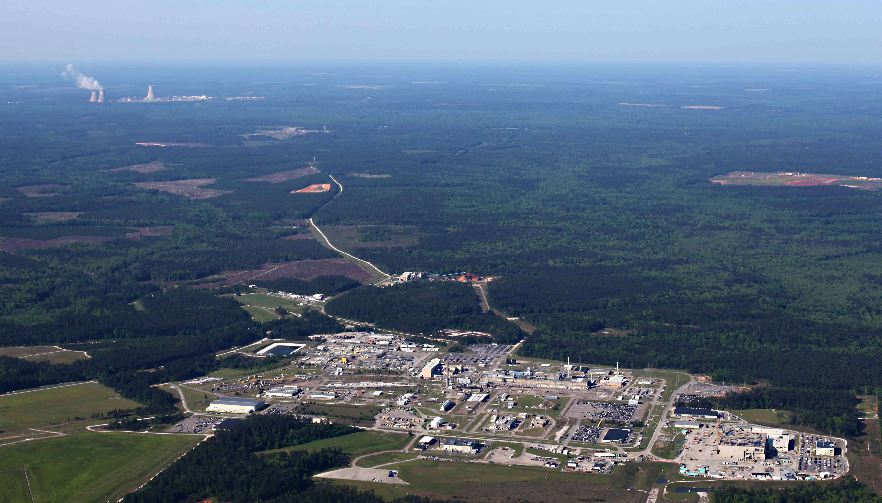
MFFF, with Plant Vogtle (Georgia Power, AP1000) in background; VC Summer (SCE&G, AP1000) project nearby, with contractor and personnel commonality, including CB&I and Superior Air Handling

Slide 5
Overview of one MOX Concept
- plans for Pu oxide feedstock preparation, nuclear reactors and funding are lacking - from Final Report of the Plutonium Disposition Red Team, August 2015

Slide 6
Host of Issues Reveal Chronic Problems Confront MOX Project & its Viability
Plutonium Management and Disposition Agreement (PMDA) between the U.S. and Russia
Massive, Uncontrolled & Unconstrained Cost Increases since Project’s Inception
Sufficient Appropriations for Project Survival?
Fixed-Cost Contract to Reduce Risk and Cost to DOE?
Construction Challenges & the “Rework” Problem
Smoking Rework Gun – “Rework Definitions” Memo
Hints of Design Problems
Oversight and Accountability Lacking: MOX Waste, Fraud, Abuse, Mismanagement & Corruption?
Fate of MOX Madness - The Doom or Gloom Option?

Slide 7
Plutonium Management and Disposition Agreement (PMDA) –
Concern about US Compliance before Russian Withdrawal
Agreement - not a treaty - in support of a noble goal, signed in 2000, stipulated the US would pursue a “dual track” - MOX and immobilization of plutonium in high-level nuclear waste, at DOE’s Savannah River Site;
Amended in 2010 to allow Russian to use BN-800 plutonium breeder reactor - a blow to nuclear non-proliferation - and stipulated an “all MOX” option for 34 MT surplus weapon plutonium on US side;
Schedule amended in 2010 to a 2016 completion date of US MOX plant & 2018 start-up date, with irradiation in 4 LWRs;
Russia announced its withdrawal from the agreement on October 3, 2016, leaving US in awkward position;
Clear US was not meeting its schedule obligations prior to Russian withdrawal;
And, US was long failing to meet stipulation of Article IX.6: “The activities of each Party under this Agreement shall be subject to the availability of appropriated funds.”
CONCLUSION: PMDA inoperative, US not bound by MOX option; loss of IAEA verification unfortunate, merits pursuit.

Slide 8
Massive, Uncontrolled & Unconstrained Cost Increases since Project’s Inception
Cost and schedule estimates have been totally unreliable and misleading since 1999 and earlier;
Estimates for MOX plant construction (does not include operating cost):
$620 million in 1999 – start-up in 2006
$1 billion in 2002 – start-up in 2007
$3.5 billion in 2005
$4.7 billion in 2007 – start-up in 2016
$7.7 billion in 2014 – start-up in 2019
$17 billion in 2016 – start-up in 2048
Increasing cost estimates have been the norm for this project, totally undermining the ability of DOE or contractors to estimate cost or schedule; $5 billion already spent, just a fraction of what’s needed for all life-cycle aspects;
CONCLUSION: Skyrocketing cost overruns have debilitated the project; failure of DOE and contractors to constrain costs along with lack of prudent project management, including poor oversight of contractors, demands investigation.

Slide 9
Sufficient Appropriations for Project Survival?
Funding of ~$340 million/year from FY 2014 to 2017 is too low to make much process with MOX plant construction (design and construction problems aside) and causes schedule to slip further and costs to rise;
Aerospace Phase I report of April 2015 states that “the MFFF construction cannot be completed at current (FY14) funding level (350M RY$...)
Red Team said “DOE could accomplish a MOX Approach to Pu Disposition for about $700M--‐$800M/yr that involves a high level of technical complexity and risk.”
Historical funding levels reached $504 million once (FY 2010) and have fallen to $400 million or lower since FY 2013;
Absolutely no indication funding will be significantly increased nor that any increase can be sustained for decades;
No politician or MOX booster has presented any plan that shows the project to be financially viable; political rhetoric to “continue MOX” absent a construction plan, budget or plan to correct construction issues further undermines the project;
CONCLUSION: While short-term funding may continue at a survival level, a small increase in funding can’t stabilize MOX project or save it. Funding for two decades or more at $700 million to $1 billion per year is unrealistic.

Slide 10
Fixed-Cost Contract to Reduce Risk and Cost to DOE?
Report accompanying National Defense Authorization Act for Fiscal Year 2017 stipulates in “SEC. 3116. DISPOSITION OF WEAPONS-USABLE PLUTONIUM” that the U.S. Army Corps of Engineers “shall prepare a report on the contract for the construction, management and operations of the MOX facility.”
Options to be reviewed include fixed-price contract, a fixed-price incentive fee or another “contractual mechanism.” The assessment is to review “construction, management and operations” and must include “milestones, cost, schedules, and any damage fees for those options” in order to “reduce risk and cost” to DOE;
Corps of Engineers report to go to DOE, which must determine if contract changes will be accepted by CB&I AREVA MOX Services, and then DOE must deliver results to Congress by ~April 23, 2017; but no indication report is under way;
Given unbridled cost overruns and lack of both a schedule and a rebaselined budget, no indication that a constrained contract, with accountability provisions and milestones, would be accepted by MOX Services;
CONCLUSION: Given past abysmal performance by MOX Services, some form of a fixed-cost contract appears unlikely; approach may be a way for NNSA to recommend to Congress removal of MOX Services and project termination.

Slide 11
Construction Challenges & the “Rework” Problem
Many mentions of construction challenges in DOE reports;
“Rework” (reinstallation) issue first rumored several years ago, more information coming out since 2014;
DOE official testified to Senate Armed Services in October 2015 about 25% reinstallation rate; who pays unclear;
MOX Services “monthly reports” - obtained via FOIA - mention a host of rework items, especially with piping and ductwork; rework resulting from sequencing errors and craft errors and poor workmanship;
Anecdotal rework reports to SRS Watch include rework problems with a host of “commodities,” such as piping, HVAC, welding, documentation, sequencing, cable trays, improper placement of concrete walls, improper inspection, altering of inspection document, incomplete records & “work packages” left open as they can’t be closed - all merit investigation;
NNSA: HVAC work “final attributes” (work installed, inspected & accepted) at 3%, piping 1%, electrical 0% - crippling levels, far under what they should be 10 years into construction, no indication how they can be corrected or how long it would take; HVAC contractor - Superior Air Handling - now off job, often named as negatively impacting all MFFF work.
CONCLUSION: Rework problems and failure to address them have crippled the project and essentially preclude a cost-effective, schedule-constrained way forward with MOX plant construction.

Slide 12
Extent of Rework Problem Revealed by NNSA in NNSA’s 2016 Updated Performance Baseline for the Mixed Oxide Fuel Fabrication Facility at SRS

Slide 13
Smoking Rework Gun – “Rework Definitions” Memo
Filed FOIA request for rumored “rework” memo by CB&I Projects Services Group (CPSG), no response yet;
Obtained memo given to MOX construction staff: “Rework Definitions – Effective September 2016”, with four “severity levels;”
Memo addresses not only HVAC work but also piping, supports, vendor-supplied commodities, sequencing, worker errors and, apparently, other things – divided into periods, pre-October 2015 (legacy problems) & post-September 2015 (current);
Appears to be a belated effort to classify rework problems in order to address them and account for charges, either to the project or to contractors and/or vendors responsible for the problems;
Effort to address the massive problem appears to be far too little, far too late - there is no indication of how much rework has to be addressed, how much it will cost, or how long it will take; plus, how can prior contractors be billed (such as Superior)?;
CONCLUSION: No indication from NNSA or MOX Services that this effort can address the monumental rework issues at hand; could be an effort to convince NNSA (if they are still managing the project and providing oversight…..) or other agencies or investigators that rework problems are finally somehow beginning to be addressed.

Slide 14
Memo: “Rework Definitions – Effective September 2016”
- copies of memo available on request -
Four severity levels of rework, classified by CB&I Project Services Group (CPSG):
Type 1a: “Construction Rework,” since September 2015
Type 1b: “Construction Rework,” prior to October 2015
Type 2: “Engineering Changes”
Type 3: “Vendor/Supplier Issues”
Type 4: “Incorrect Sequence”

Slide 15
Hints of Design Problems
GAO in 2007: “The design of the Mixed Oxide Fuel Fabrication Facility has presented technical challenges in adapting the design of a similar plant in France to the design needs of this project.” And GAO in 2013: “…the design of the facility is based on a similar facility in France, the cost of adapting the French design to the design needs of this project was not well understood when the project was approved for construction.”
DOE 2014: “…different regulatory environment in France [at MELOX facility] than exists with the NRC in the U.S., and the U.S. facility must be adapted accordingly.”
Aerospace, Phase I, 2015: “Uncertainty in the remaining design work..” & “Because construction is initiated prior to completion of design, there is added cost and schedule risk if something in the engineering (interfaces, integration, etc.) was not considered early enough to preclude rework in construction or if there are substantial deviations from the original direction/design…”
DOE OIG, 2014: “Prior to approval, the Department’s own independent review of the project baseline found that the design review of the MOX Facility was incomplete.”
Aerospace, Phase II, 2015: “The design-build acquisition approach results in uncertainty in the remaining design and construction work scope to complete the project.”
Anecdotal to SRS Watch: NNSA bought an antiquated MELOX design from AREVA based on antiquated equipment that can never efficiently work and can’t be adapted to U.S. regulatory standards; Shaw engineers knew from the start design might not work; what happens to design problems, obsolescence & ability to meet regulatory and DOE standards in 2048?
CONCLUSION: Though construction is licensed by the NRC there is no demonstration by NNSA that the facility based on the MELOX design will work or can be adopted to U.S. regulatory standards in the future.

Slide 16
Oversight and Accountability Lacking: MOX Waste, Fraud, Abuse, Mismanagement & Corruption?
As far as is known, no DOE/NNSA or MOX Services managers have been held accountable for the stunning cost increases, construction problems and schedule delays. Investigations must determine how the MOX debacle developed and who is responsible and how to address this lack-of-accountability situation moving forward (to termination or continuation).
GAO, 2013: Government Accountability office has warned many times about DOE’s “management weaknesses in major projects,” including with the MOX project, which remains on “GAO’s list of areas at high risk of fraud, waste, abuse, and mismanagement for major contract and project management…”
GAO, 2014: ““NNSA has not analyzed the underlying, or root, causes of the Plutonium Disposition program construction cost increases to help identify lessons learned and help address the agency’s difficulty in completing projects within cost and schedule…”
GAO, 2015: “We maintain an ongoing program to focus attention on government operations that are high risk due to their greater vulnerabilities to fraud, waste, abuse, and mismanagement or that are in need of transformation”
Senator Graham, Armed Services, Feb. 2016: “I don't know how we fix this, but somebody needs to be fired…” Nobody has been fired or even disciplined or in any way held accountable as far as is publicly known.
Two MOX fraud cases now in federal court – concerning unqualified rebar and fraudulent receipts; w/ federal attorney, OIG & FBI.
CONCLUSION: Urgent that investigations take place into mismanagement and cost overrun and those responsible held accountable.

Slide 17
Fate of MOX Madness - The Doom or Gloom Option?
Aim to forever remove plutonium from being used in nuclear weapons is admirable and good policy but the MOX part of plutonium disposition became mired in politics and management & technical problems and was captured by those seeking to use the project to their advantage, including as a parochial jobs program for South Carolina;
Due to lack of funding, chronic mismanagement issues, construction problems and lack of accountability the project has been dealt a multi-pronged crippling blow;
Current “unofficial termination” track of Congress is not sustainable and demands resolution.
GLOOM OPTION: Short-term survival is possible but no plan is known to exist for salvaging the project beyond the short term. If such a plan exists why is it being withheld? Continuing MOX with so many unanswered problems would simply underscore why NNSA has wanted to terminate it and why Congress has kept it on a shut-down track.
DOOM OPTION: Based on the assessment of the outlined problems we believe that official termination of the failed MOX project is most likely inevitable and unavoidable. NNSA will be free to pursue cheaper downblending option.

Slide 18
Tom Clements
Director, Savannah River Site Watch
1112 Florence Street
Columbia, SC 29201
cell 803-240-7268
srswatch@gmail.com
http://www.srswatch.org/
https://www.facebook.com/SavannahRiverSiteWatch

