Slide 1
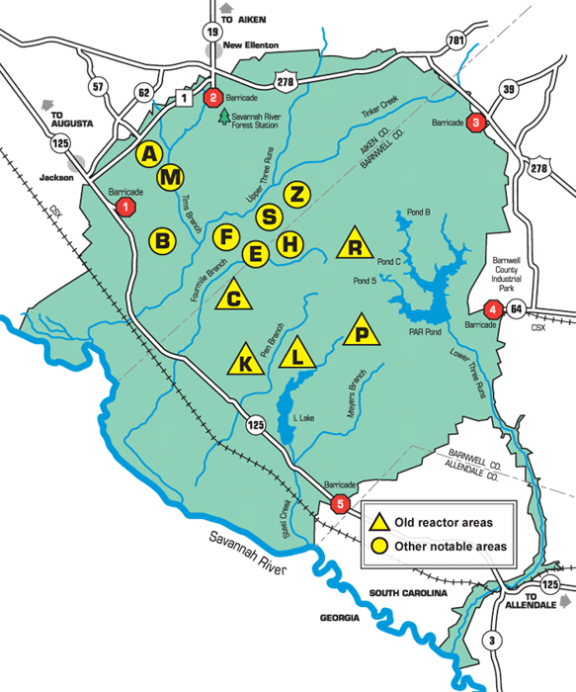
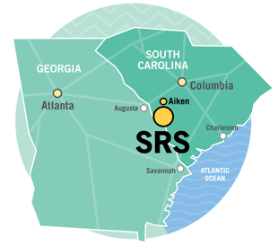
Savannah River Site:
Growing Role in Nuclear Weapons
Tom Clements, Savannah River Site Watch

Slide 2
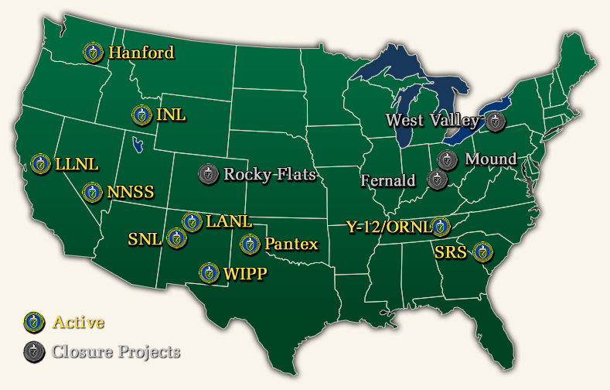
DOE’s nation-wide complex;
DOE makes and maintains the warheads for its customer, the Dept. of Defense

Slide 3
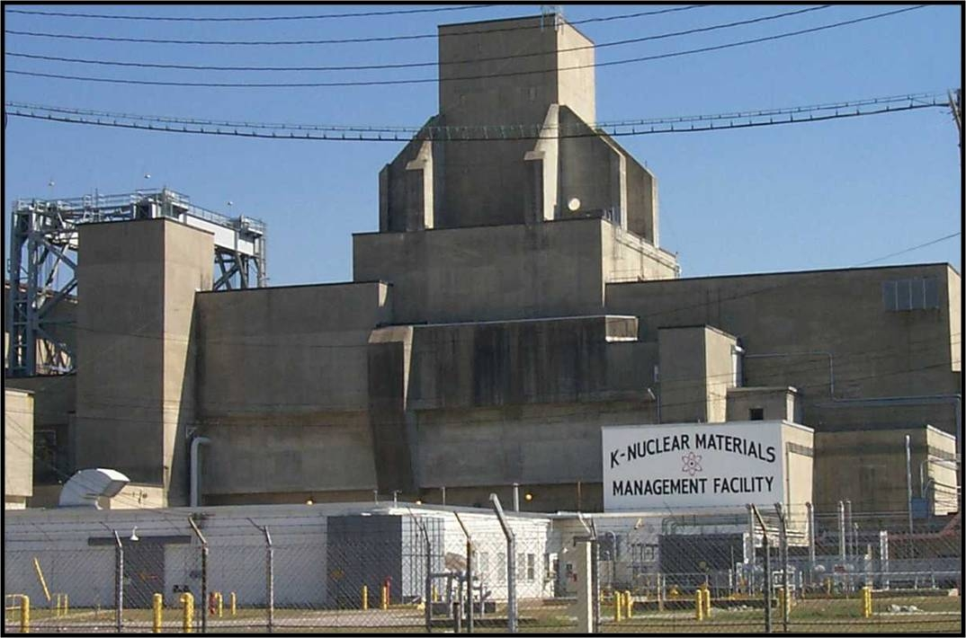
Starting in 1953 until late 1980s – 5 reactors at SRS produced plutonium and tritium for nuclear weapons

Slide 4
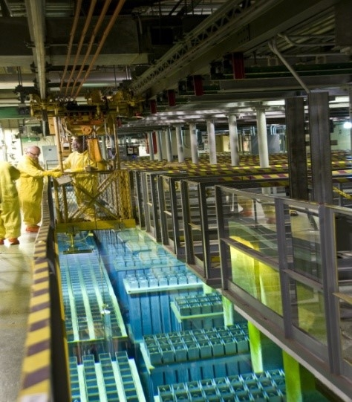
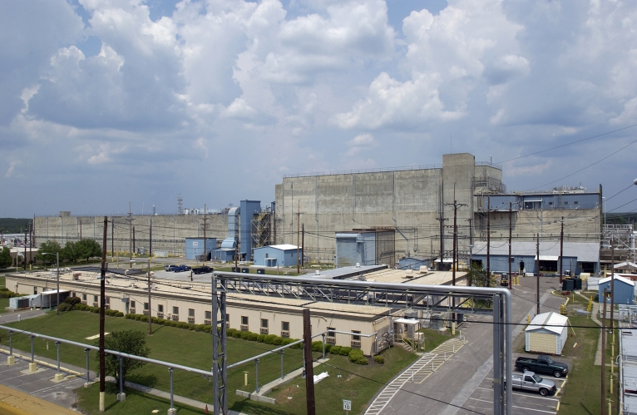
Spent fuel from the reactors was processed in two reprocessing plants, called “canyons”

Slide 5
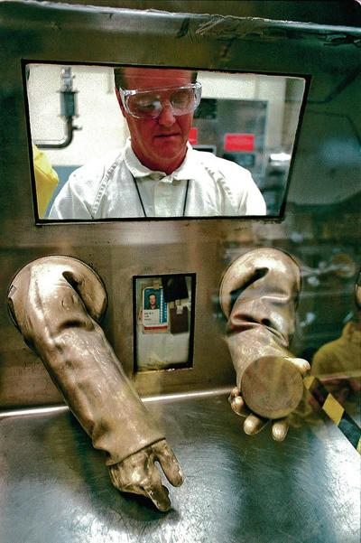
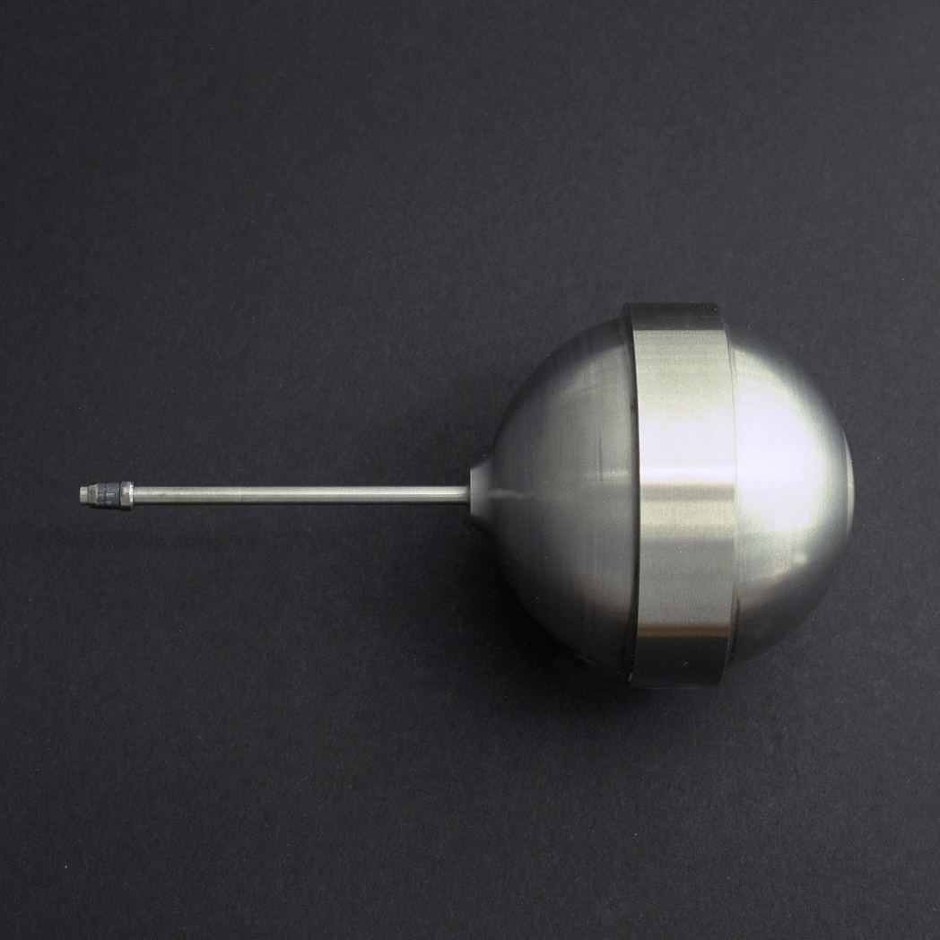
SRS produced 36 metric tons of weapon grade plutonium & all tritium for U.S. nuclear warheads

Slide 6
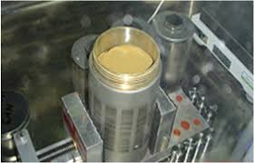
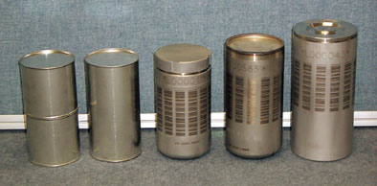
Typical plutonium storage containers – with plutonium oxide (powder) in the can on the left; plutonium has a 24,000-year half-life

Slide 7
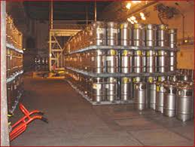
SRS stores 11.5 metric tons of plutonium, in storage drums stacked high in the old K-Reactor

Slide 8
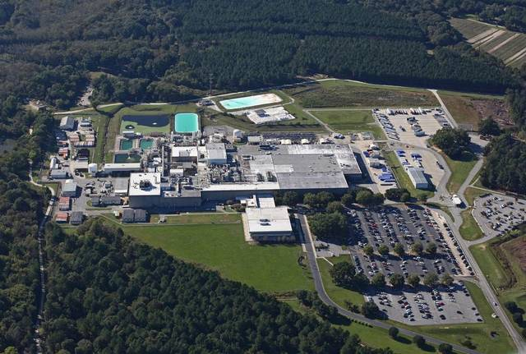
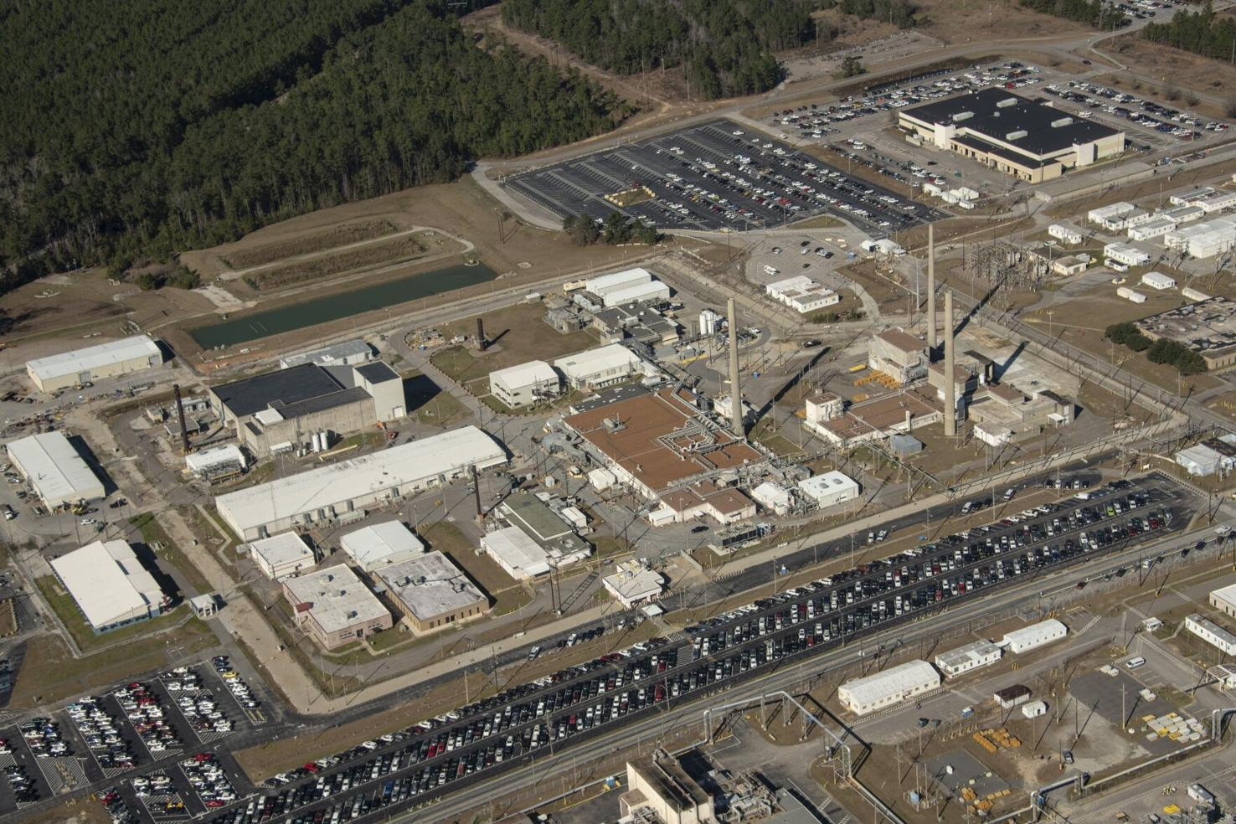
SRS still processes and packages all tritium for US nuclear weapons - tritium rods fabricated by Westinghouse, irradiated by TVA & processed at SRS

Slide 9
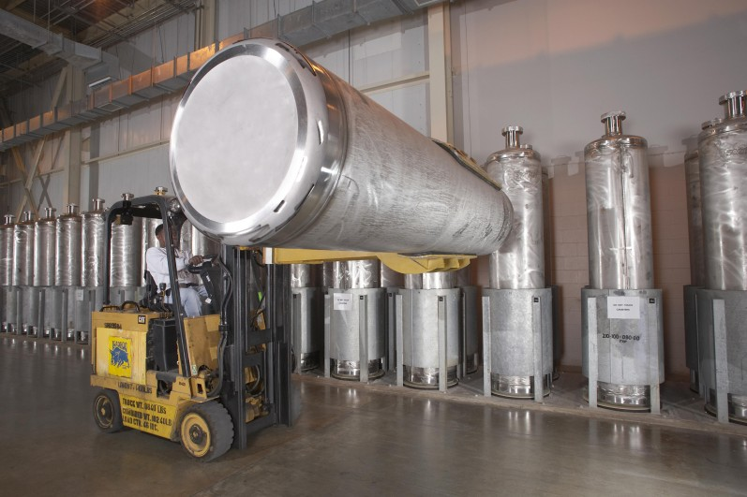
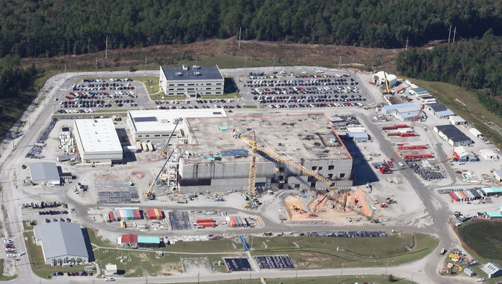
In 1995, a project got under way to “dispose” of 61.5 MT of “surplus” weapons plutonium - via immobilization in high-level nuclear waste & via plutonium fuel (MOX)

Slide 10
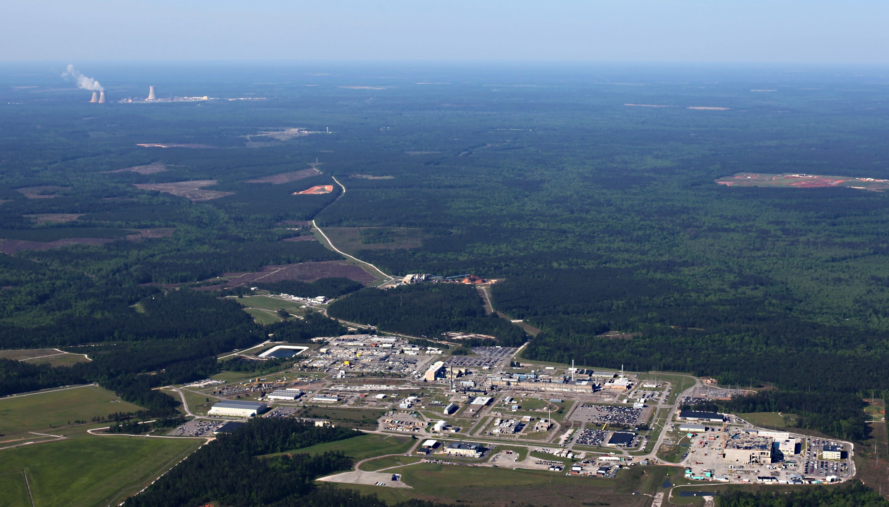
New nuclear “ground zero” – MOX/pit plant and Plant Vogtle across Savannah River in Georgia

Slide 11
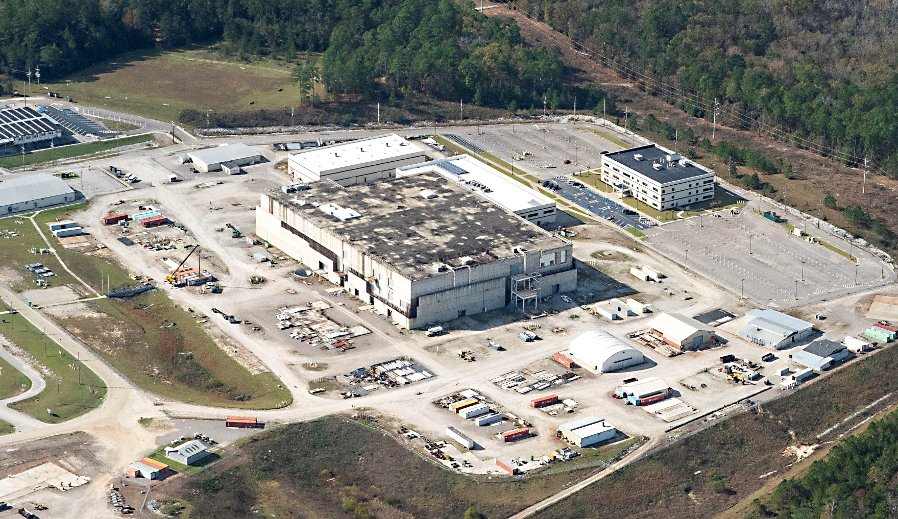
Immobilization terminated in 2002; MOX eventually killed in 2018 after $8 billion wasted, with no congressional or DOE investigations

Slide 12
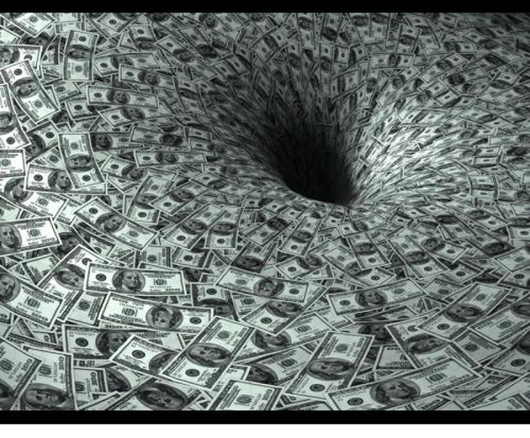
As DOE is an unconstrained money machine for contractors and special interests, a new “mission” had to be quickly found to fill the $500 million/year “loss” in funding

Slide 13
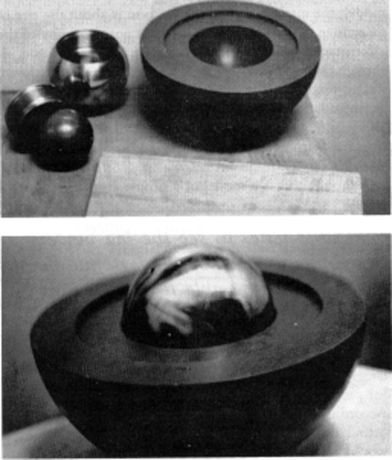
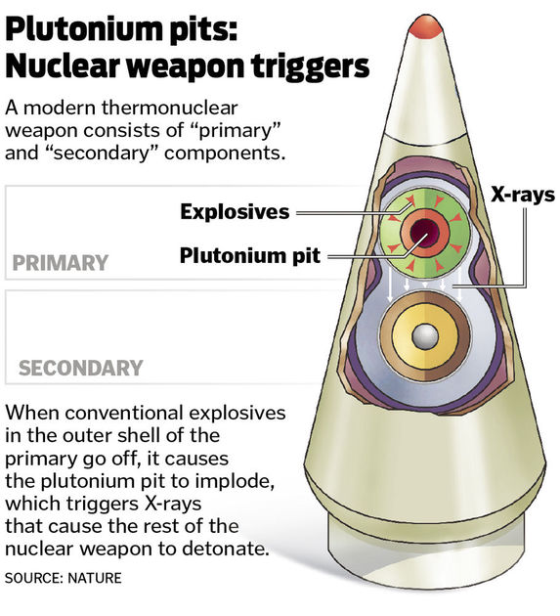
May 2018 – DOE/DOD announced the goal to produced 80 “pits” per year – 50 at SRS, 30 at Los Alamos National Lab in New Mexico

Slide 14
Budget approved by Congress has been on the order of $500 million/year until Fiscal Year 2023 – DOE requested about $750 million for the SRS Plutonium Bomb Plant but the Nuclear Weapons Council asked for $500 million more, so the appropriation is about $1.3 billion. Requirement is to start operation in 2030 but DOE admits it won’t be until 2035 or later. Cost estimate has soared from $4 billion to convert the MOX plant to $11 billion. Now to $16 billion? In DOE land, this Failure in cost and schedule = Success! Contractors happy!

Slide 15
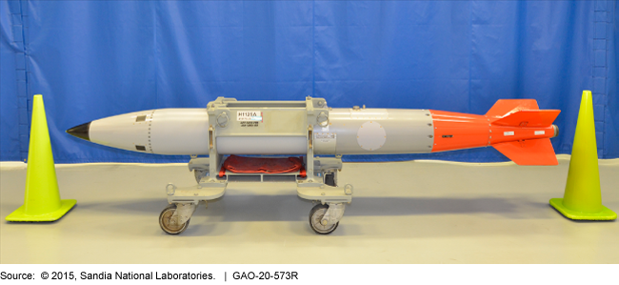
B-61 gravity bomb

Slide 16
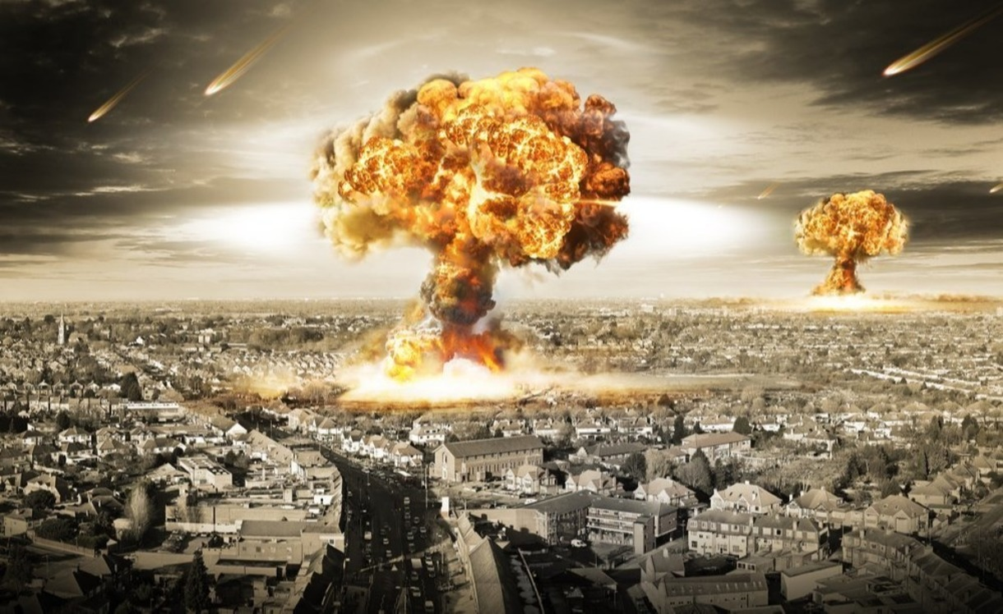
Goal is to first produce two kinds of pits for two new nuclear warheads. Then, focus will be on other new warheads and replacing the pits in all 4000 weapons, so the “mission” at SRS will be for 50+ year$$$$; plus there are a host of nuclear waste streams, including TRU to WIPP

Slide 17
WIPP being turned into an arm of DOE’s National Nuclear Security Administration (NNSA); WIPP a “choke point” for pit production

Slide 18
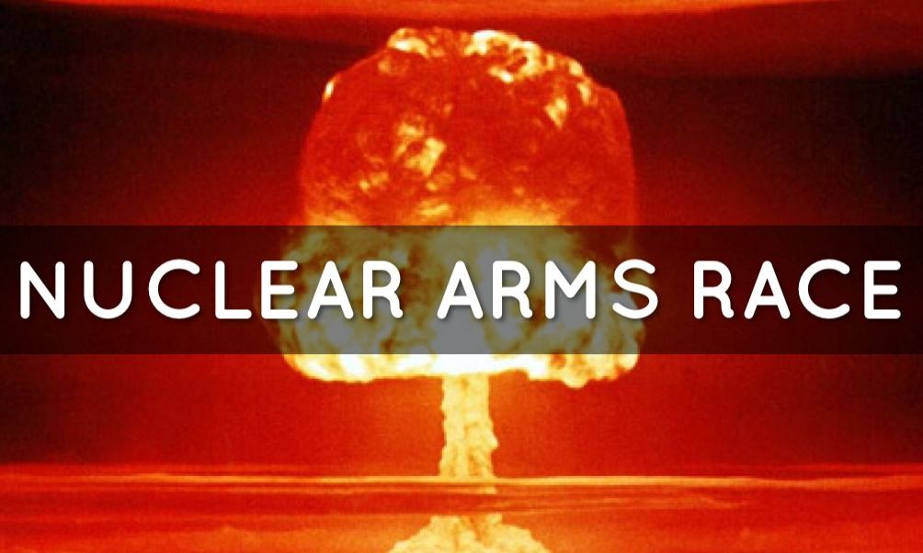
Obama/Trump/Biden $2-trillion plans to rebuild the DOE nuclear weapons complex and build new pit facilities are part of enduring US plans to fight a full-scale nuclear war; FY23: DOE $46.8 B, with $17 B for “weapons activities” & $7 B “clean-up”

Slide 19
https://www.congress.gov/117/crpt/hrpt397/CRPT-117hrpt397.pdf
NATIONAL DEFENSE AUTHORIZATION ACT FOR FISCAL YEAR 2023 - R E P O R T
OF THE COMMITTEE ON ARMED SERVICES HOUSE OF REPRESENTATIVES
Plutonium Pit Production
“…there has not been adequate prioritization of studies and analysis of plutonium aging. The committee believes that given the scale, complexity, and history of plutonium pit production, NNSA must ensure that plutonium pit requirements and plans are fully understood and that past mistakes regarding safety shutdowns, cost overruns, and schedule delays are not repeated.” Response to this? Throw $1.3 billion at the SRS pit plant.
Requires a “master schedule” for pit production, with schedules and costs & plans for studies on pit aging & “a briefing that describes the holistic environmental impact of expanded plutonium pit production, accounting for simultaneous pit production at multiple sites.”
With the South Carolina Environmental Law Project (SCELP) as our attorneys, SRS Watch, Nuclear Watch New Mexico, Tri-Valley CAREs have a lawsuit in federal court demanding preparation of a Programmatic EIS – filed June 2021, so ruling yet

Slide 20
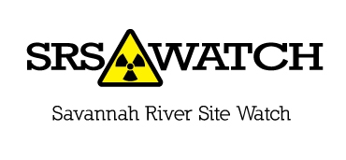
Tom Clements
Director, Savannah River Site Watch
Columbia, SC www.srswatch.org srswatch@gmail.com tel. 803-834-3084
Contact me to get on a SRS update list. When the next DOE budget, for Fiscal Year 2024, comes out we will have action items to address to Congress.

