Slide 1
Failure of the Westinghouse AP1000 Projects in the USA - Implications for Central & Eastern Europe
Nuclear Energy Conference 2024, 19 June 2024
Tom Clements
Director, Savannah River Site Watch (SRS Watch)
(formerly with Friends of the Earth-US)
Columbia, South Carolina USA
(40 km south of terminated VC Summer Westinghouse AP1000 project)
srswatch@gmail.com
www.srswatch.org

Slide 2
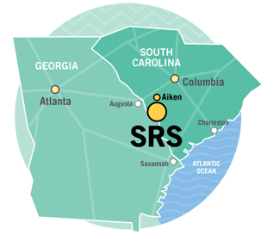
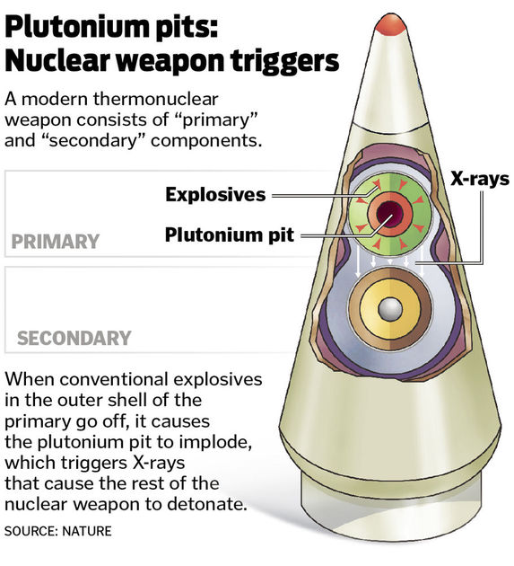
From 2008 to 2019, I represented Friends of the Earth in bringing formal, legal interventions before the regulator of electricity utilities in South Carolina - the South Carolina Public Service Commission. Thus, I am intimately familiar with the fate of the two U.S. Westinghouse “Advanced Passive 1000” (AP1000) reactor projects.
Now, I’m with Savannah River Site Watch (SRS Watch,) a NGO that monitors the US Department of Energy’s 1000-square km “Savannah River Site,” in South Carolina, a nuclear weapons facility across the Savannah River from the Vogtle AP1000 site.

Slide 3
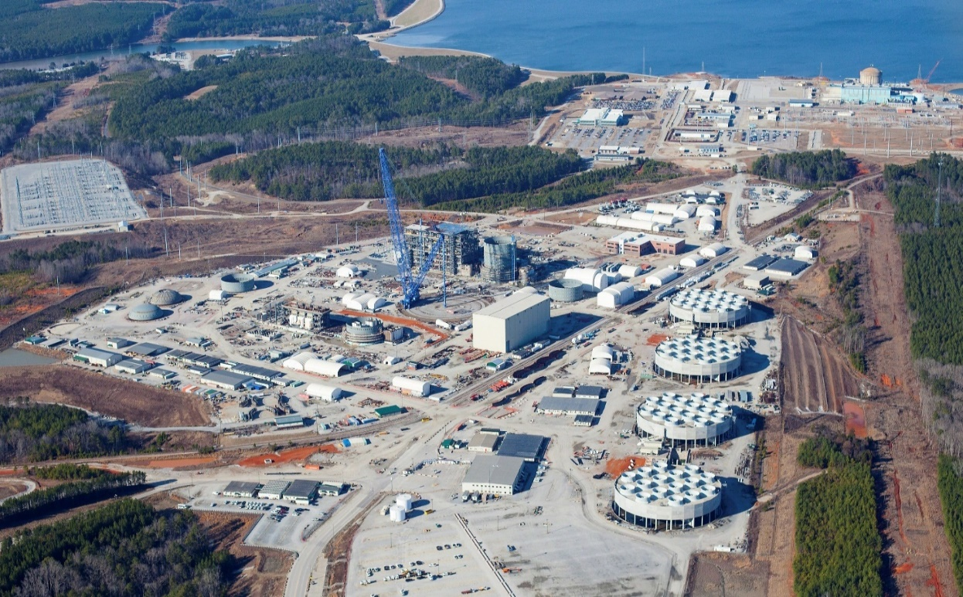
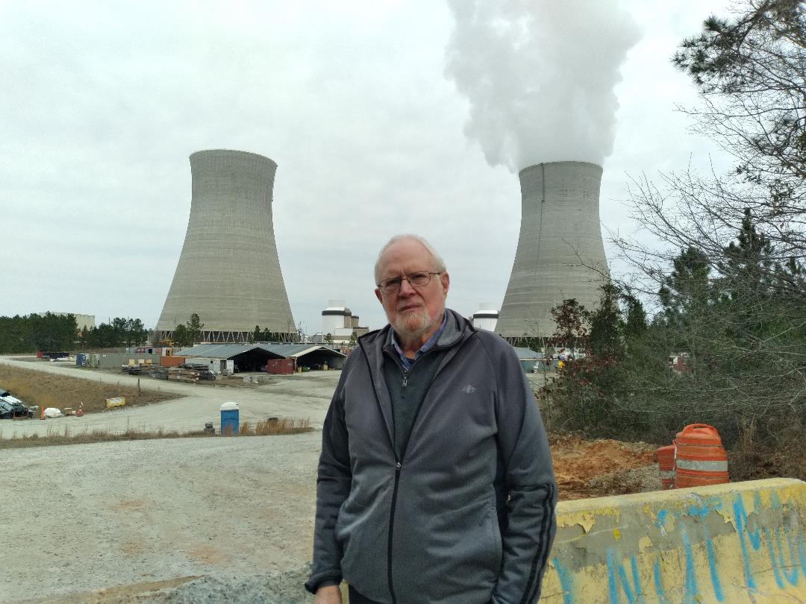
Total Failure: VC Summer AP1000 units 2 & 3, South Carolina Electric & Gas; construction started in 2009, halted in 2017 after $9 billion wasted on construction. Partial Failure: Vogtle AP1000, units 3 & 4, Georgia Power Company; construction started in 2009, were to be finished in 2016 and 2017 but started operation in 2023 and 2024. The cost went from estimated $14.5 billion to $36 billion. This project could be the world’s most expensive nuclear reactors and most expensive power facility.
Photos: VC Summer, November 2020, ©High Flyer & Vogtle, 18 February 2024

Slide 4
The reasons for failure are multi-faceted. U.S. Department of Energy finally admitted in 2023 some of the debilitating problems in pursuit of the Westinghouse AP1000 reactors, which NGOs were aware of for 10 years. Due to the AP1000 experience, DOE has turned away from large reactors and is now aggressively pushing speculative smaller reactor schemes.
Inadequate integrated project schedule,
Shortage of experienced labor,
Failure of supply chains,
Lack of companies with nuclear certification,
Incomplete design before start of construction,
Ongoing design issues of safety concern,
Lack of coordination between construction consortiums (Westinghouse & construction companies) and owners (electric utilities),
Construction problems,
Endless deception and lies to regulators and the public about schedule delays, cost overruns & rate impacts,
No solution to radioactive waste disposal,
Inadequate review of energy alternatives.

Slide 5
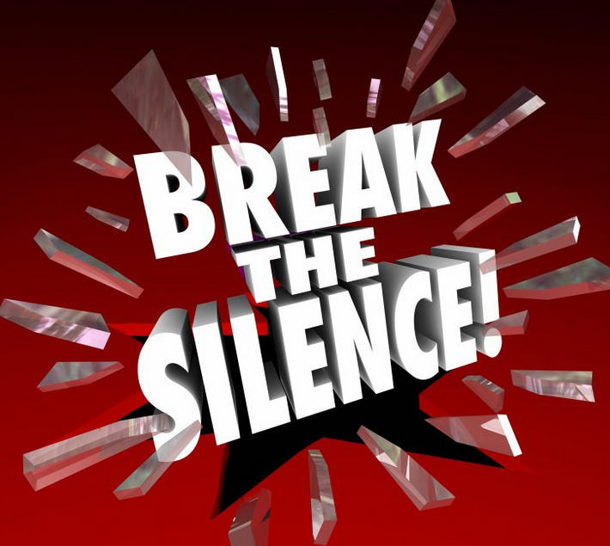
In reviewing news articles and reports about Westinghouse AP1000 nuclear reactor proposals in Central and Eastern Europe, it’s very clear that the bad news about the problem-plagued AP1000 projects in the U.S. is being hidden or covered up by Westinghouse, the nuclear industry, regulators and the media. Why no mention here of the VC Summer failure and problems at Vogtle? Is something sinister afoot?
The truth must be told in the CEE before Westinghouse or any other reactor vendor is allowed to proceed.

Slide 6
On 28 May 2024, Westinghouse released a report entitled 2023 Sustainability Report. In it, Patrick Fragman, President & CEO presents the same old worn out platitudes related to Westinghouse’s push for the AP1000 and other reactors:
“In 2023, Westinghouse was proud to deliver clean, affordable, and secure nuclear energy that meets the needs of both the present and future generations. We also continued to advance our own sustainability initiatives across the Westinghouse global operational footprint.”
“Clean” and “secure” and “sustainable”? Ignores environmental impacts all along the nuclear fuel cycle, especially concerning no disposal solution for highly radioactive spent fuel and ignores risks of nuclear accidents and attacks.
“Affordable”? This ignores the failure of the $11 billion wasted so far on construction and interest costs on the twin-unit VC Summer AP1000 project and the near-failure of the twin-unit $36 billion Vogtle project - $18 billion per reactor. Or, almost $48 billion in the US for 2 AP1000 reactors – or about $24 billion per reactor. Is this the kind of devastating “affordability” that Westinghouse is offering to CEE countries?

Slide 7
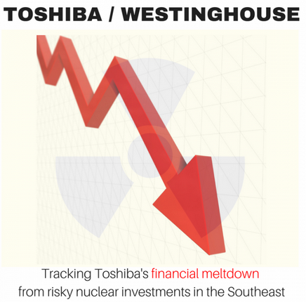
Westinghouse went bankrupt and was sold due to the failed AP1000 projects.
The new Westinghouse isn’t the old Westinghouse. Toshiba bought major control in Westinghouse in 2006 then Westinghouse filed for bankruptcy in March 2017 due to the massive cost overruns with the AP1000 projects. Acquired for $4.6 billion in January 2018 by Brookfield Business Partners equity firm. Sold/transferred in 2023 for $7.9 billion - now owned by Brookfield Renewable Partners (51%) and Cameco (49%), both Canadian companies, but Westinghouse is headquartered in the US.
Will the financing of the projects here be set up such that if they go badly, that Brookfield will be able to withdraw Westinghouse, minimize any losses and extract as much money as possible, leaving the state and consumers holding the bag?

Slide 8
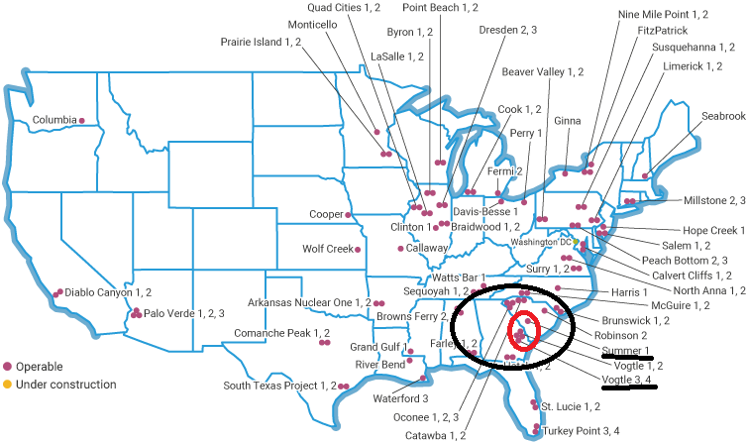
Vogtle units 3&4, Georgia Power; VC Summer units 2 &3 (terminated in 2017), South Carolina Electric & Gas (60% owner, went bankrupt and was acquired by Dominion Energy in 2019). These are private semi-regulated monopolies which made the decision on their own, with no public input, to pursue the Westinghouse AP1000 (1117 MWe), the only two AP1000 projects that went forward in the US.

Slide 9
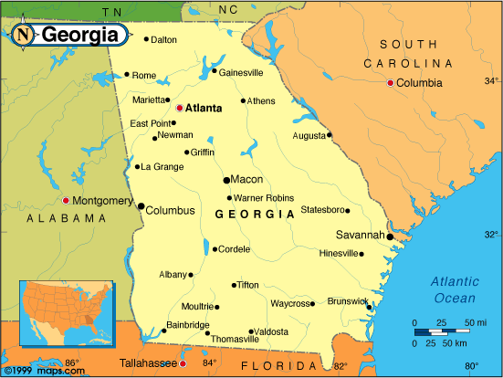
Georgia (154,000 km², 11 million population), now has 6 nuclear reactors, including 4 at Vogtle, now the largest nuclear power facility in the U.S. (4,536 MWe capacity).
South Carolina (83,000 km², 5.4 million population), 7 reactors, started in 1970s & 1980s.

Slide 10
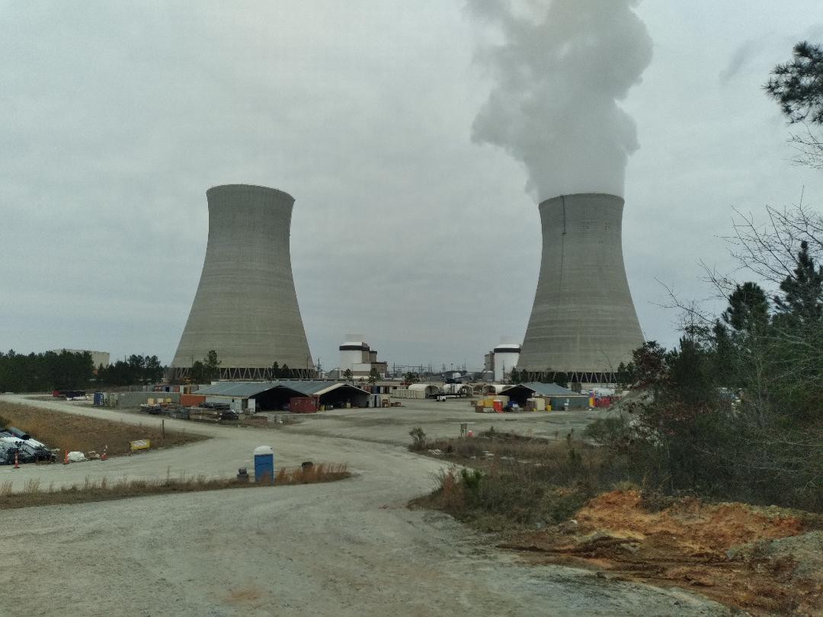
Vogtle, units 3 &4 (Georgia Power) - 2 AP1000s went into commercial operation 31 July 2023 & 29 April 2024; costing $36 billion, financed from equity, borrowing & from ratepayers. Plus, Vogtle got a $12 billion loan guarantee from DOE, placing U.S. taxpayers at risk. This project reveals that the word “failure” actually means great success as guaranteed company profits for nuclear reactor construction in a poorly regulated environment is a win for the company no matter the outcome, and the customer always loses.
For now, these are the last large reactors constructed in the US.
(photo taken 18 February 2024, by SRS Watch)

Slide 11
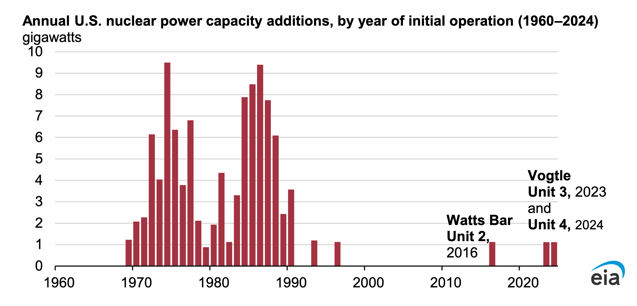
US is down to 94 operating reactors, with only 3 new units in over 25 years.
The bad experience with Vogtle and VC Summer has resulted in a halt to pursuit of large reactors. The US did not have manufacturing, planning and construction ability to pull off the much advertised “nuclear renaissance.”

Slide 12
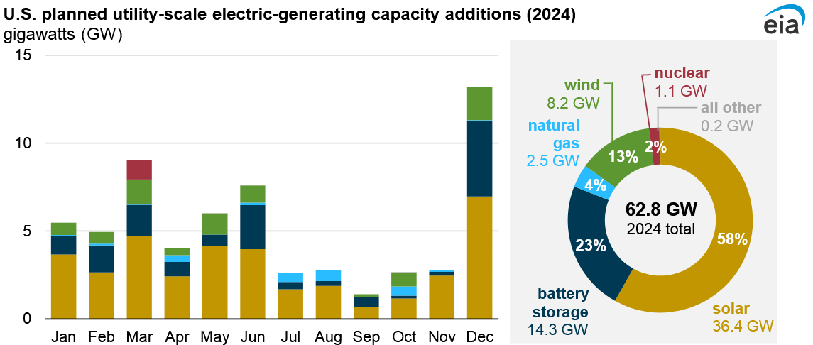
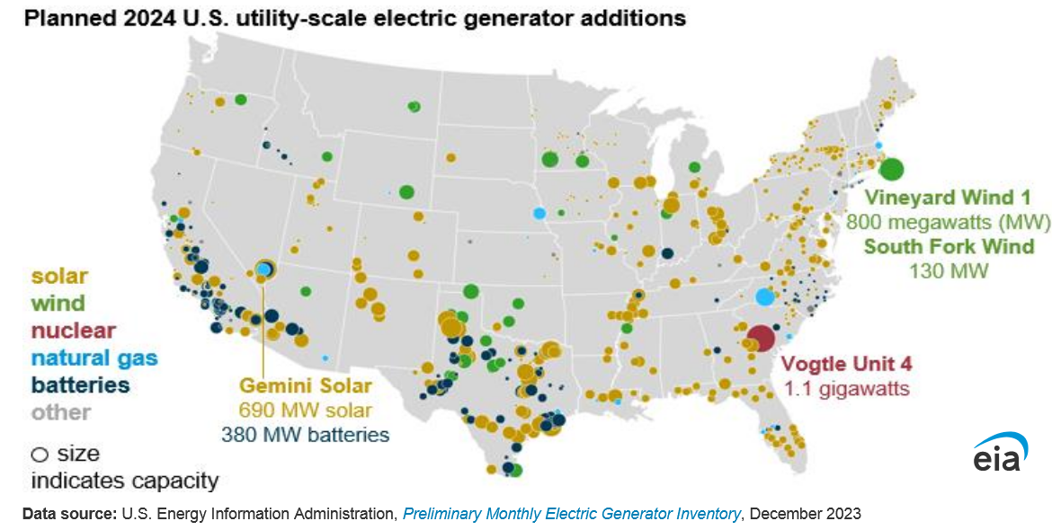
Vogtle unit 4 started in April 2024, and is expected to add only 2% to new US electricity generating capacity in 2024. The overwhelming trend in new electricity generation in the US this year is solar, battery storage, wind and some natural gas. Solar and battery projects - mostly small scale and localized - are all over the US, with concentration in the two most populous states: California (39 million) and Texas (30 million).
(Information from US Energy Information Administration - EIA)

Slide 13
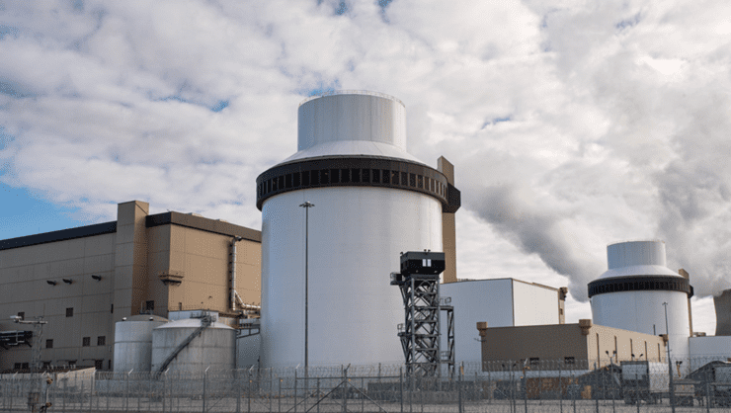
To be more blunt: Utility mismanagement, Westinghouse problems and negative economics at Plant Vogtle - cost of $36 billion and a 7+-year delay - and cancelation of the VC Summer project, large nuclear reactor construction in the US has been killed by the nuclear industry itself.
There is no sign of recovery and the negative trend continues. But DOE is frantically pushing speculative “small modular reactors” (SMRs), which face their own problems, and the first SMR project - by NuScale - failed in November 2023.
(photo from Georgia Power Company)

Slide 14
The application for VC Summer to “South Carolina Public Service Commission” - a “captured agency” that serves the electricity utilities - was on 30 May 2008. Friends of the Earth-US intervened against the project on 13 August 2008. Unanimously approved: 11 February 2009.
Our predictions beginning in 2008: 1) It was a huge mistake to overlook alternatives. 2) We said that the project would threaten both the company and rate payers with “spiraling increases in construction costs and delays in the construction schedule.” We were proven right from the first day to project termination on 31 July 2017 and company termination in January 2019.

Slide 15
The AP1000 design went through 19 official changes with the NRC. But flaws remain - passive cooling tank on top of the reactor could be ruptured by earthquake or attack and “reactor pressure vessel” cooling after an accident could be lost. In the event of a reactor breach, the “shield building” is open to the environment and is not sealed containment.

Slide 16
The NRC issued a construction license in 2012 and “first nuclear concrete” (FNC) was poured that year as the base for the reactor buildings. All construction before then was not officially construction in the eyes of the NRC.
But in reality, construction for both VC Summer and Vogtle began in early 2009, when the state approved the projects and site activity began, 3 years in advance of the NRC date. Caution is thus urged when “start of construction” is mentioned.

Slide 17
Claims by Westinghouse that “modular construction” of the reactor and key buildings would lead to more efficient construction was proven wrong. Reality: Failure of company constructing modules to meet quality requirements resulted in big delays and huge cost increases as the work had to be shifted elsewhere.

Slide 18
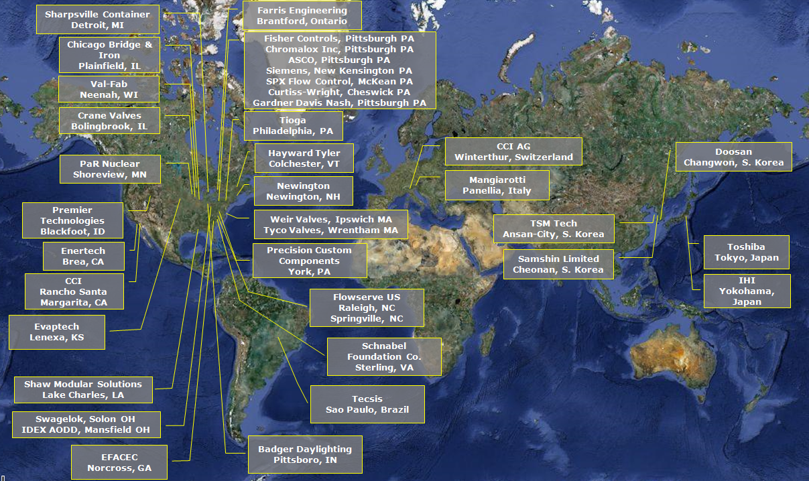
The US AP1000 supply chain, which fractured at several places, was global. It appears that Westinghouse is seeking lists of local CEE suppliers to participate in the AP1000 projects. Will the regulator in each country certify that the domestic and foreign companies that supply equipment or services that provide a safety function have a “Nuclear Quality Assurance (NQA-1) Certification”? [For example, the NRC inspected a supplier in Italy and identified “potential programmatic weakness in WEC’s [Westinghouse’s] Quality Assurance Program.”]

Slide 19
When the supply chain broke, module assembly shifted to the “modular assembly buildings” (MABs) at the AP1000 sites, which put great stress on the projects, increasing costs and causing more schedule delays.

Slide 20
Given the growing problems, SCE&G and its partner contracted Bechtel in 2015 to analyze what was wrong with the VC Summer project and how to rectify things. The report, which was kept secret until after project termination in 2017, didn’t state it but it was clear the project could not be salvaged (and it collapsed 1 1/2 years later). As a consolation with a positive side, Bechtel, if involved in the CEE projects, knows the huge challenges that will be faced but Bechtel was not able to salvage the failing VC Summer project.

Slide 21
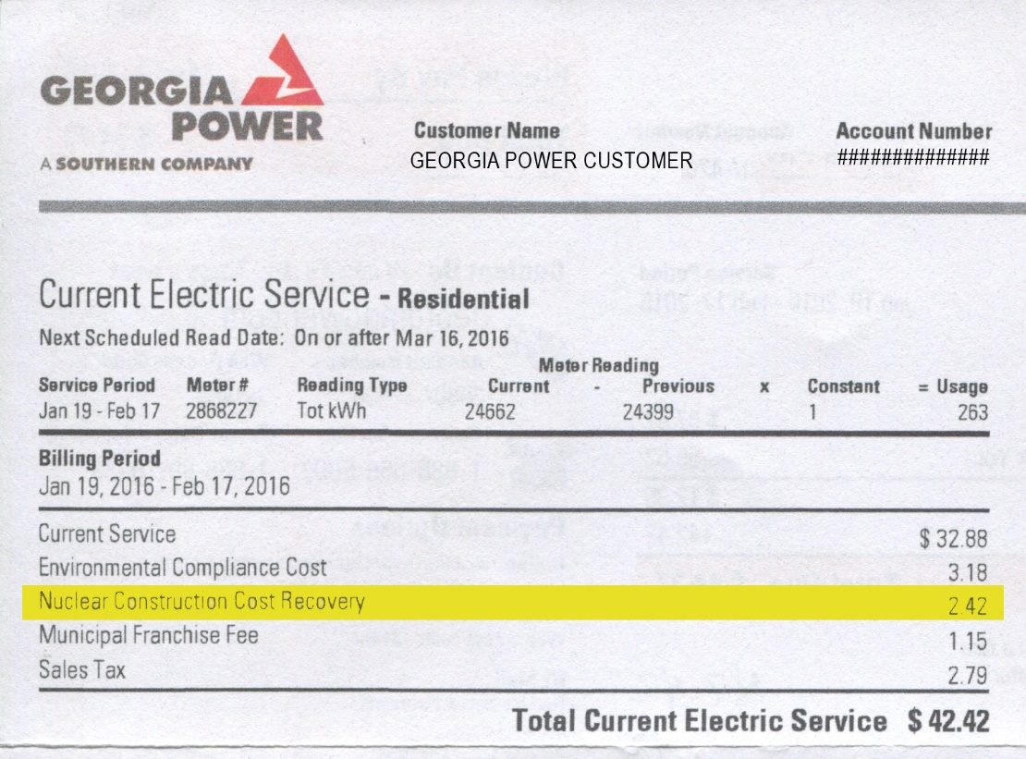
The interest charge on the debt for Vogtle was allowed to be collected from customers before the reactors were operational and appeared on the Georgia Power bill as “Nuclear Construction Cost Recovery.” This was not the capitol cost of construction, which is now going into the bill but is not being shown. The 24% rate increase so far for the company’s controlling interest (45.7%) of the 2 new reactors - is also not shown on the bill. The company’s “return on equity” in 2022 was a startling 11.9%. (Under Georgia electricity regulation, electric utilities are guaranteed a profit, so the more they spend or waste the more they make, and were given a “blank check” for cost of the AP1000 reactors.)

Slide 22
From 2009 to before the VC Summer project was halted on 17 August 2017, SCE&G customers were hit with 9 rate hikes for reactor construction, as allowed by our “Construction Work In Progress” law. Those were only for financing charges. Further CWIP charges and much larger rate hikes to pay for capital costs were thankfully avoided.

Slide 23
Customers of Dominion Energy - took over bankrupt SCE&G - are now paying 5.6% of the monthly bill for the failed VC Summer project and will pay another 15 years (20 years total). Our Construction Work in Progress (CWIP) law - “BLRA” - allowed collection of financing charges in advance of reactor operation. Capital costs could be collected when the reactors started operating. Plus ~10+% guaranteed “return on investment” was allowed. The law was terminated in 2018 after VC Summer project failure but the “BLRA” still applies in only this case. The 5.6% charge is not shown on the monthly electricity bill, so few customers know about it.
Image on left: residential electricity charges from 2009-2023, in a document obtained via Freedom of Information Act (FOIA) request to a South Carolina state energy department, with BLRA charges shown

Slide 24
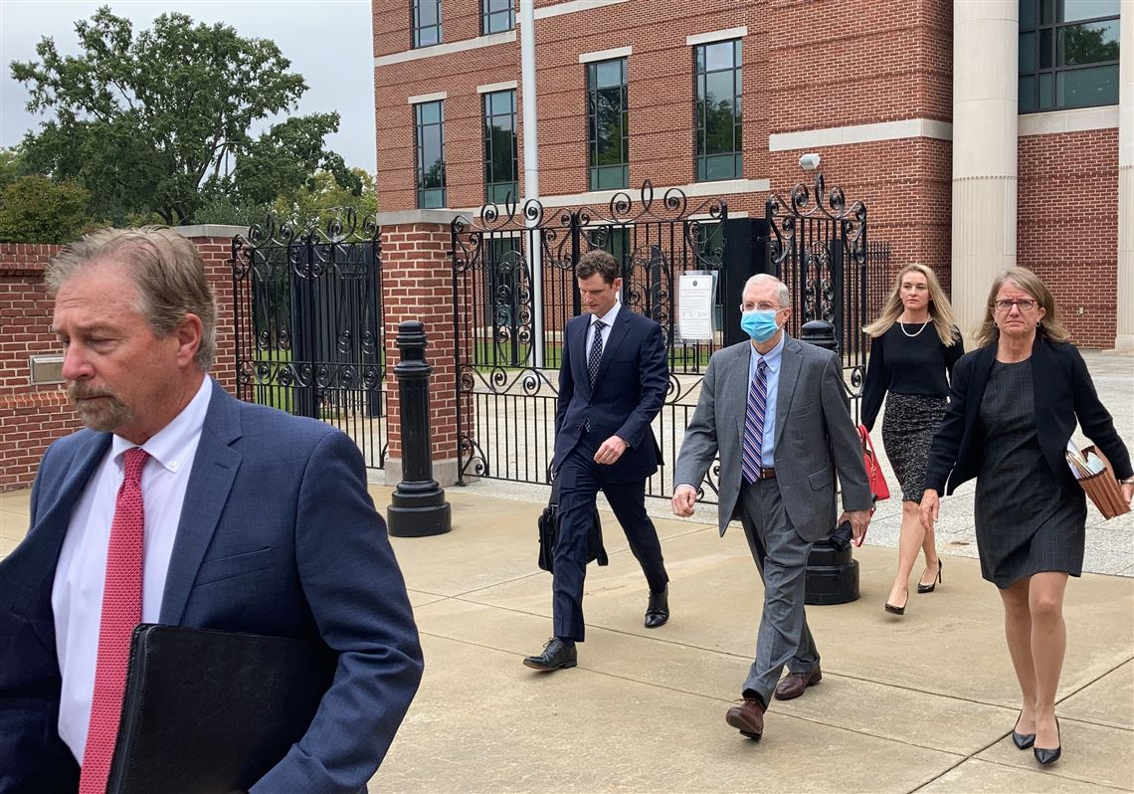

The failed AP1000 project in South Carolina became a “criminal conspiracy” designed to guarantee a profit for the company, resulting in federal felony charges - for fraud - against two top SCE&G officials and two Westinghouse officials, for lying in official, legal proceedings about the cost, schedule and insurmountable technical difficulties. The SCE&G CEO (in photo) and the vice president in charge of construction served time in federal prison; one Westinghouse official received home detention and one is yet to be sentenced.

Slide 25
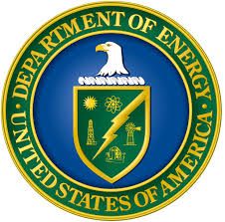
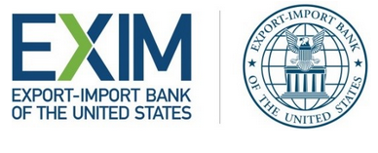
The EXIM Bank and the U.S. Department of Energy (DOE) - especially Assistant Secretary for International Affairs Andrew Light - have some explaining to do about why they are promoting in CEE countries reactor projects that horribly failed in the US and why they are not telling the truth about what happened. Why do they want U.S. taxpayers and CEE taxpayers and electricity customers to assume any risk for speculative Westinghouse AP1000 projects no longer being pursued in the U.S.? DOE well understands what has happened and not talking about it reveals negligence, dishonesty and a conspiracy of silence with Westinghouse and potential CEE partners.
As EXIM bank/DOE/Westinghouse search for other countries to take on debt and the risk of new reactors, CEE citizens must demand honesty and accountability and to be engaged in the process and have input at every step.

Slide 26
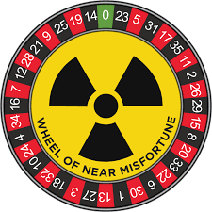
Caution! We found out first hand that Westinghouse and the utilities misled and lied to the public and regulators at almost every step, in part deluded by their own nuclear-construction fairy tale, with little consideration for the electricity customers and “present and future generations.” We’ll pay another 15 years for their mistakes with VC Summer & the nuclear industry in the US was severely damaged.
It looks like similar grandiose promises about costs and schedules are being made again, this time in CEE. Who will monitor developments with an objective eye?

Slide 27
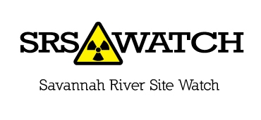
Thank you.
Tom Clements
Director, Savannah River Site Watch (SRS Watch)
Columbia, South Carolina USA tel. 1-803-834-3084 srswatch@gmail.com www.srswatch.org

Slide 28
Additional slides follow, for possible use in Q&A session

Slide 29
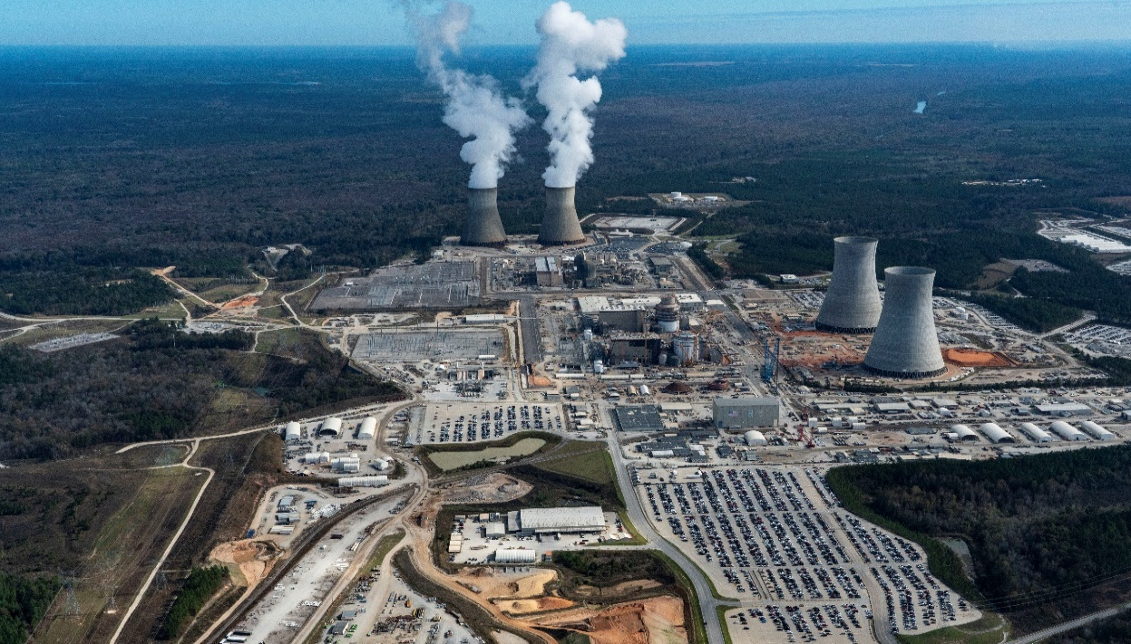
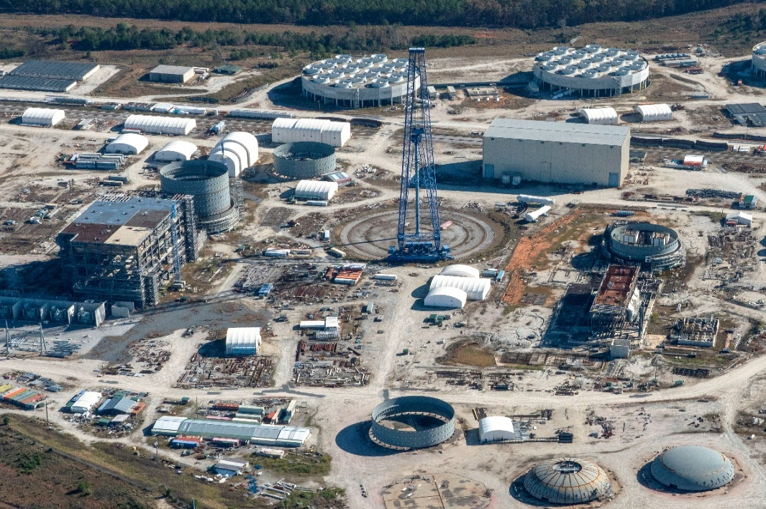
Vogtle, units 3 & 4
Site preparation: 2009
State of Georgia permission: 2009
US NRC construction license: 2012
Forecast start dates in 2008: 2016, 2017
Cost estimate in 2009: $14 billion
Actual start dates: 2023, 2024
Cost: $36 billion (with $12 billion US DOE loan guarantees)
VC Summer, units 2 & 3
Site preparation: 2009 (tree clearing in 2008)
State of South Carolina permission: 2009
US NRC construction license: 2012
Forecast start dates in 2008: 2016, 2019
Cost estimate 2009: $9.8 billion; 2013: $11.5 billion
Project termination: 2017; $25 billion projected cost
Amount wasted: $9 billion + $2 billion financing; about 50% complete, but extent of construction problems unknown

Slide 30
Hard-hitting report by public-interest groups in Georgia on the host of problems with the Vogtle project, released on 30 May 2024:
PLANT VOGTLE: The True Cost of Nuclear Power in the U.S. https://www.pattyforpsc.com/wp-content/uploads/2024/06/Truth-about-Vogtle-report.pdf

Slide 31
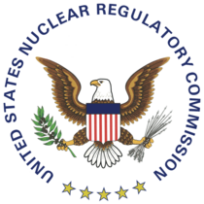
License application for VC Summer to the US Nuclear Regulatory Commission in 2008; license granted in 2012 and terminated in 2019 (US NRC licensing information: https://www.nrc.gov/reactors/new-reactors/large-lwr/col/summer.html). Environmental Impact Statement was inadequate, with no plan for disposal of the highly radioactive spent fuel.

Slide 32
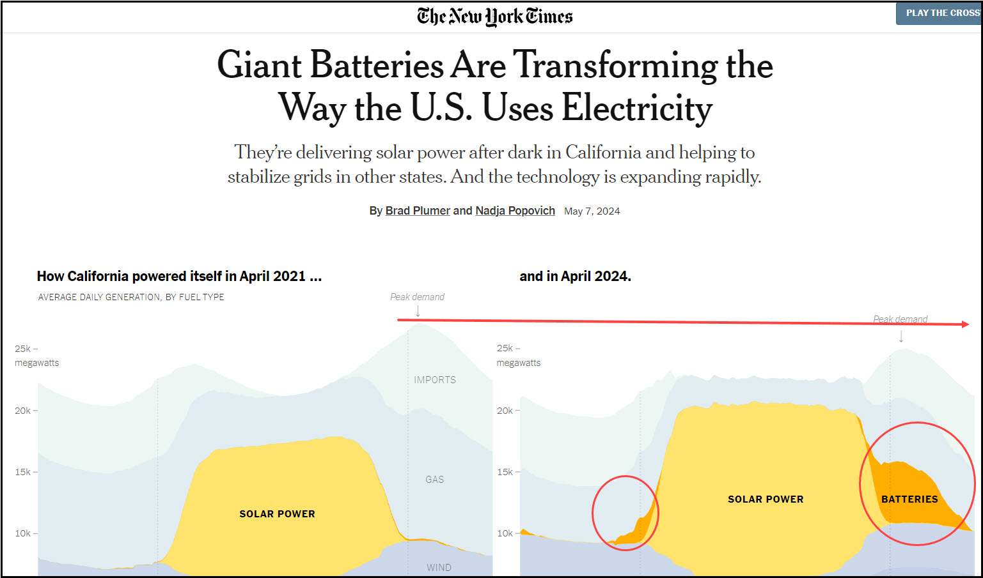
Solar power, battery storage and wind are growing rapidly in California; gas use is falling.

Slide 33
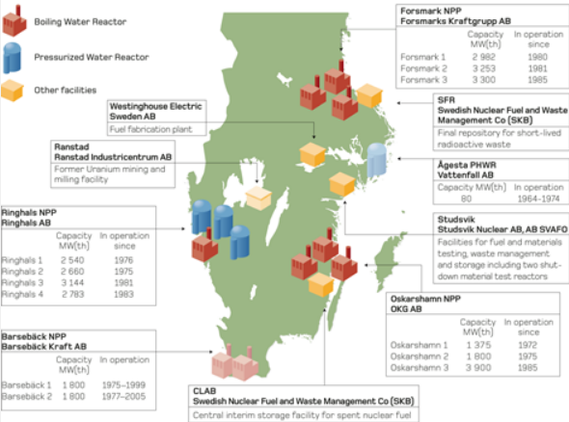
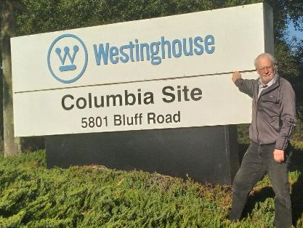
As an extra benefit to the company, Westinghouse likely wants the business to supply AP1000 fuel and has uranium fuel fabrication facilities in Columbia, South Carolina & Västerås, Sweden.

Slide 35
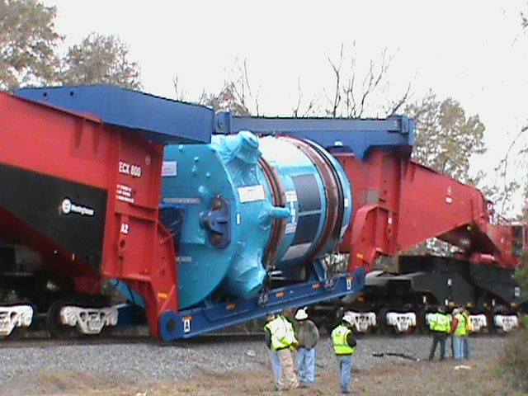
Articulated rail car (Schnabel wagon) problems when carrying Vogtle AP1000 reactor pressure vessel (RPV) - made in South Korea - out of port of Savannah, Georgia USA. How will RPVs be transported? In the US, rail was the only option. RPVs remain at the VC Summer site, exposed to the weather.
Photo January 2013

Slide 36
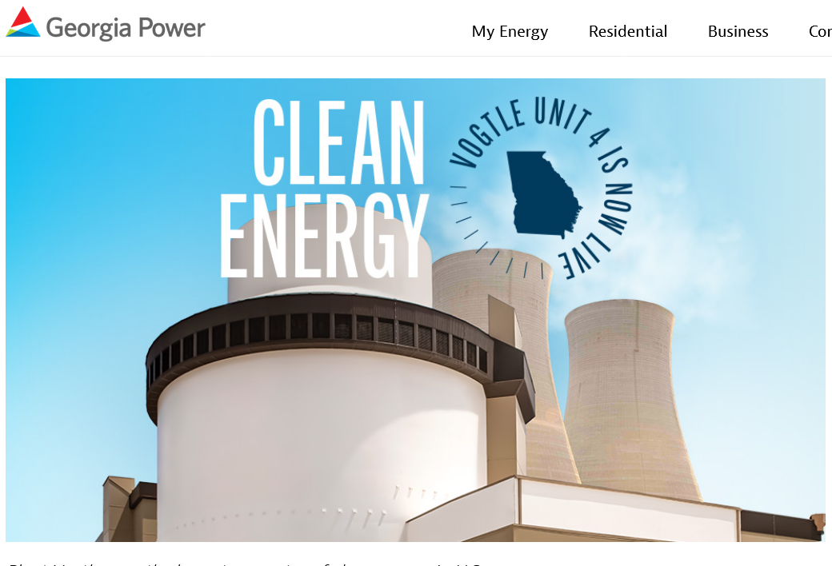
The U.S Department of Energy’s “Office of Nuclear Energy” is in on the cover-up about Vogtle’s construction problems, massive cost overruns and endless schedule delays. There’s not a word about those issues in this DOE feel-good video from 7 May 2024, days after unit 4 started operation: https://www.youtube.com/watch?v=fY7qrDeffec

