Slide 1
Citizens say “No!” to the proposed New Production Reactor, aka New Pork-barrel Reactor (NPR) - Oink! - May 1991 & They Won!

Slide 2
The NPR, proposed for $R$, would have produced tritium for all US nuclear warheads. Around 2001, the same people WON AGAIN against a new plutonium “pit” plant proposed for SRS – the Modern Pit Facility (MPF). So, victory against the nuclear war machine is possible.

Slide 3
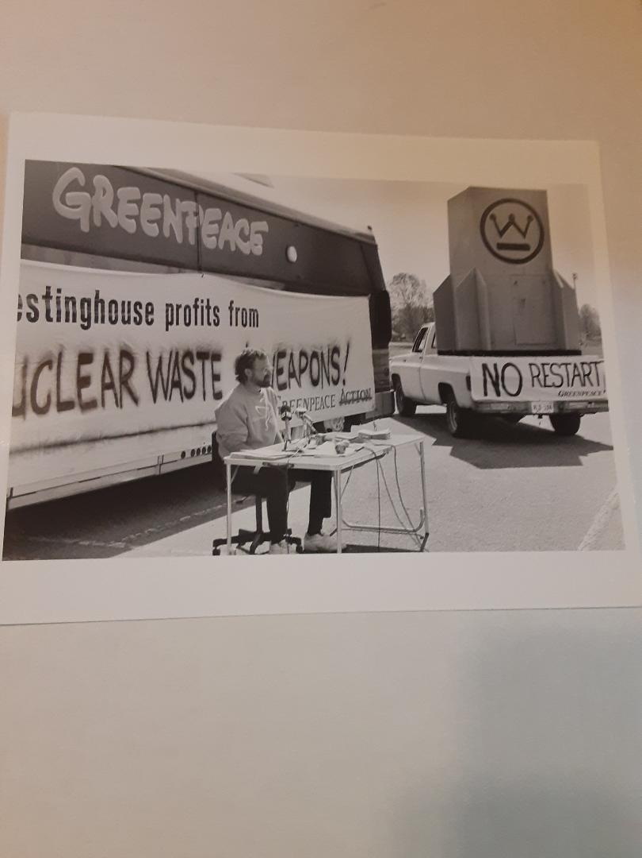
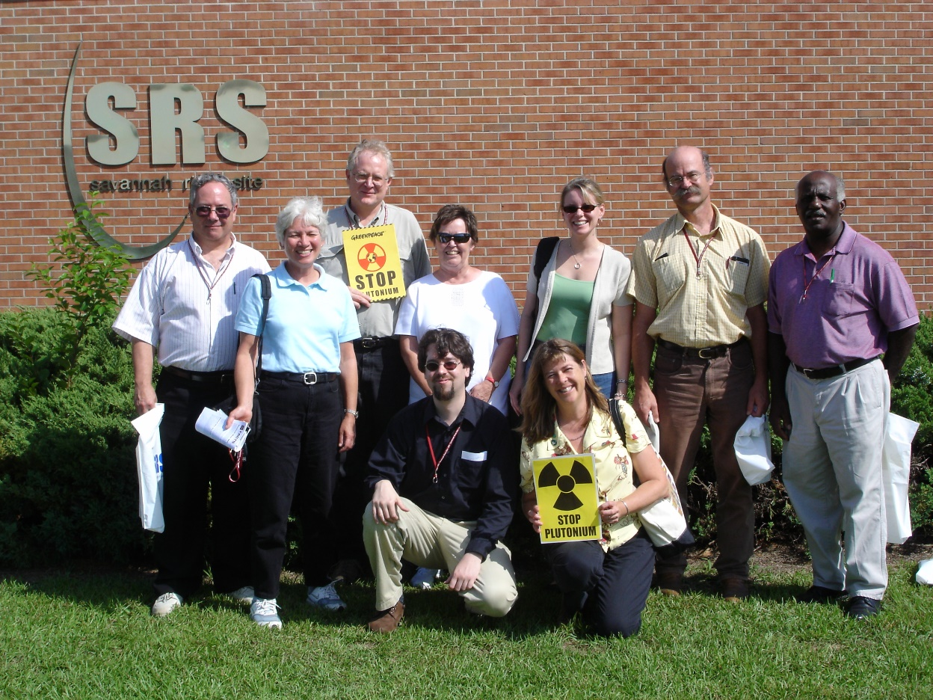
No Restart of K-Reactor, to produce tritium, 1991 in Aiken –
WE WON AGAIN! SRS tour 2005

Slide 4
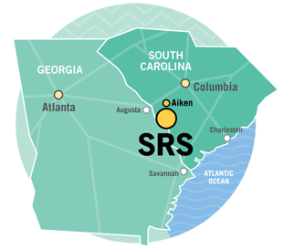
Profiteering Off Secret Nuclear War Planning in South Carolina
Exposing the “Conspiracy Reality” of the Real Deep State’s Planning for Full-Scale Nuclear War
Savannah River Site Watch, www.srswatch.org
November 19, 2024

Slide 5
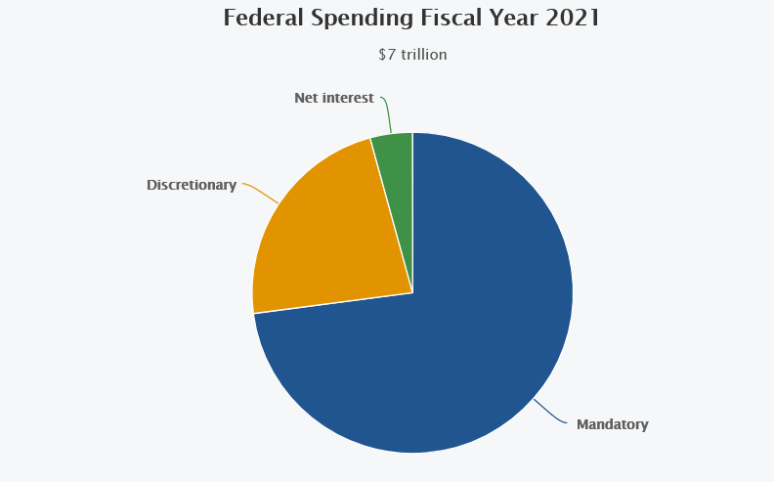
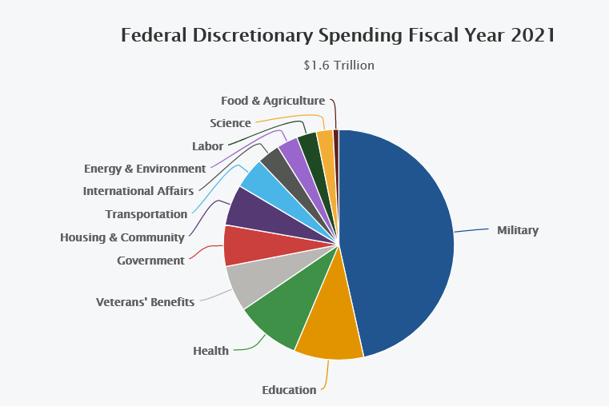
Half of federal “discretionary spending” is now for the military

Slide 6
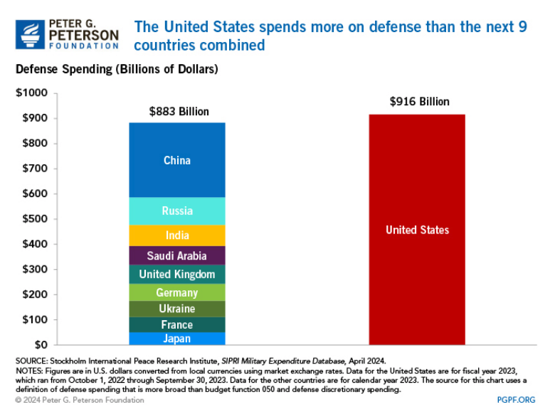
U.S. military spending tops the world, by far.
“Overseas Contingency Operations” (OCO) is a Pentagon slush fund appropriated apart from the base military budget and can add 10% or more to DOD spending

Slide 7
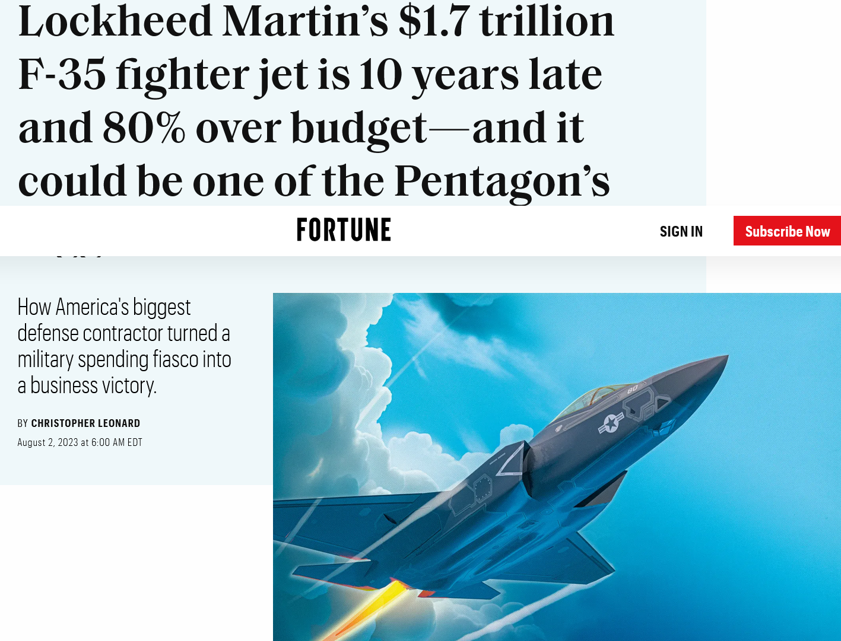
Lockheed Martin thrives on war preparation: $1.7 trillion for the F-35 fighter aircraft. In contractor terms, success = failure (cost overruns & delays are profitable).

Slide 8
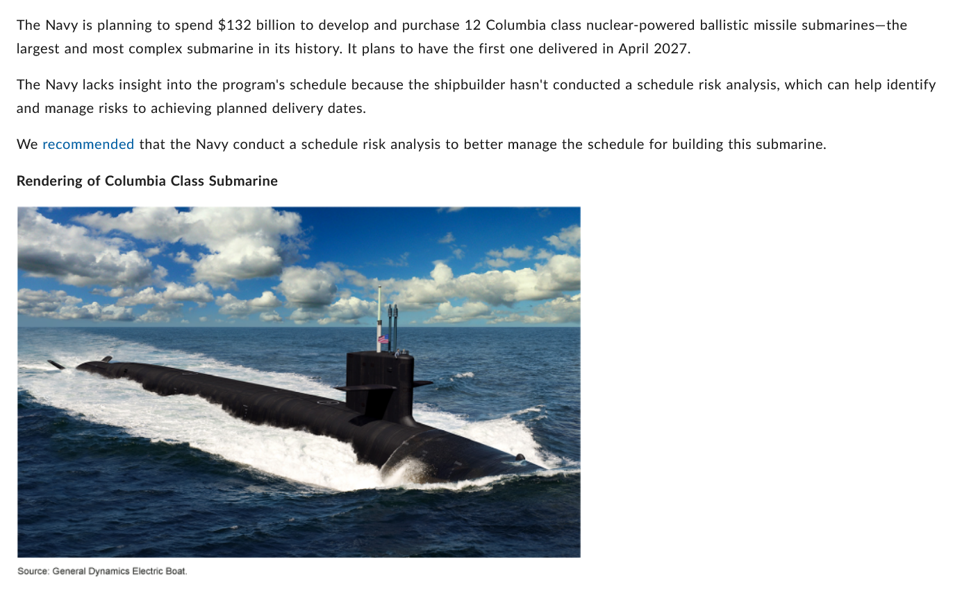
“General Dynamics Electric Boat” – 12 new “Columbia class” submarines with nuclear-tipped missiles: $132 billion, with W93 warhead with plutonium “pit” from SRS

Slide 9
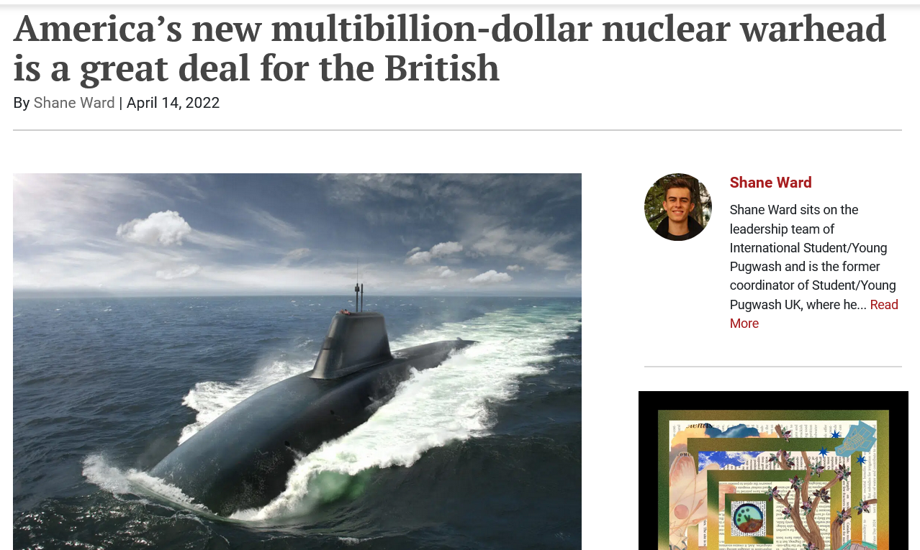
What’s planning for nuclear war amongst friends? W93 warhead being developed by Lockheed Martin with the UK, with which the US “legally” shares nuclear weapons materials and components under the “Mutual Defense Agreement”

Slide 10
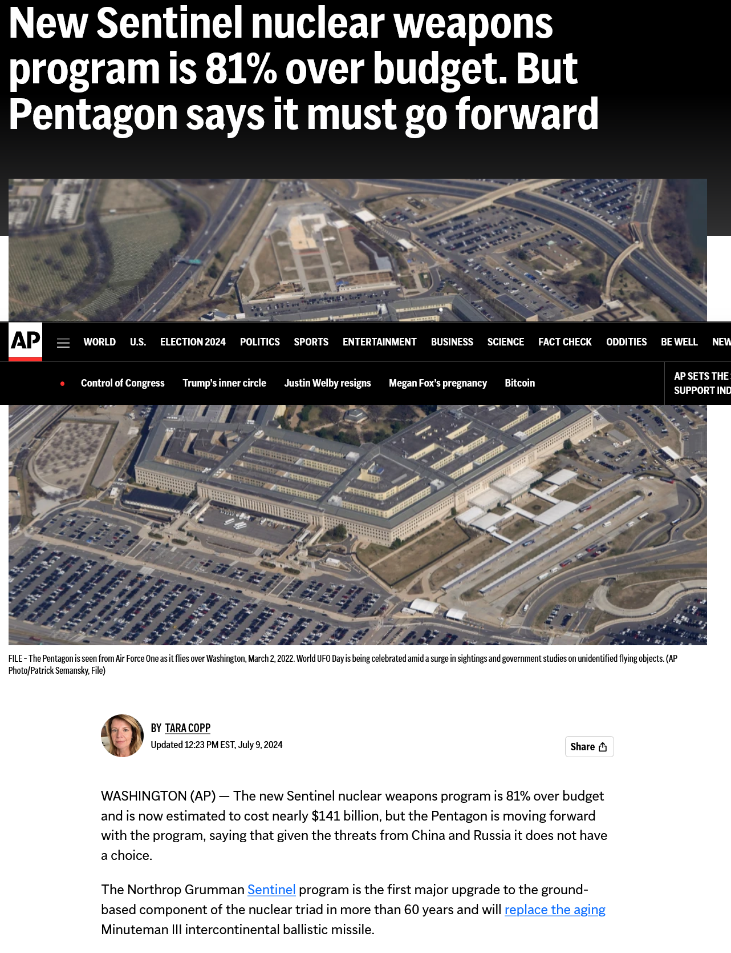
Sentinel W87 warhead designed by Lawrence Livermore National Lab, with plutonium “pits” from Los Alamos and Savannah River Site - $141 billion for the missile and retrofitting existing silos

Slide 11
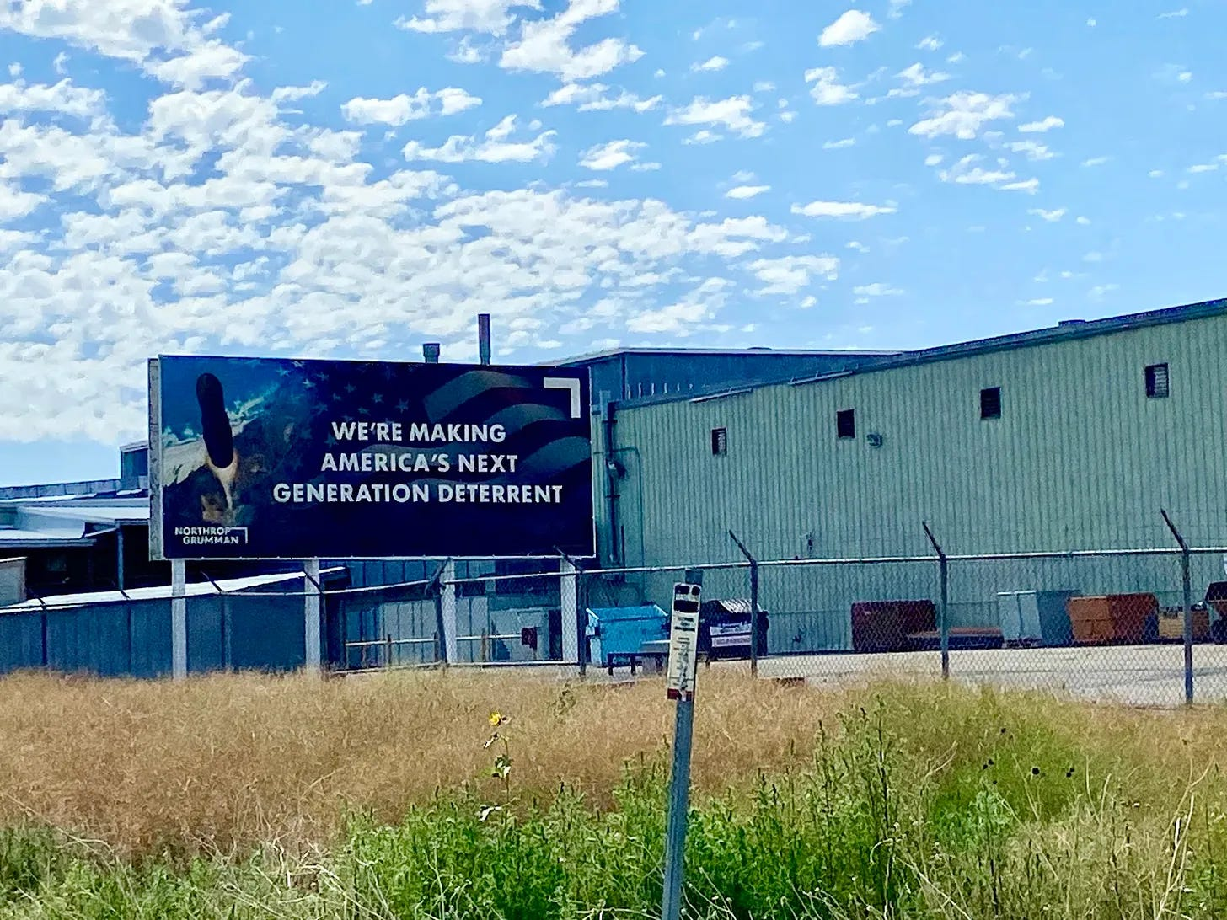
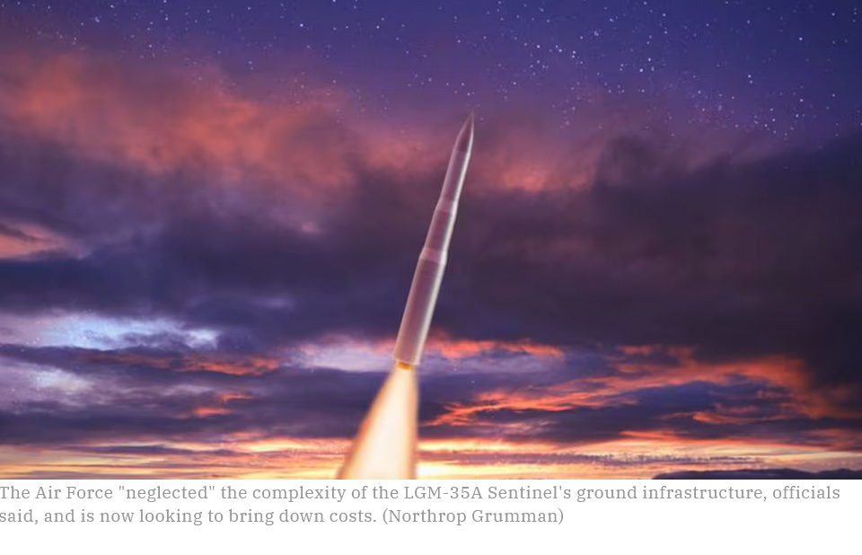
Sentinel missile by Northrup-Grumman to be based in upper Midwest, to replace older ICBMS, would use new plutonium “pit” for the W87 warhead; missile production in Utah

Slide 12

Is planning for nuclear war the path to happiness (or just wealth)? These happy Northrup Grumman board members well know that “success = failure”.

Slide 13
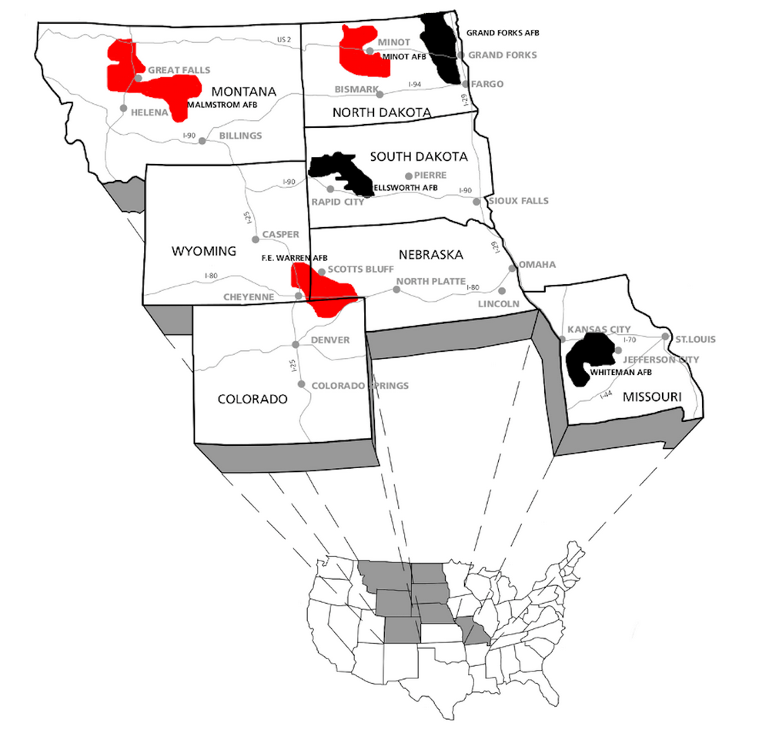
400 ICBMS based in the Midwest – first-strike weapon or “nuclear sponge” – part of obsolete nuclear “triad” (land, sea, air weapons) – where the Sentinel would be based

Slide 14
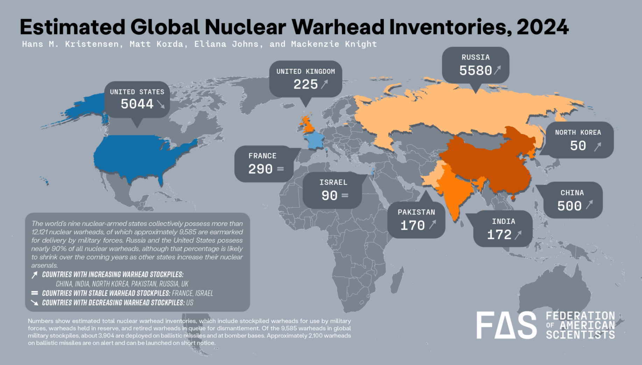
“Nuclear Weapons States” - US and Russia have far more weapons than other nuclear weapons states combined. US, Russia & China are pursuing a variety of new nuclear weapons but the US blames Russia and China for the new nuclear arms race.
Do you feel safer given that we are on the precipice of an arms race?

Slide 15
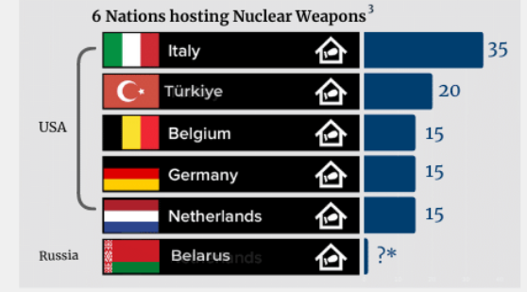
De facto nuclear weapons states

Slide 16
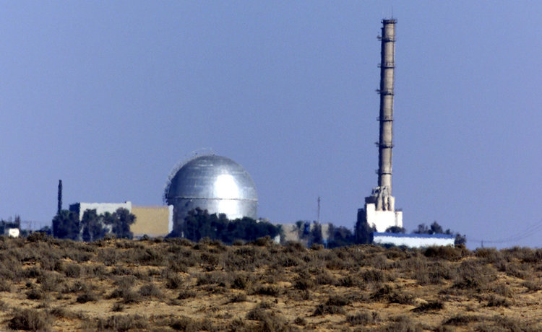

Slide 17
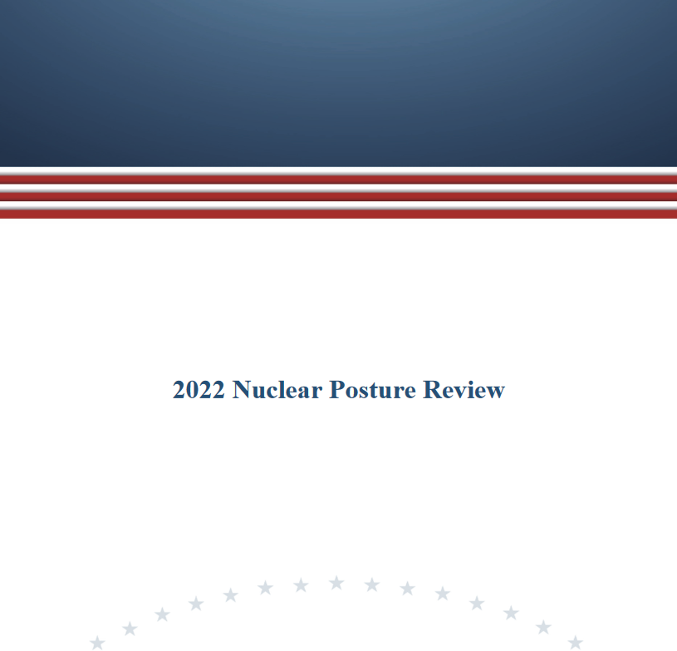
Presidential/DOD’s “Nuclear Posture Review” (NPR) – playbook for nuclear war preparation, feebly disguised as “deterrence” (word used to justify large nuclear stockpile & war preparation).

Slide 18
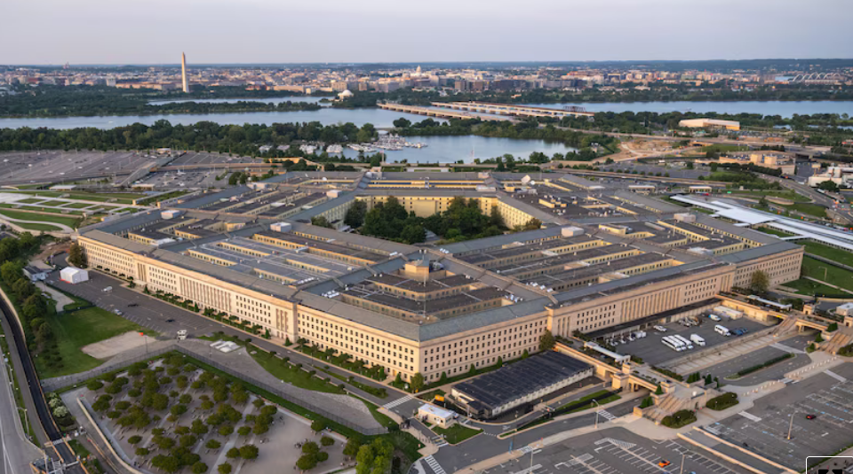
The “Department of War” drives military spending but the U.S. Department of Energy - really the “Department of Nuclear Weapons” - makes the nuclear warheads and has its own budget

Slide 19
DOE’s “National Nuclear Security Administration” (NNSA) complex, operated by private contractors, is a business enterprise to serve its client

Slide 20
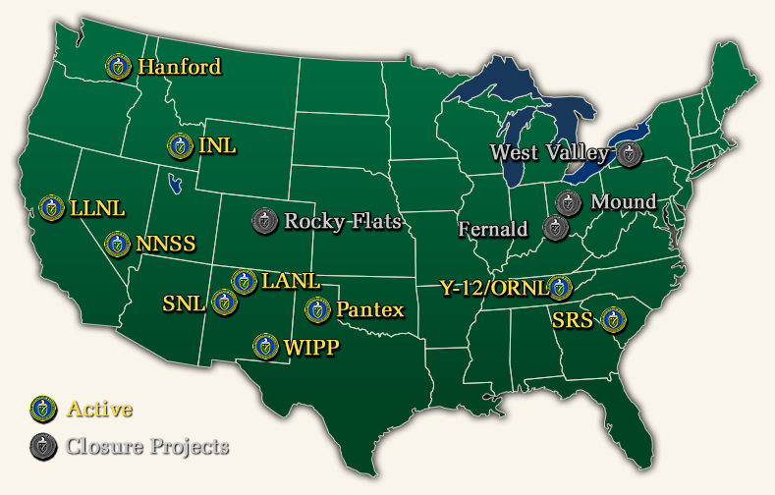
DOE’s nation-wide complex run by contractors:
DOE makes and maintains the warheads and supplies the nuclear materials and non-nuclear components & the assembled warheads provided to its customer

Slide 21
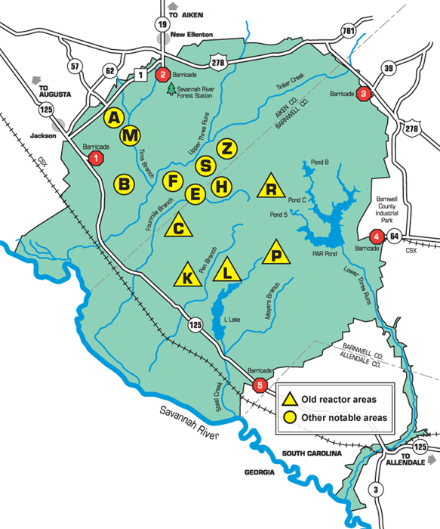
Savannah River Site (SRS) – operations in center of 310-square-mile site; founded by the Atomic Energy Commission in early 1950s, operated nuclear reactors to produce two key nuclear warhead materials: plutonium and tritium. A vast amount of nuclear and chemical waste was created. 11,500 employees. NNSA took over Oct. 1, 2024.

Slide 22
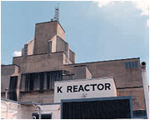
SRS had five reactors that produced about 36 metric tons of plutonium and all the tritium gas for nuclear weapons.
Do the math: 36,000 ÷ 3 = 12,000

Slide 23
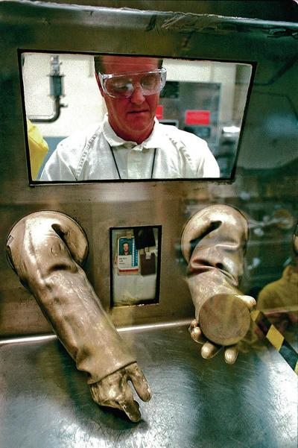
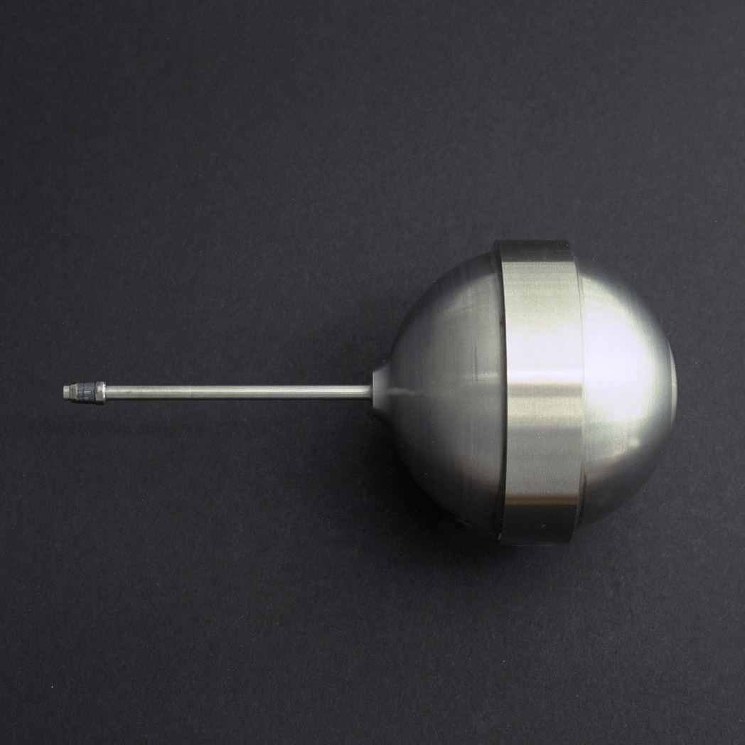
Plutonium-239 has a half life of 28,000 years; tritium gas is used in all US nuclear weapons – all tritium is processed at SRS, from radioactive rods irradiated by TVA & made by Westinghouse

Slide 24
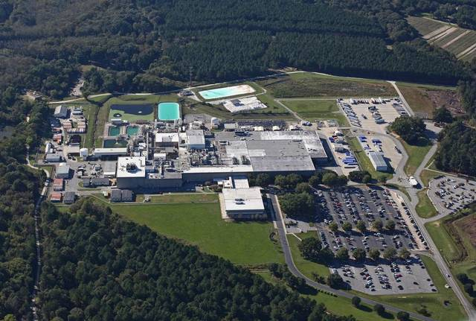
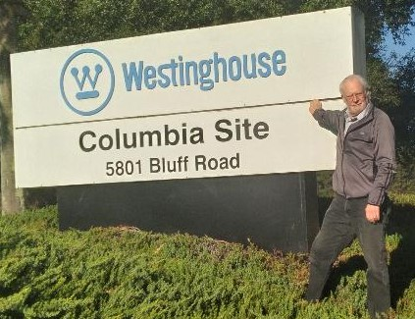
Shhhh! Westinghouse nuclear fuel plant is a “dual-use” commercial-military facility and another key to the nuclear arms race; the military part fabricates special tritium rods, with no formal regulation

Slide 25
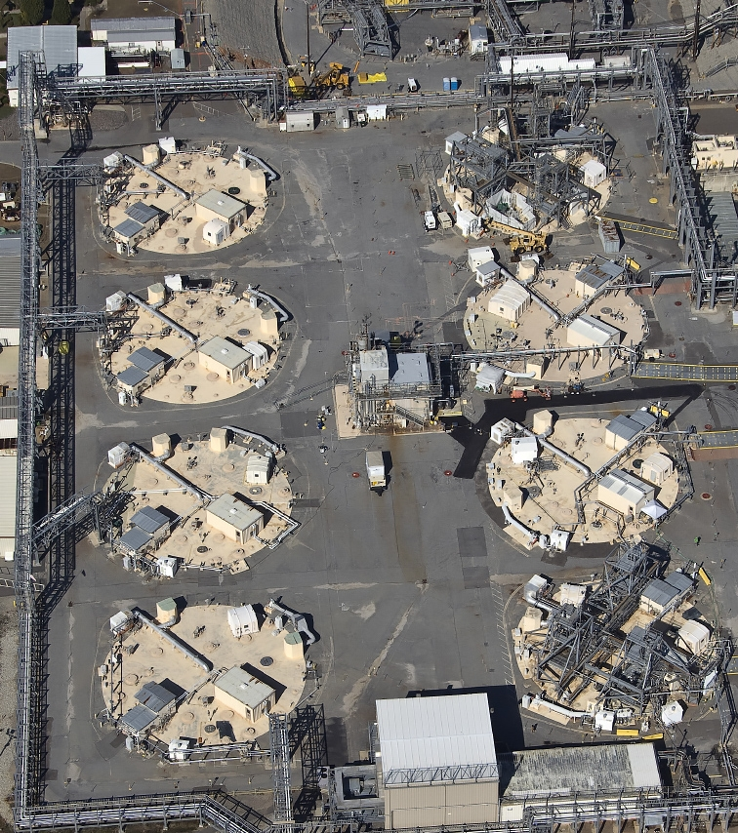
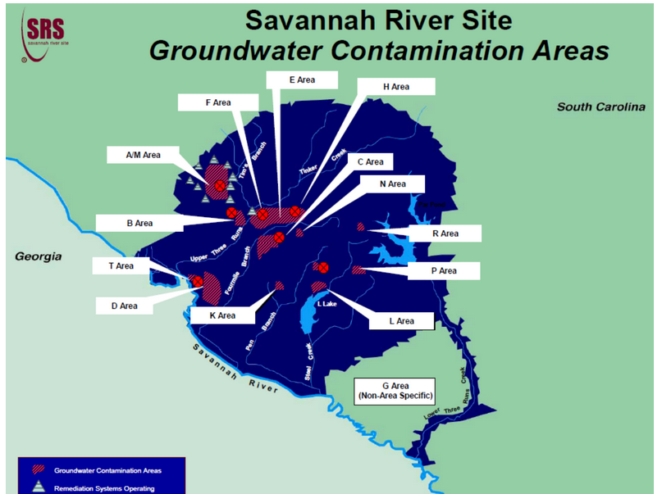
SRS high-level waste tanks – deadly radioactive waste is a by-product of nuclear material production; clean-up of this waste is where the focus must remain – 43 of 51 tanks yet to be dealt with; 2037 closure date at risk. One of the biggest environmental threats to South Carolina. SRS groundwater “cleanup” by 2065 (don’t count on it). “Environmental liability” at SRS is more than $100 billion and there will be an effort to use that for nuclear weapons programs at SRS.

Slide 26
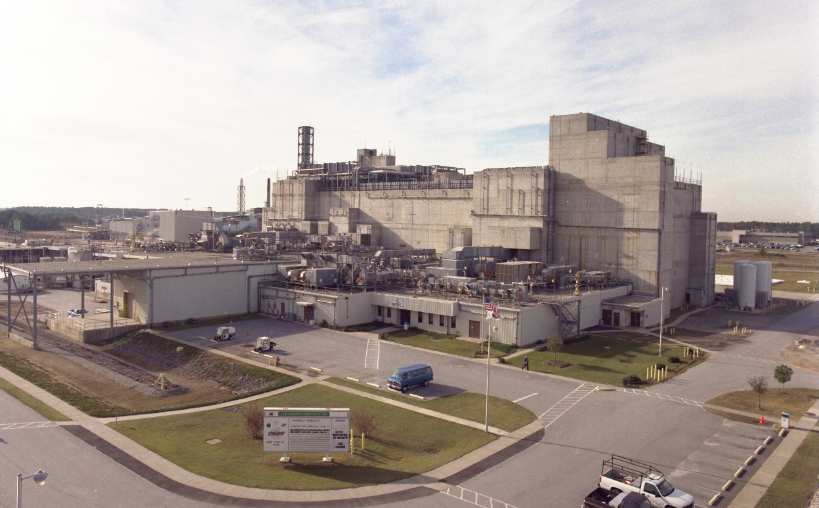
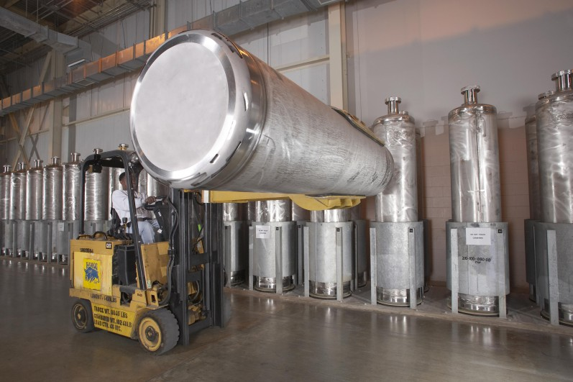
Highly radioactive nuclear waste – liquid and sludge – is being removed from the HLW tanks to be “vitrified” – over 4000 canisters filled, but no disposal site is available so it stays at SRS

Slide 27
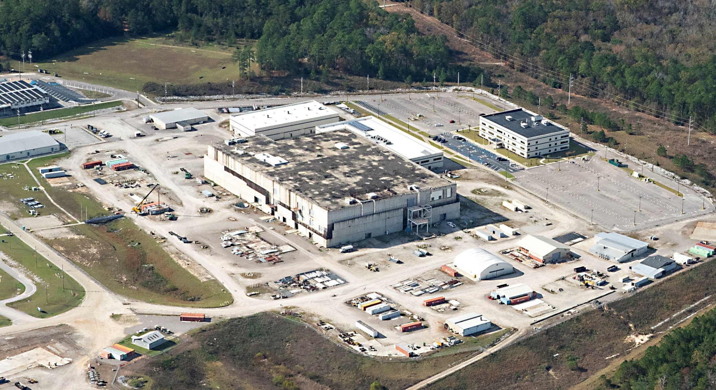
“MOX” facility at SRS to make plutonium fuel terminated in 2017 -$8 billion wasted, with no congressional or DOE investigations. Proposed in 2018 as SRS Plutonium Bomb Plant to make “pits” for new warheads

Slide 28
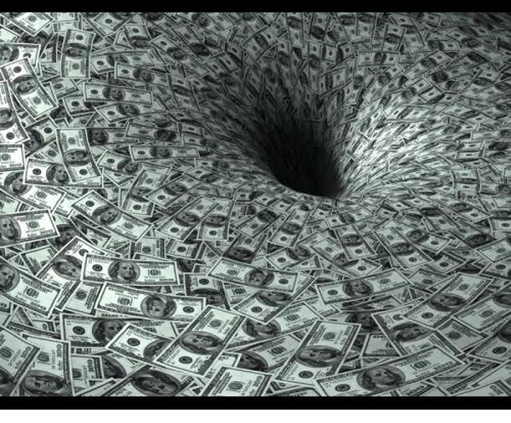
As DOE is an unconstrained money machine for contractors and special interests, a new “mission” had to be quickly found to fill “loss” in funding when the MOX project was terminated. Pit production was a perfect choice – large initial costs & high annual cost, with guaranteed delays and cost overruns. Voilà!

Slide 29
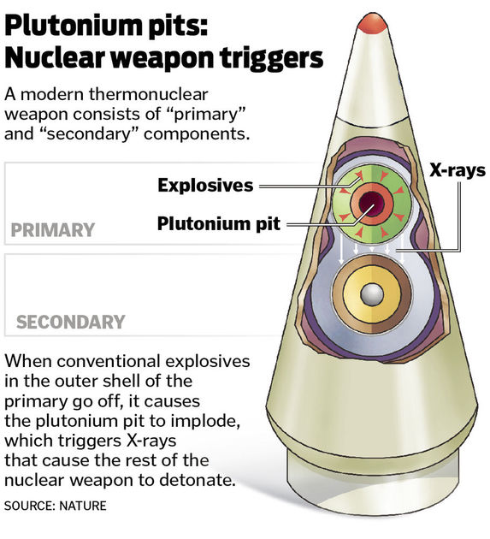
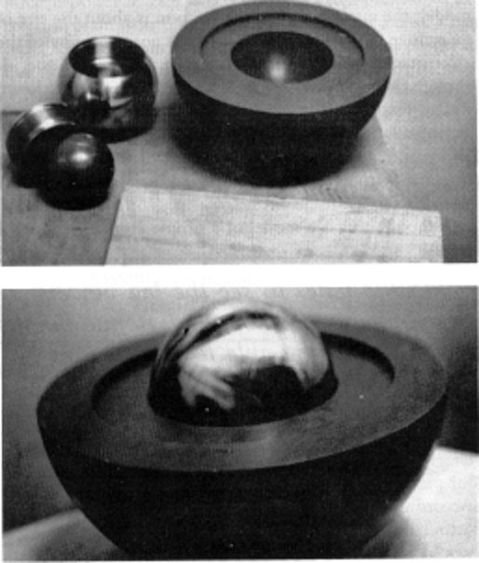
In May 2018, DOE/DOD announced the goal to produced 80 “pits” per year, at two DOE sites. SRS is not required by law to produce pits, this was a deep state decision.

Slide 30
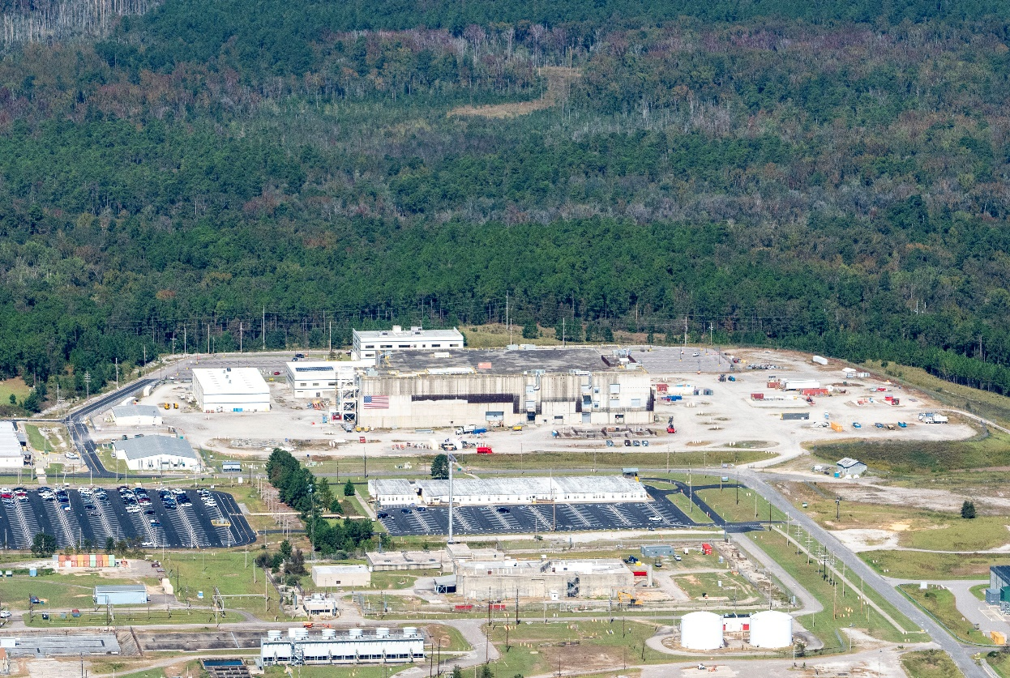
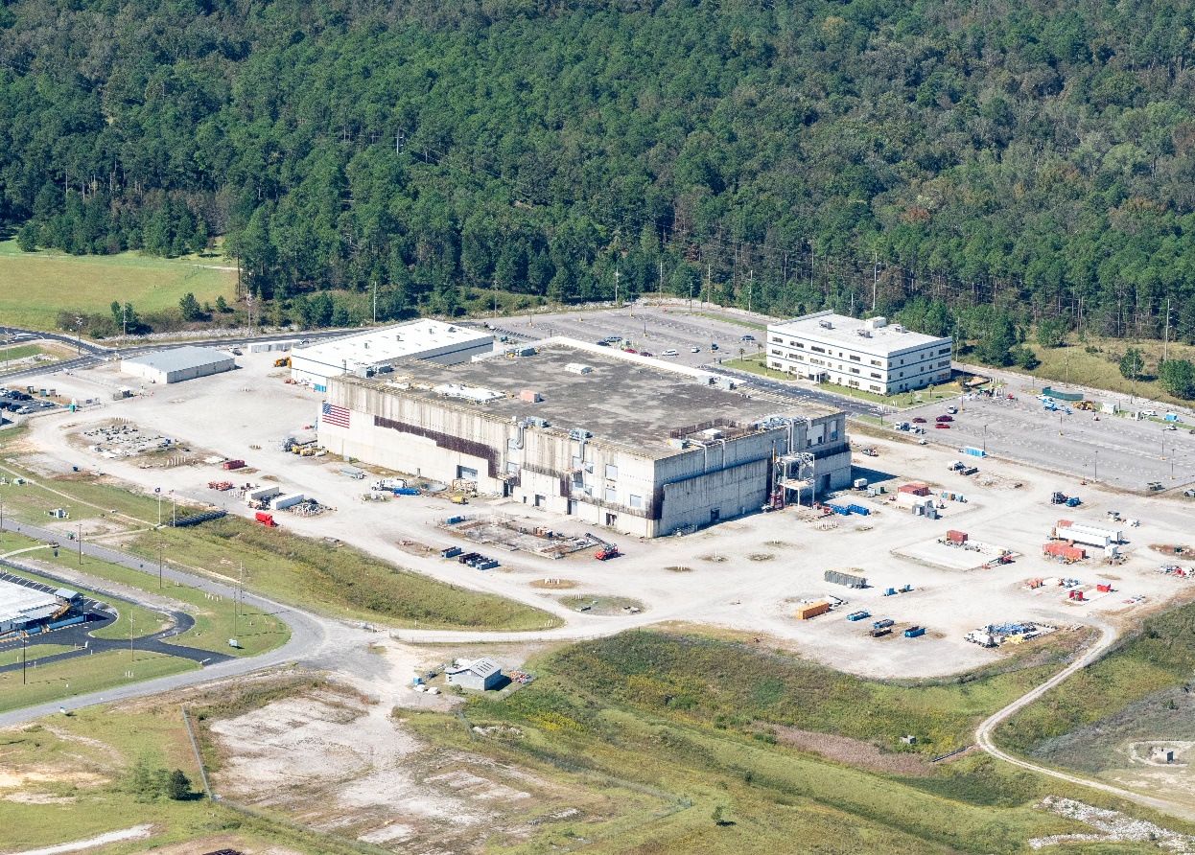
Pit production sites are Los Alamos National Lab & SRS – first pits for Sentinel ICBM (W-87 warhead)& next pits for SLBM (W93 warhead)

Slide 31
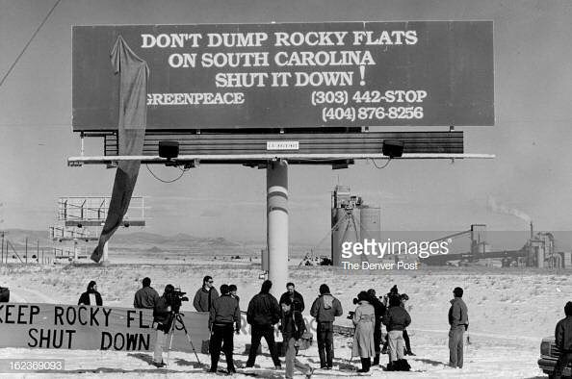
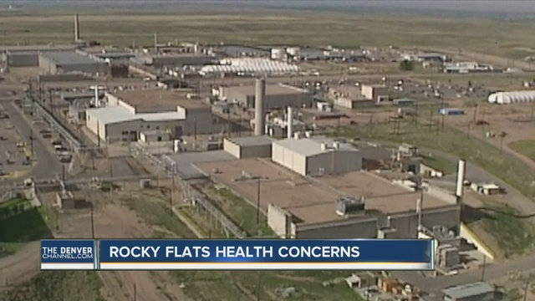
Pit production at DOE’s Rocky Flats (near Denver, CO) was The Rocky Flats Horror Show - with numerous plutonium fires; closed in 1989 after FBI raid. As plutonium can undergo a “criticality” or burn in air and is an extreme carcinogen, we don’t want a repeat of Rocky Flats horrors in South Carolina.

Slide 32
Pit Production at SRS: Government & contractors tell citizens “hand over your money!”
$2.9 billion requested for Fiscal Year 2025 for pit production at SRS and Los Alamos National Lab
SRS - $1.1 billion requested in FY 2025
FY 25 request says SRS pit plant “TPC range of approximately $18B ‐ $25B, and the total project schedule extension of approximately 1 to 3 years.”
SRS pit plant estimate up from $6.9 to $11.1 billion estimate in 2021; that increase is sweet music to a contractor’s ears [success (maximizing cost) = failure (huge schedule delays and massive cost increases)]
SRS plutonium pit plant – most expensive building in U.S. history?

Slide 33
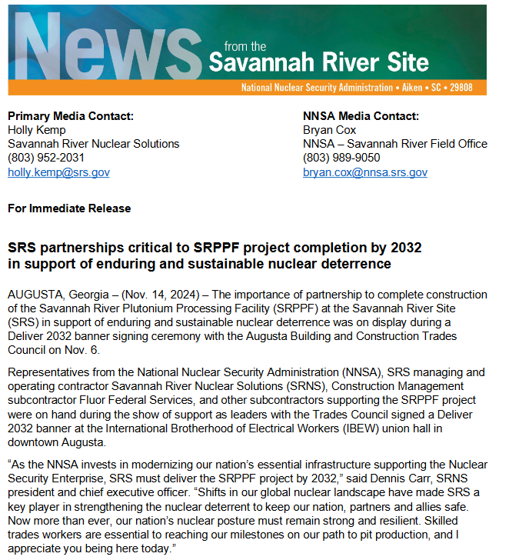
Hard to tell DOE, contractors and boosters apart
In a contractor (Savannah River Nuclear Solutions, SRNS) – DOE-NNSA joint news release of November 14, 2024, the contractor speaks for the government: “As the NNSA invests in modernizing our nation’s essential infrastructure supporting the Nuclear Security Enterprise, SRS must deliver the SRPPF project by 2032,” said Dennis Carr, SRNS president and chief executive officer. “Shifts in our global nuclear landscape have made SRS a key player in strengthening the nuclear deterrent to keep our nation, partners and allies safe. Now more than ever, our nation’s nuclear posture must remain strong and resilient.” (= spend more money & faster)
“Also on the panel [on pits, on Nov. 13] was Bob Peters, a deterrence research fellow from the conservative Washington think tank Heritage Foundation, who said that the National Nuclear Security Administration (NNSA) should ramp up from its current “glacial pace” to a “wartime footing” for building warheads to compete with Russia and China.”
(= spend more money & faster)

Slide 34
https://www.congress.gov/117/crpt/hrpt397/CRPT-117hrpt397.pdf
NATIONAL DEFENSE AUTHORIZATION ACT FOR FISCAL YEAR 2023 - R E P O R T
OF THE COMMITTEE ON ARMED SERVICES HOUSE OF REPRESENTATIVES
Plutonium Pit Production
“…there has not been adequate prioritization of studies and analysis of plutonium aging. The committee believes that given the scale, complexity, and history of plutonium pit production, NNSA must ensure that plutonium pit requirements and plans are fully understood and that past mistakes regarding safety shutdowns, cost overruns, and schedule delays are not repeated.”.
Requires a “master schedule” for pit production, with schedules and costs & plans for studies on pit aging & “a briefing that describes the holistic environmental impact of expanded plutonium pit production, accounting for simultaneous pit production at multiple sites.” Those things do not exist.
With the South Carolina Environmental Law Project (SCELP) as our attorneys, SRS Watch, Nuclear Watch New Mexico, Tri-Valley CAREs have a lawsuit in federal court demanding preparation of a Programmatic EIS – filed June 2021. We won on September 30, 2024 and are now in negotiations with DOJ/NNSA.

Slide 35
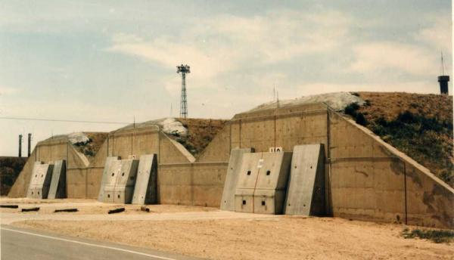
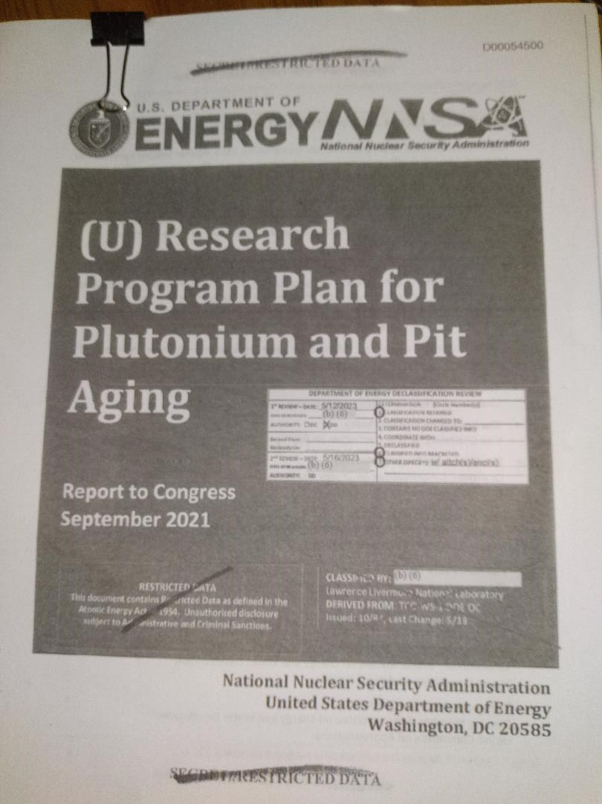
DOE refuses to consider reuse of 20,000 stored pits at DOE’s Pantex site in Texas and blocks public access to information.

Slide 36
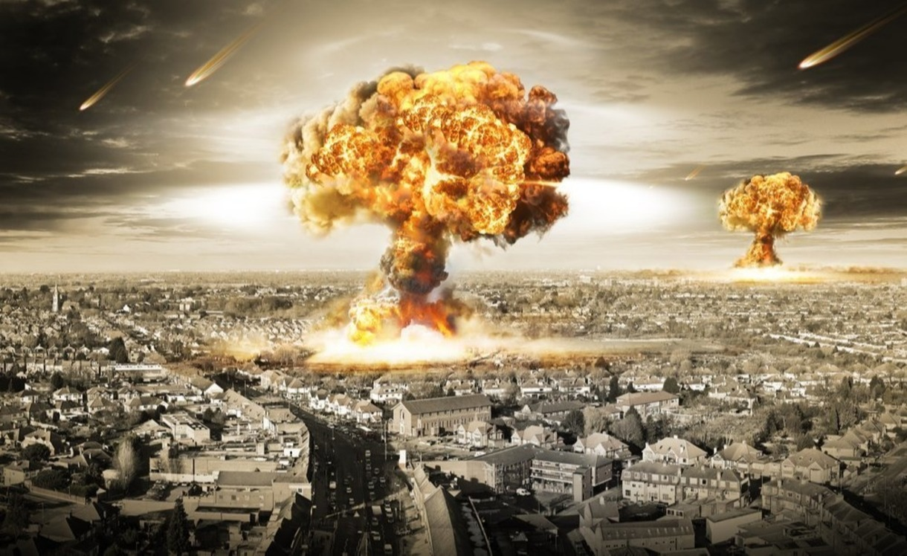
Goal is to first produce two kinds of pits for two new nuclear warheads. Then, focus will be on other new warheads and replacing the pits in 4000 weapons, so the “mission” at SRS will be for 50+ years; plus there are a host of nuclear waste streams, including TRU to WIPP. With our lawsuit, we have forced DOE to pause and consider all environmental impacts of pit production, at all involved DOE sites.

Slide 37
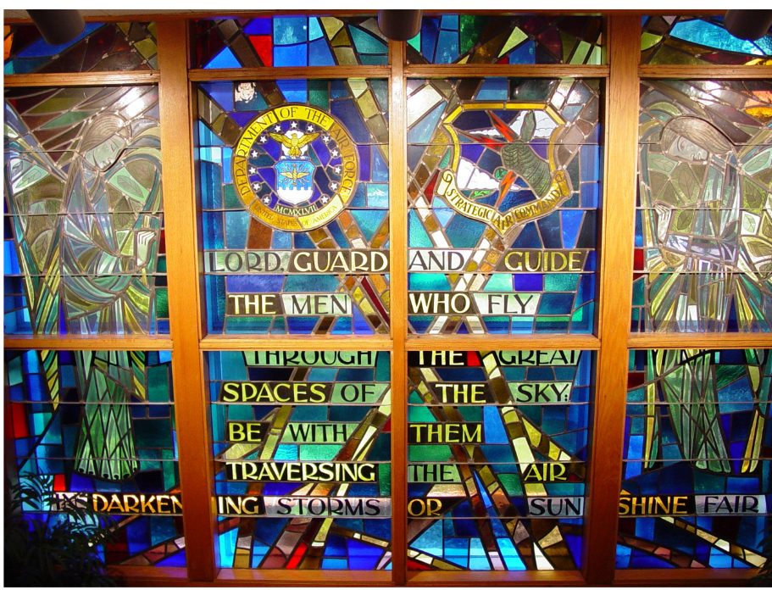
Some claim that planning for nuclear war is blessed by their god
Stratcom chapel: “We dedicate these windows to their memory and ourselves to the ideals which they represented. Like them, we stand in the light of God and like them we pray that we may have resoluteness of purpose and courage of conviction to answer the challenge by saying, “Here am I! Send me.”

Slide 38
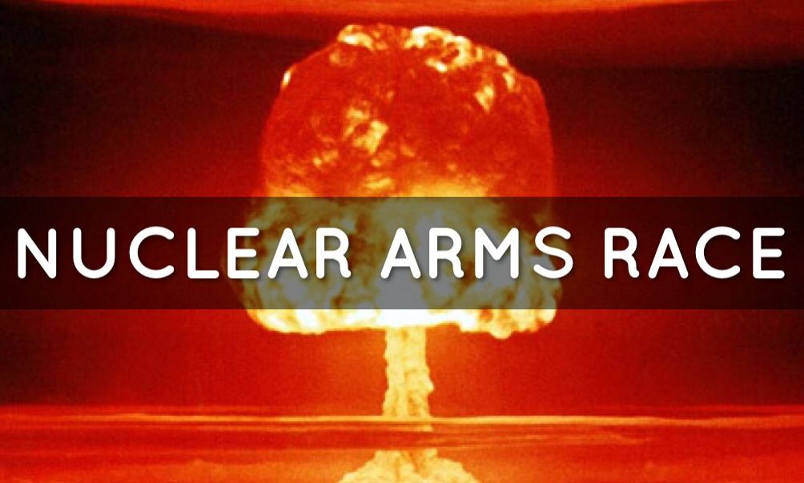
In reality, the Obama/Trump/Biden $2-trillion plan to rebuild the DOD/DOE nuclear weapons complex and build new pit facilities are part of enduring US plans to fight a full-scale nuclear war and create environmental damage, a devilish proposition indeed.
How can the public oppose this madness?

Slide 39
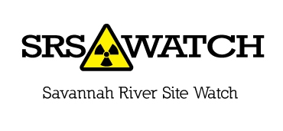
Tom Clements
Director, Savannah River Site Watch
Columbia, SC www.srswatch.org https://www.facebook.com/SavannahRiverSiteWatch srswatch@gmail.com tel. 803-834-3084
SRS & other nuclear victories since 1970s: https://srswatch.org/wp-content/uploads/2024/11/Savannah-River-Site-public-victories-October-2024.pdf

