Slide 1
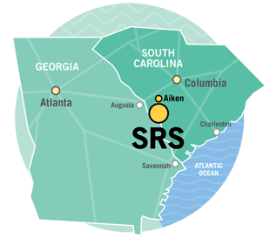
Exposing the “Conspiracy Reality” of On-Going Planning at the Savannah River Site (SRS) for Full-Scale Nuclear War
Tom Clements, Savannah River Site Watch, www.srswatch.org
May 10, 2025 – Unitarian Universalist Congregation of Columbia
Archived livestream: https://www.youtube.com/live/paiDOA8thlc

Slide 2
SRS: Back to The Bomb Plant
Known during the Cold War as “The Bomb Plant,” the Department of Energy’s Savanah River Plant made plutonium and tritium (a radioactive gas) for US nuclear weapons.
Today, the Savannah River Site (SRS) processes and packages all tritium, used in all US nuclear warheads.
Backers of an increase in nuclear weapons want SRS to start fabricating plutonium “pits,” the core of all US warheads.
So, as the focus is being ended on cleaning up SRS, it’s back to The Bomb Plant for SRS as its role in the nuclear arms race is key…and is very lucrative.

Slide 3
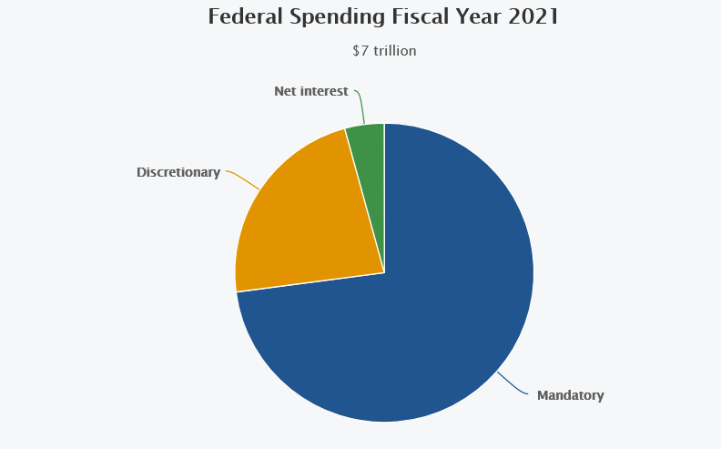
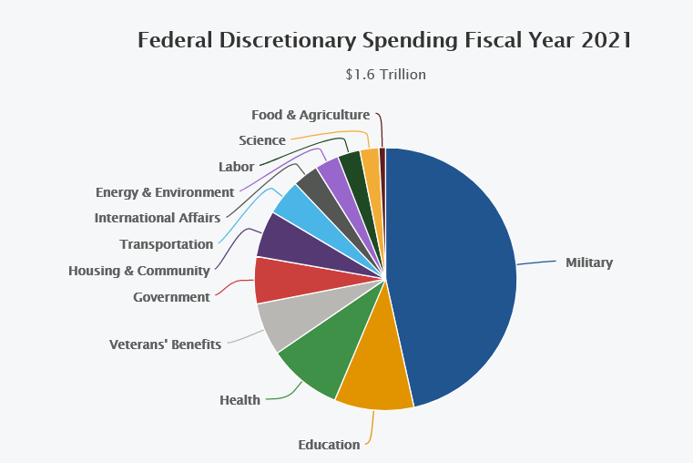
Half of federal “discretionary spending” is now for the military (DOD) and is headed to $1 trillion/year, per the president’s request of late April 2025

Slide 4
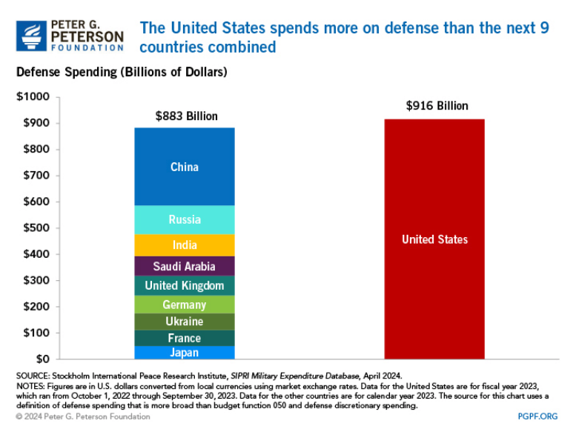
U.S. military spending tops the world, by far.
“Overseas Contingency Operations” (OCO) is a Pentagon slush fund appropriated apart from the base military budget and can add 10% or more to DOD spending

Slide 5
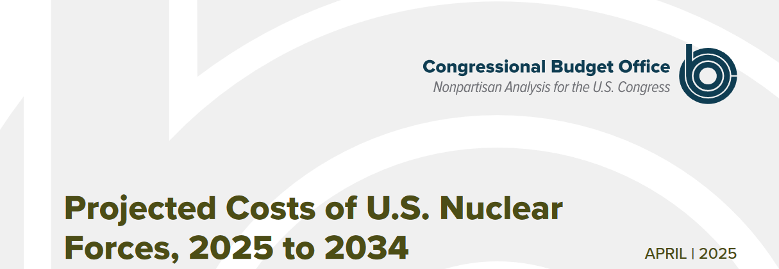
The CBO’s new estimate for the cost to maintain nuclear weapons by DOD and DOE is now $946 billion from 2025-2034, 25% higher than its estimate of $756 billion in 2023. This new figure includes $190 billion for DOE.

Slide 6
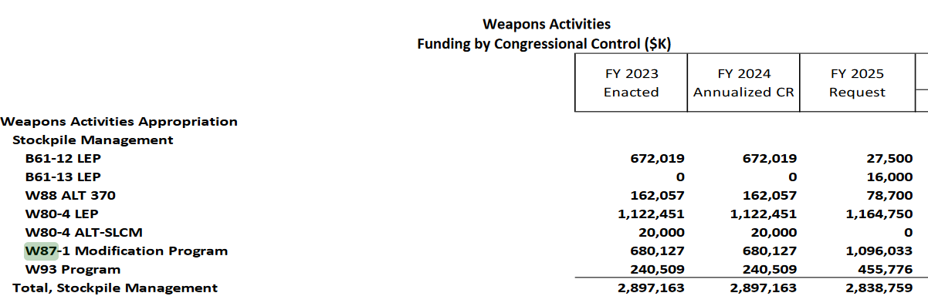
Military spending in DOE: Fiscal Year 2025 budget request by DOE’s National Nuclear Security Administration (NNSA) for new & updated nuclear warheads.
For FY 26: DOE $45 billion, with NNSA $24 billion;
DOE = Department of Nuclear Weapons

Slide 7
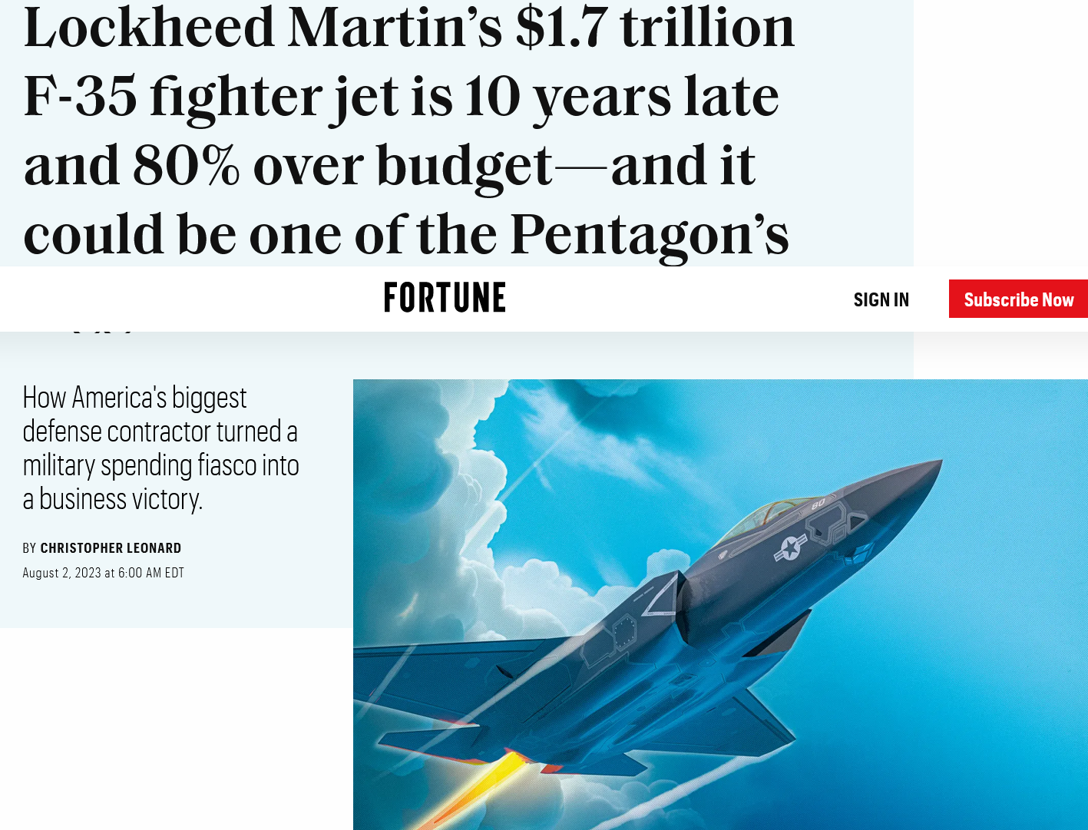
Lockheed Martin thrives on war preparation: $1.7 trillion for the F-35 fighter aircraft
In contractor terms, success = failure (cost overruns & delays are profitable).

Slide 8
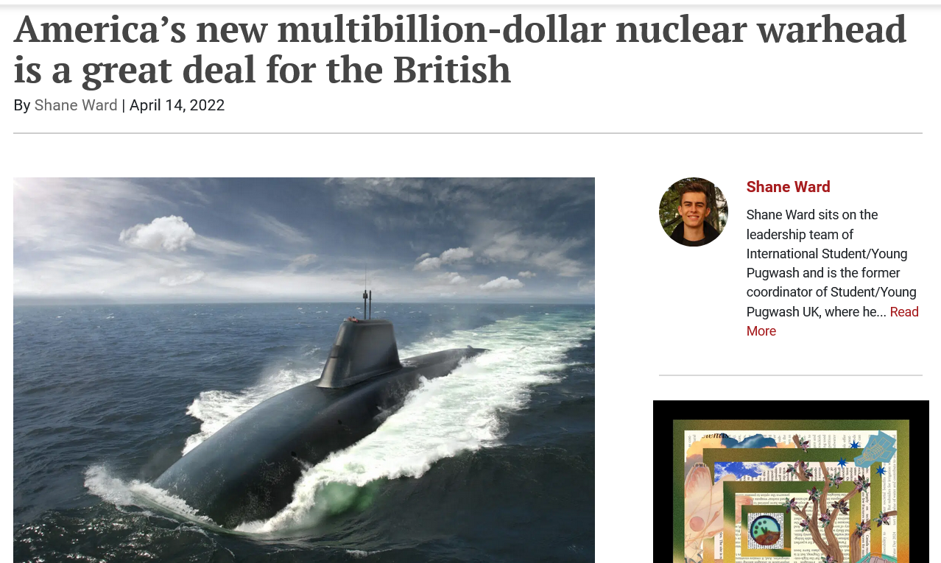
“General Dynamics Electric Boat” – 12 new “Columbia class” submarines with nuclear-tipped missiles: $132 billion, with W93 warhead with plutonium “pit” from SRS, a US-UK SLBM program by Lockheed Martin, legal under the under the Mutual Defense Agreement and Atomic Energy Act

Slide 9
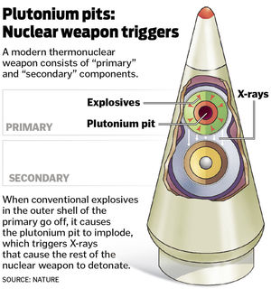
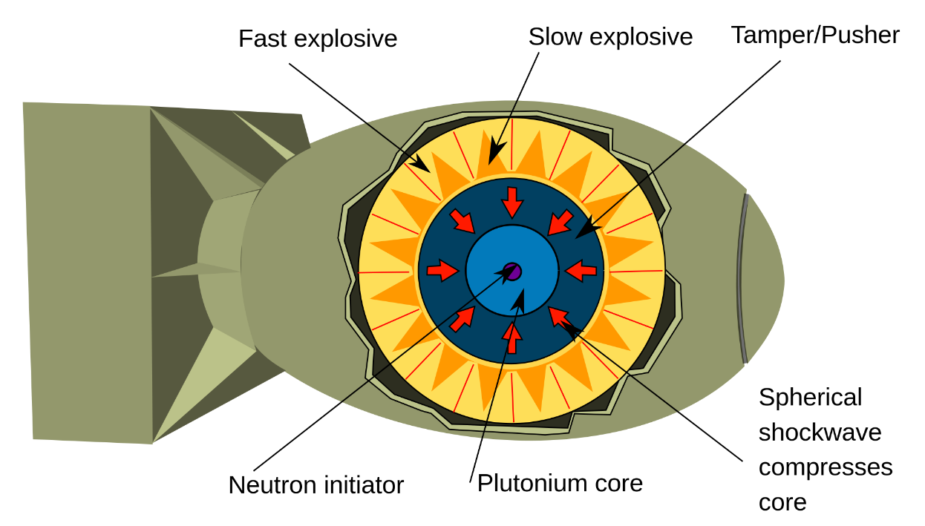
Plutonium “pit” – heart of all US atomic bombs – proposed new nuclear weapons role for SRS

Slide 10
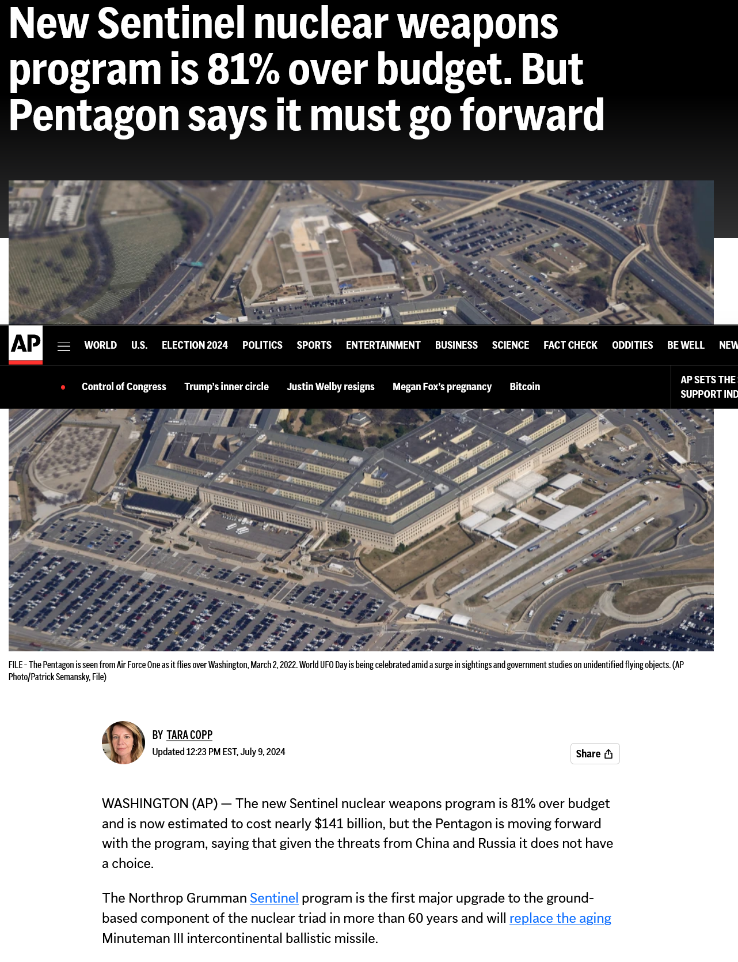
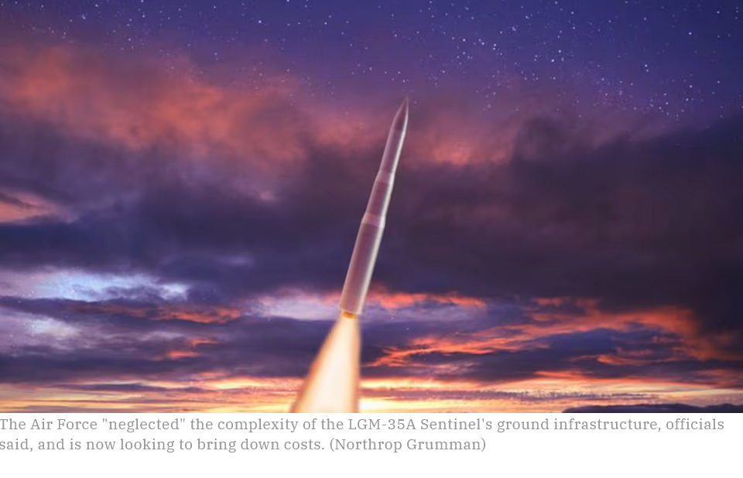
Sentinel W87 warhead designed by Lawrence Livermore National Lab, with plutonium “pits” from Los Alamos National Lab and possibly Savannah River Site – vastly over budget, with $141 billion for the missile and retrofitting existing silos, vs $78 billion in 2020. The Air Force now wants new silos.

Slide 11
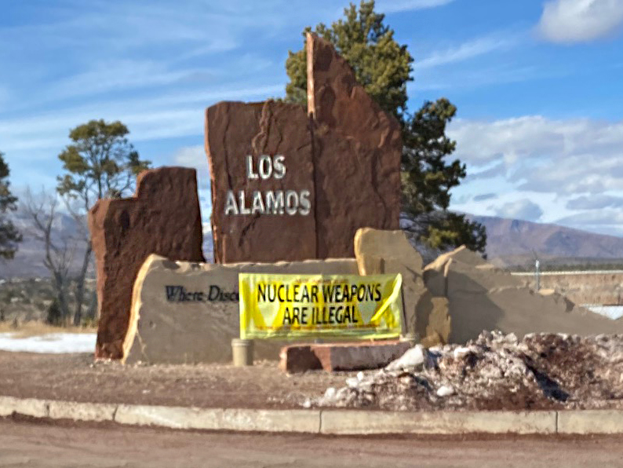
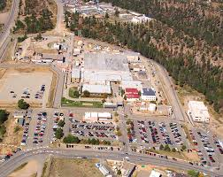
Los Alamos National Lab is aiming to make 30 pits per year by 2030, initially for the W87-1 warhead (on the Sentinel missiles)

Slide 12
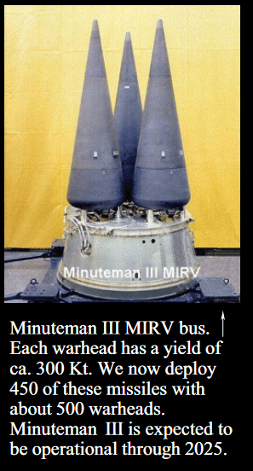
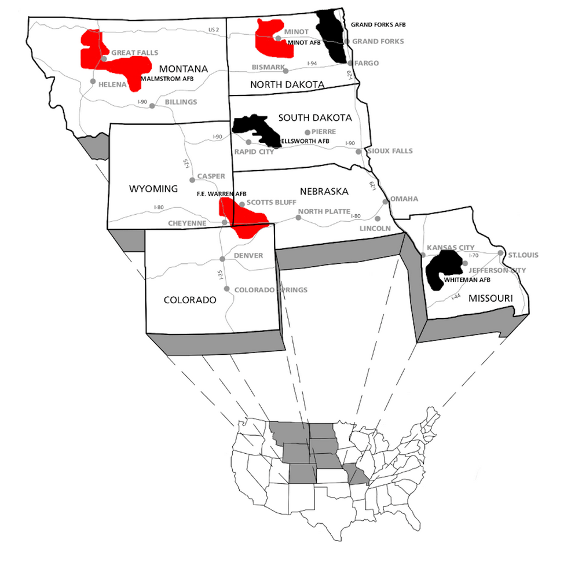
400 Minute Man III ICBMs, with 400 silos, to be replaced by the Sentinel, possibly to be MIRVed; based in the Midwest – first-strike weapon and/or “nuclear sponge” – part of obsolete nuclear “triad” (land, sea, air weapons)
Image on left from NPS, Minuteman Missile National Historic Site.

Slide 13
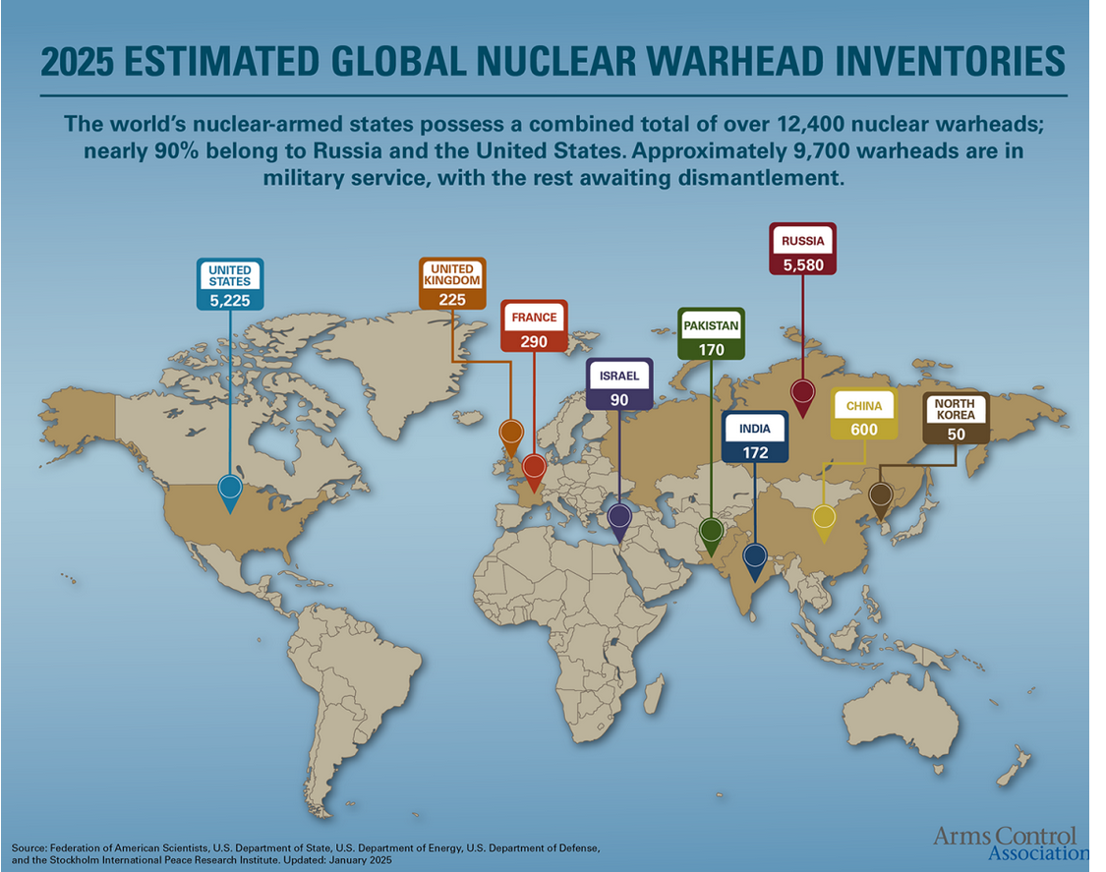
“Nuclear Weapons States” - US and Russia have far more weapons than other nuclear weapons states combined. US, Russia & China are pursuing a variety of new nuclear weapons but the US blames Russia and China for the new nuclear arms race. “Deterrence” or planning for nuclear war?
New Strategic Arms Reduction Treaty (New START) with Russia, caps deployed warheads at 1550, expires in February 2026

Slide 14
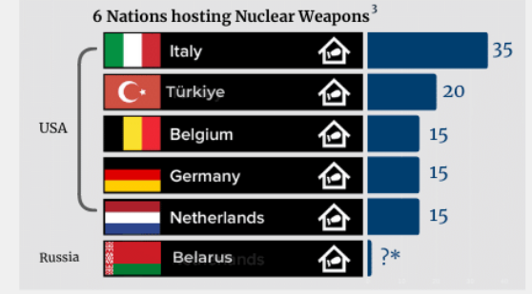
De facto nuclear weapons states, “nuclear sharing” with US or Russian nuclear weapons

Slide 15
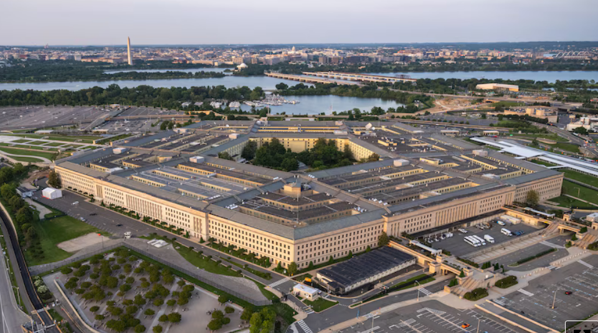
The “Department of Defense” drives military spending but the U.S. Department of Energy - really the “Department of Nuclear Weapons” - makes the nuclear warheads and has its own budget

Slide 16
DOE’s “National Nuclear Security Administration” (NNSA) - “Nuclear Security Business Enterprise” - is operated by private contractors as a business enterprise to serve its client: DOD

Slide 17
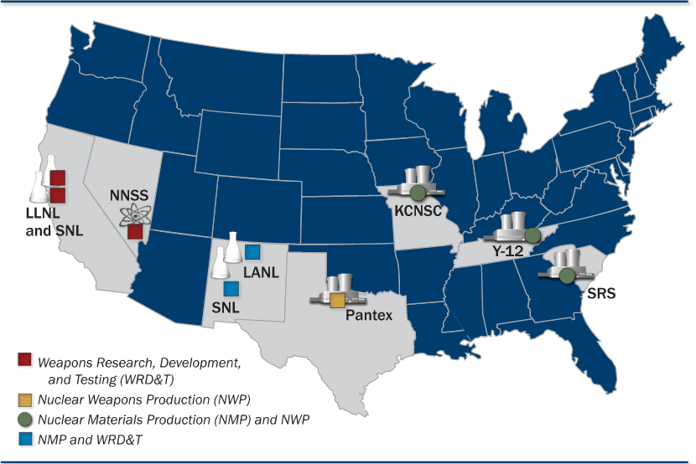
DOE’s nation-wide complex run by contractors: NNSA makes and maintains the warheads and supplies the nuclear materials and non-nuclear components & the assembled warheads to its customer

Slide 18
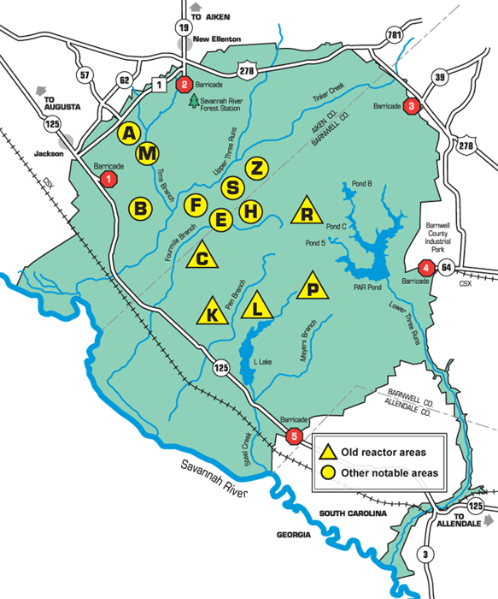
Savannah River Site (SRS) - operations in center of 310-square-mile site; founded by the Atomic Energy Commission in early 1950s, operated nuclear reactors to produce two key nuclear warhead materials: plutonium and tritium. A vast amount of nuclear and chemical waste was created. 12,000 employees. NNSA took over site management on Oct. 1, 2024.

Slide 19
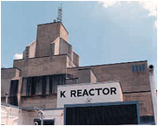
SRS had five nuclear reactors - 1953-1985 - that produced tritium and about 36 metric tons of weapon-grade plutonium (half-life 24,000 years); Hanford produced 67 MT plutonium. SRS now processes and packages all the tritium gas for nuclear weapons.
Do the math: 36,000 ÷ ~3 kg Pu/warhead = ~12,000 warheads from SRS plutonium

Slide 20
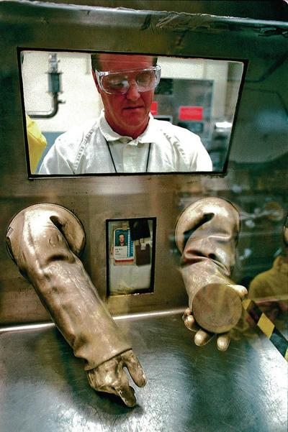
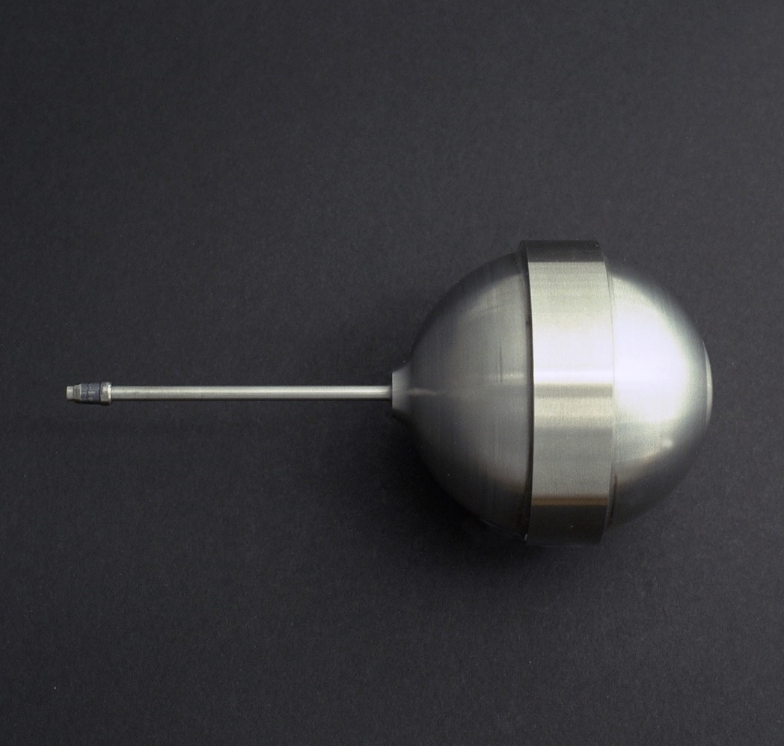
Tritium gas is used in all US nuclear weapons – all tritium is processed at SRS, from rods irradiated by TVA in the commercial Watts Bar nuclear power reactors, with those rods made by Westinghouse in its nuclear fuel plant in Columbia, SC

Slide 21
Tritium processing at SRS greatly expanding, to provide more tritium for nuclear warheads; but pits trumps tritium
SRS completes years-long effort, doubles capacity of tritium loading line in support of nation’s nuclear deterrent
AIKEN, S.C. (May 25, 2021) – The Savannah River Site (SRS) recently completed a years-long effort to upgrade a tritium loading line, doubling the capacity of the line to support the National Nuclear Security Administration’s ability to accomplish its mission of providing safe, secure, and effective nuclear weapons to support the nation’s nuclear deterrent.
“Teams in the tritium facilities collaborated with the Savannah River National Laboratory to complete the loading line upgrade, conduct a series of tests to ensure proper operation and resume production,” added Zecha. “Its successful completion continues to make us the backbone of deterrence in support of peace.”
The Department of Energy’s National Nuclear Security Administration (NNSA), which manages civilian nuclear weapons programs, plans to replace the tritium facilities at Savannah River Site’s H-Area Old Manufacturing Facility with a new Tritium Finishing Facility in the Savannah River Tritium Enterprise (SRTE) that is supposed to be operational around 2030, site officials have said.
Start of site preparation – Nov. 2023…..delayed “to ensure design resources and critical personnel are available to execute the Savannah River Plutonium Processing Facility (SRPPF) project.”

Slide 22
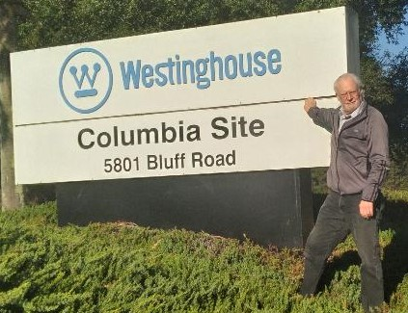
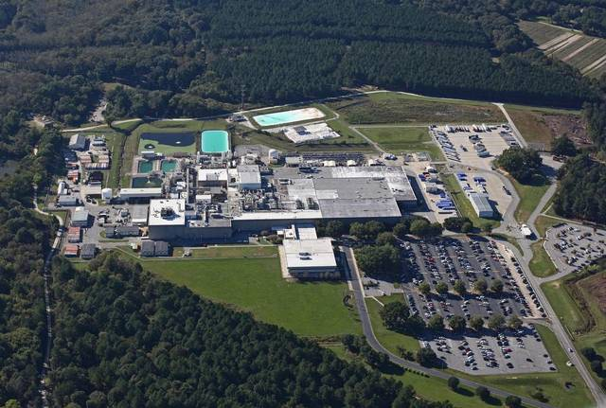
South Carolina’s other, secret bomb plant: Westinghouse nuclear fuel plant is a “dual-use” commercial-military facility and another key to the nuclear arms race; the military part fabricates special tritium rods, with no formal regulation; TPBAR fabrication due to increase and SRS tritium processing to increase as DOD wants to completely fill all tritium reservoirs in all warheads

Slide 23
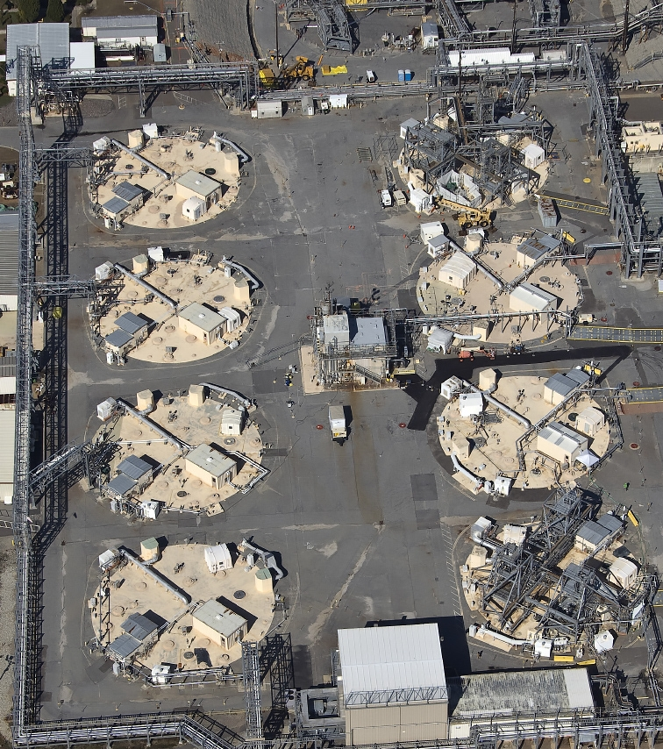
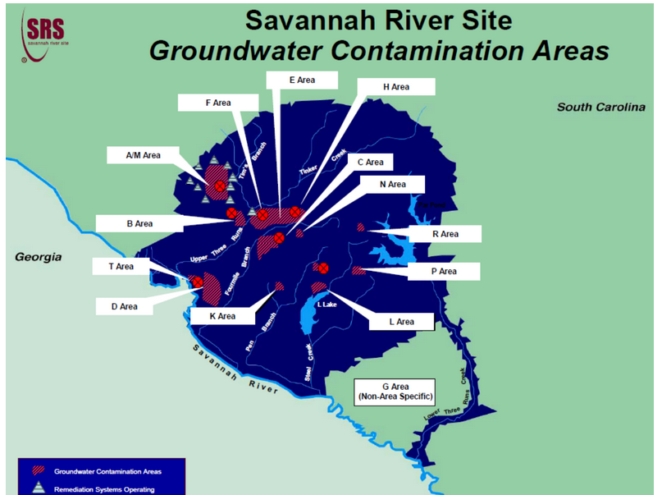
SRS high-level waste tanks – deadly radioactive waste is a by-product of nuclear material production; clean-up of this waste is where the focus must remain – 43 of 51 tanks yet to be dealt with; 2037 closure date at risk. One of the biggest environmental threats to South Carolina. SRS site “cleanup” by 2065 (don’t count on it). “Environmental liability” at SRS is more than $100 billion and there will be an effort to cut and delay cleanup and use that for nuclear weapons programs at SRS.

Slide 24
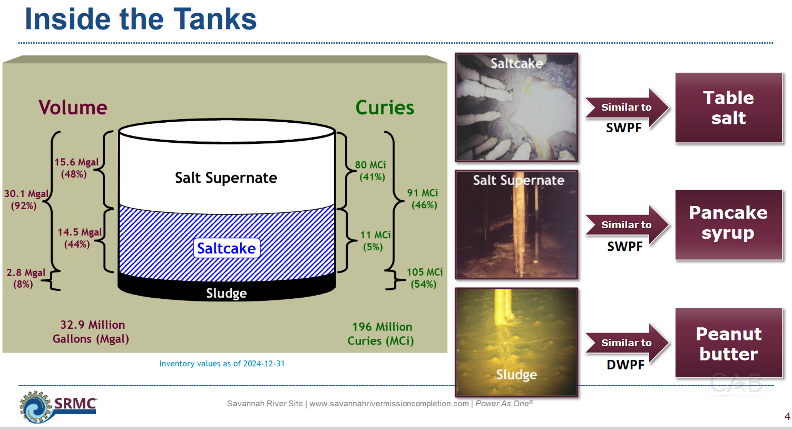
“Liquid Waste Update,” by Savannah River Mission Completion to SRS Citizens Advisory Board, March 25, 2025, Aiken

Slide 25
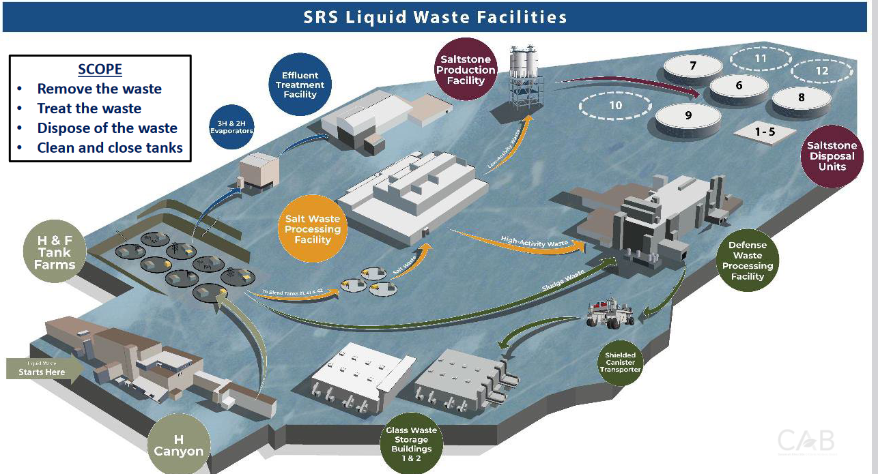
High-level nuclear waste system: costly but essential

Slide 26
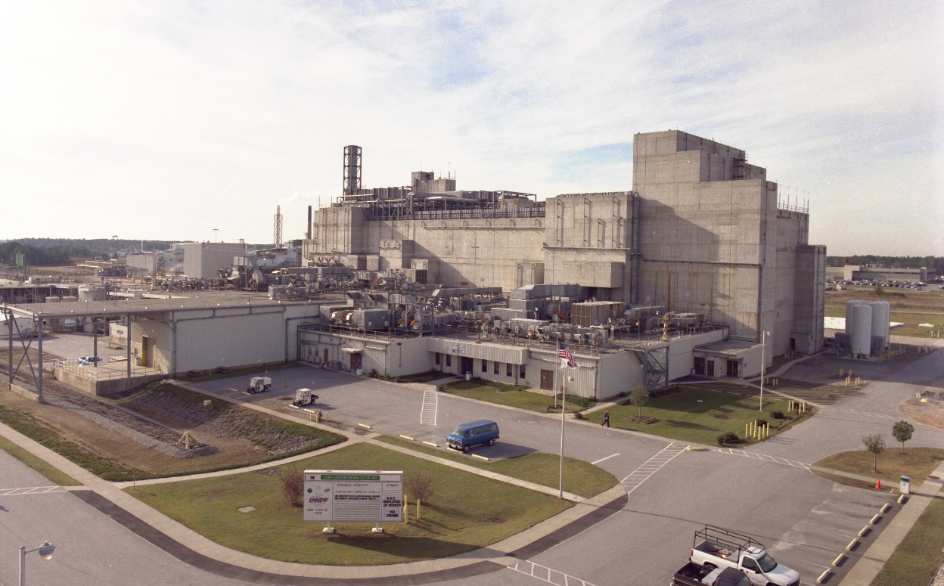
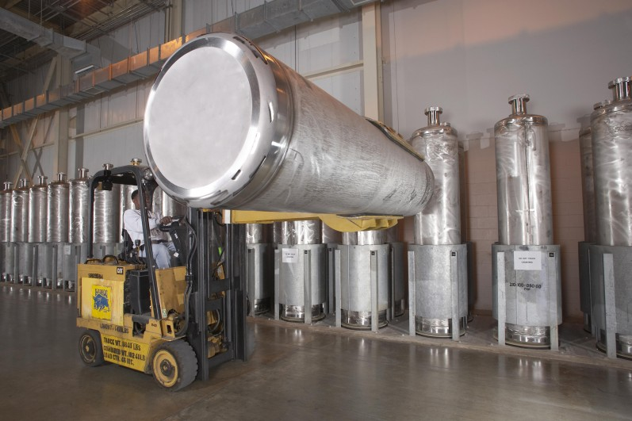
Highly radioactive nuclear waste - liquid and sludge, a by-product of plutonium production - is being removed from the HLW tanks to be “vitrified, ”with over 4000 canisters filled,; but no disposal site is available so it stays at SRS. SRS has LLW disposal trenches & numerous chemical disposal sites.

Slide 27
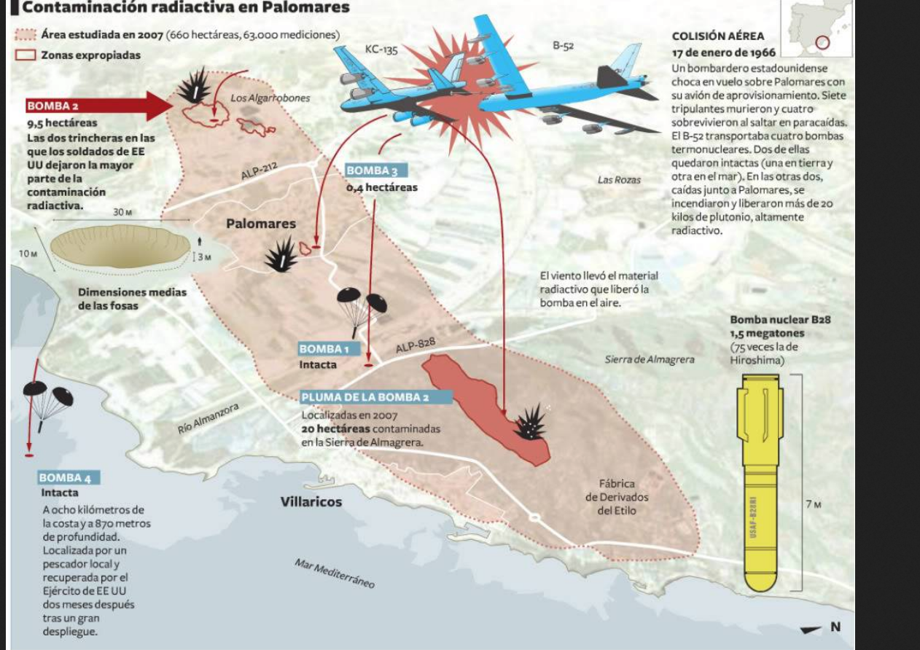
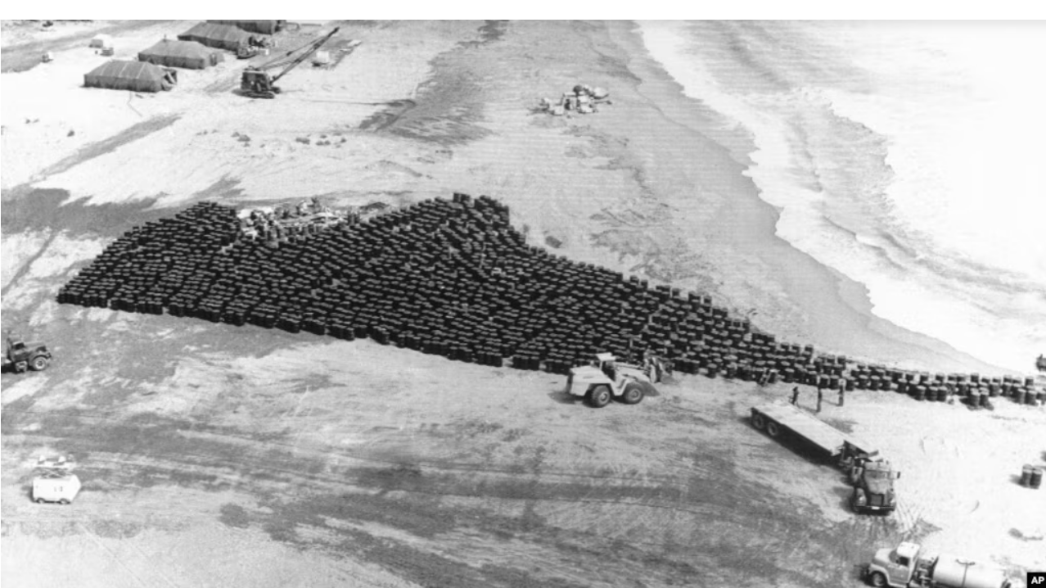
Plutonium-contaminated soil and equipment from B52 nuclear weapons accidents - at Palomares, Spain (1966) and Thule Air Base, Greenland (1968) - now Pituffik Space Base - dumped in unlined trenches at SRP though it isn’t LLW by legal definition

Slide 28
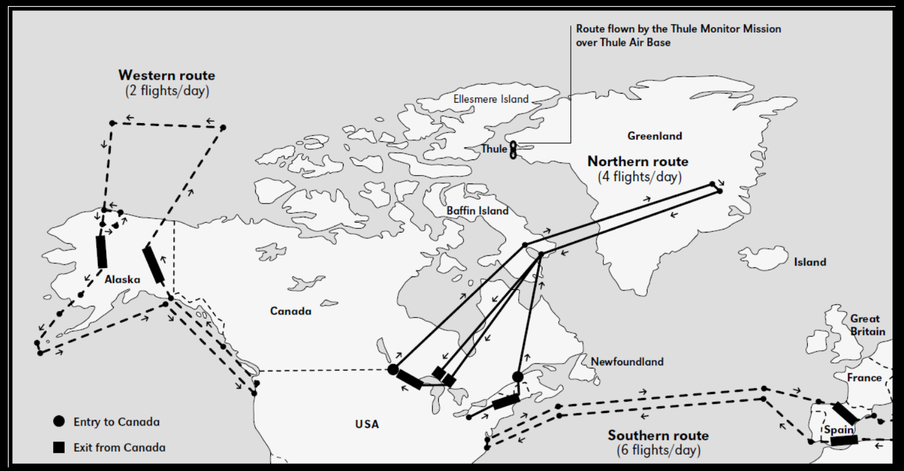
24/7 flights during the Cold War with nuclear-armed B52s bombers, in Operation Chrome Dome: planned erosion of “deterrence” into nuclear war in a matter of hours

Slide 29
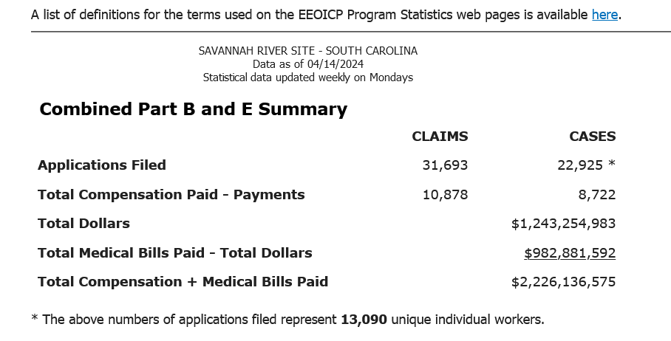
SRS has harmed health. Department of Labor’s Federal Energy Employees Occupational Illness Compensation Program Act (EEOICPA) has paid out $ billions to DOE employees with potential health impacts – now appears to be terminated

Slide 30
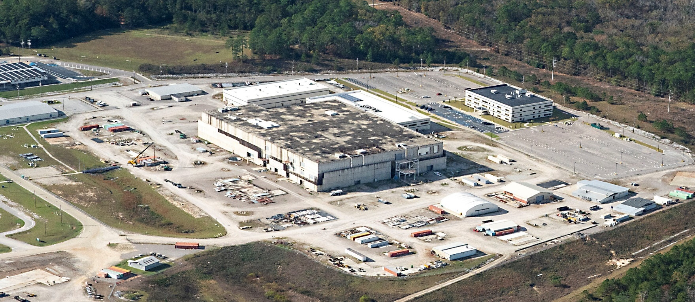
Cleanup wasn’t good enough for some… Plutonium fuel “MOX” facility at SRS to make plutonium nuclear reactor fuel terminated in 2017 w/ $5 billion wasted on construction, with no congressional or DOE investigations. Proposed in 2018 as SRS Plutonium Bomb Plant (Savannah River Plutonium Processing Facility) to make 50+ “pits” per year, for new & old warheads, a project of DOE’s National Nuclear Security Administration (NNSA)

Slide 31
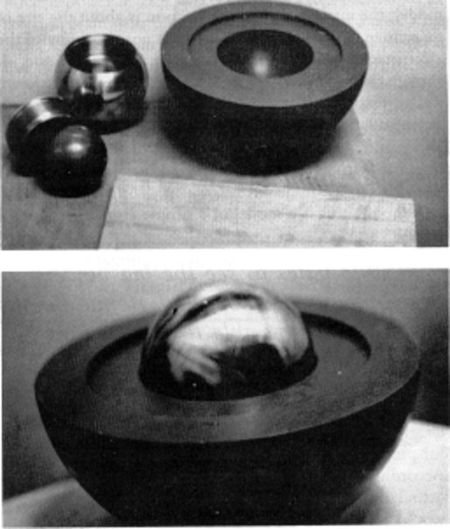

In May 2018, DOE/DOD announced the goal to produced 80 “pits” per year, at two DOE sites. SRS is not required by law to produce pits, this was a “deep state” decision by bureaucrats. Hearing on May 7, 2022:
“highest production modernization priority is re-establishing the ability to produce new plutonium pits”

Slide 32
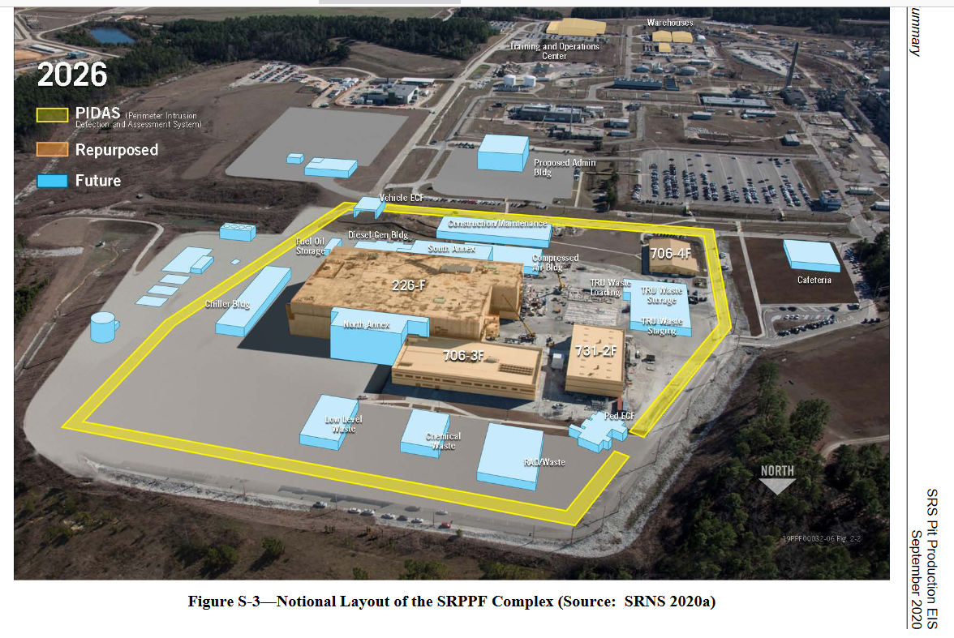
SRS Plutonium Bomb Plant complex, if finished

Slide 33
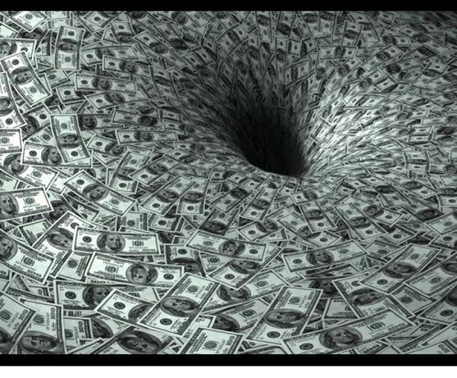
As DOE is an unconstrained money machine for contractors and special interests, a new “mission” had to be quickly found to fill “loss” in funding when the MOX project was terminated. Pit production was a perfect choice - large initial costs & high annual cost, with guaranteed delays and cost overruns. Voilà!
Cost estimate: $18-25 billion (FY 2025 NNSA budget request) + sunk cost of $5 billion (for MOX plant)

Slide 34
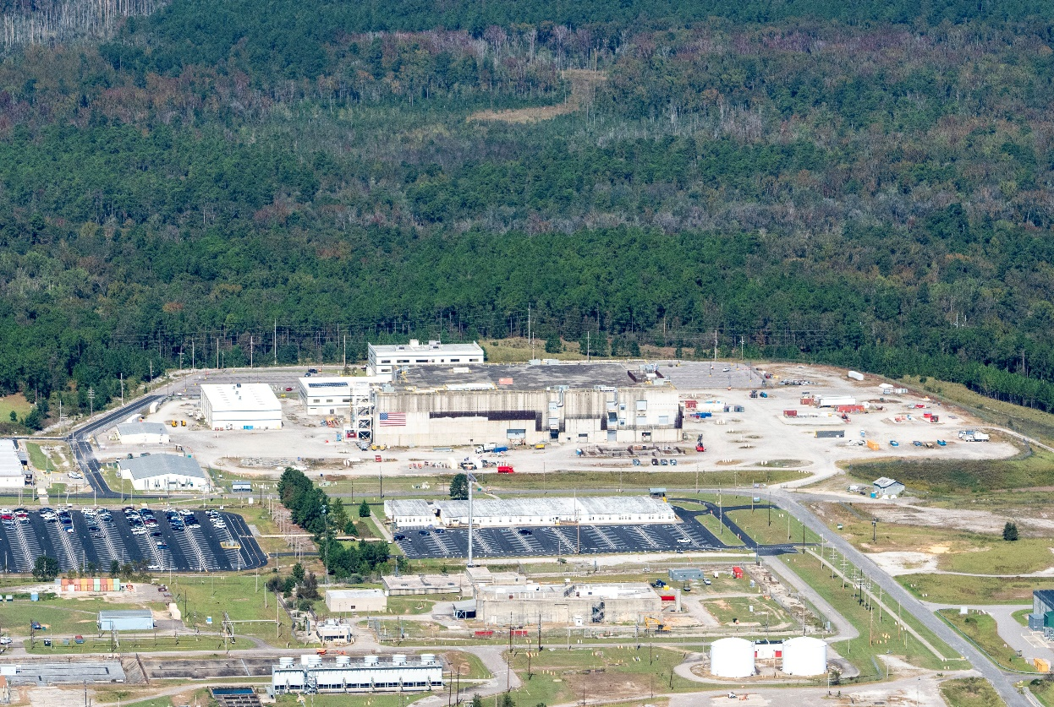
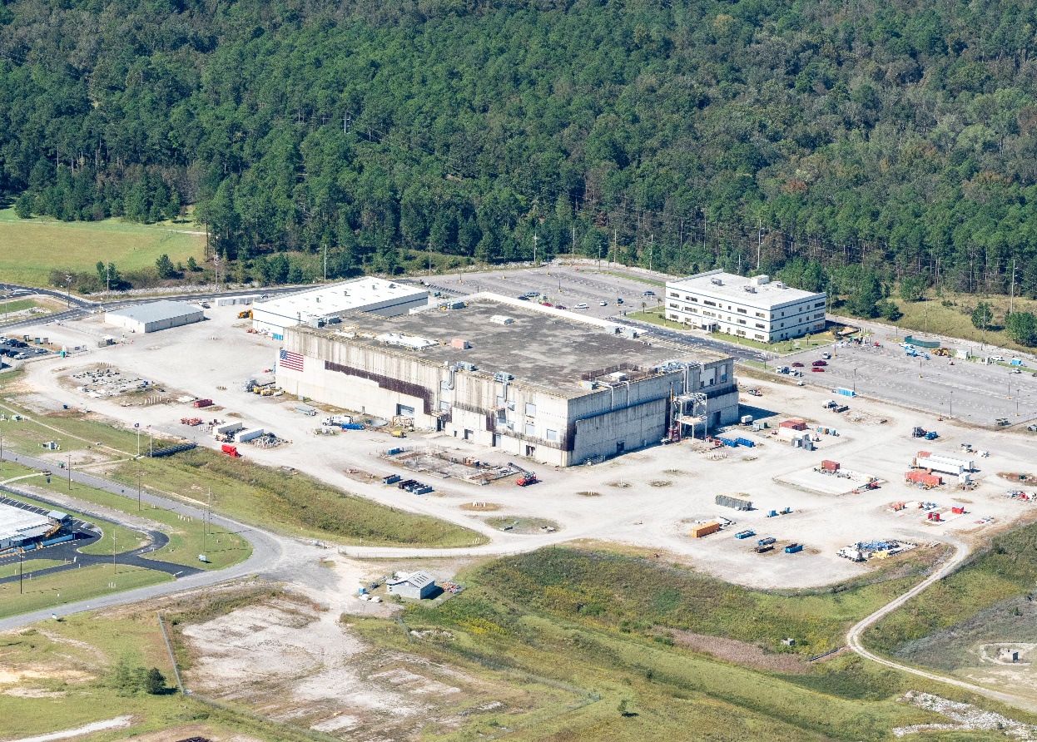
Pit production sites are Los Alamos National Lab & SRS - first pits for Sentinel ICBM (W-87 warhead) & next pits for SLBM (W93 warhead); SRS has no pit production experience and has mostly lost plutonium-handling experience = recipe for disaster?

Slide 35
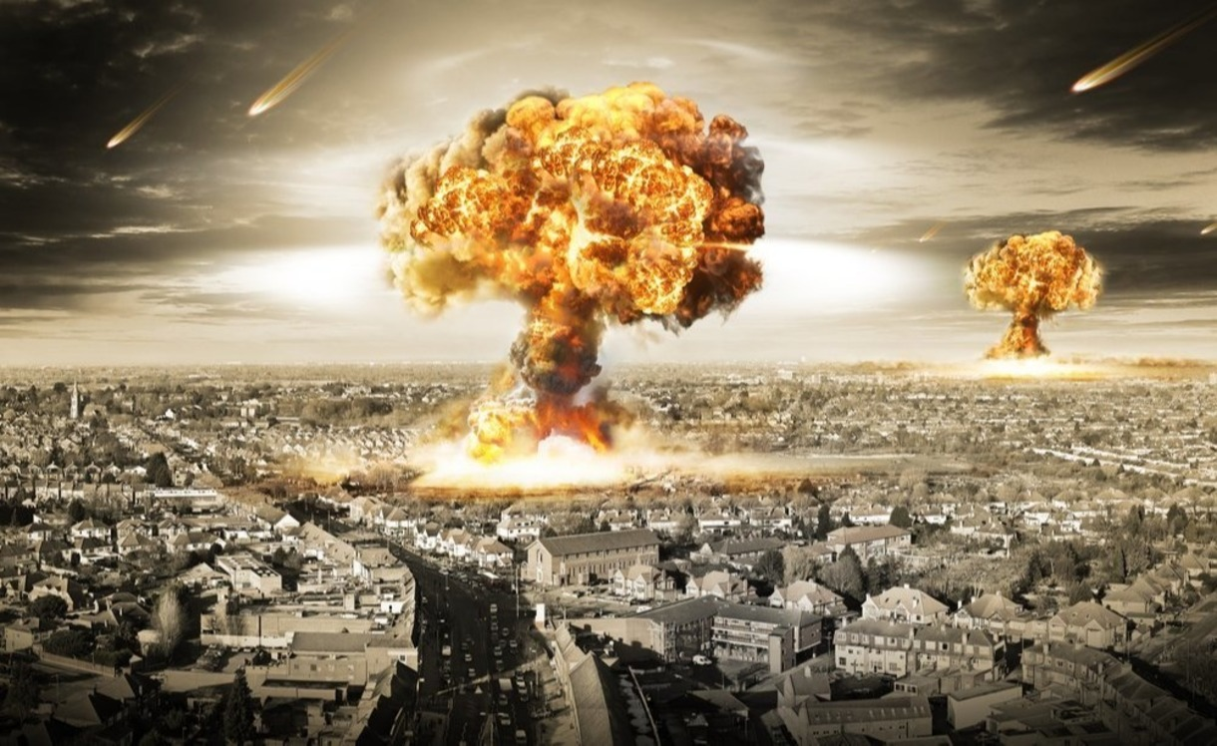
Goal is to first produce two kinds of pits for two new nuclear warheads. Then, focus will be on other new warheads and replacing the pits in 4000 weapons. Why?! Thus, the pit “mission” at SRS will be for 50+ years. There are a host of nuclear waste streams, including TRU to WIPP. With our NEPA lawsuit that we won, we have forced DOE to pause and consider all environmental impacts of pit production, at all involved DOE sites.

Slide 36
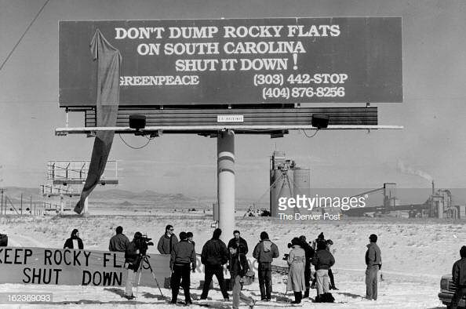
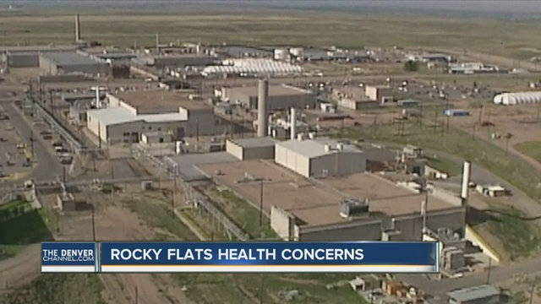
Pit production at DOE’s Rocky Flats (near Denver, CO) was The Rocky Flats Horror Show - with numerous plutonium fires; closed in 1989 after FBI raid. As plutonium can undergo a “criticality” or burn in air and is an extreme carcinogen, we don’t want a repeat of Rocky Flats horrors in South Carolina.

Slide 37
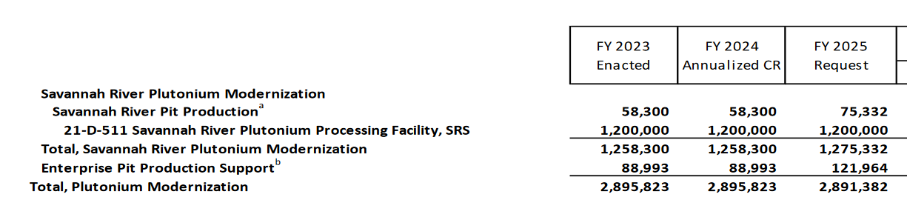
SRS Plutonium Bomb Plant funding: ~$1.3 billion/year

Slide 38
Pit Production at SRS: Government & contractors tell citizens “hand over your money!”
$2.9 billion requested for Fiscal Year 2025 for pit production at SRS and Los Alamos National Lab; FY 2026 budget not yet released
SRS - $1.3 billion requested in FY 2025
FY 25 request says SRS pit plant “TPC range of approximately $18B ‐ $25B, and the total project schedule extension of approximately 1 to 3 years.”
SRS pit plant estimate is up from $6.9 to $11.1 billion estimate in 2021; that increase is sweet music to a contractor’s ears [success (maximizing cost) = failure (huge schedule delays and massive cost increases)]
SRS plutonium pit plant complex - at $26 billion to $33 billion – SRS pit plant most expensive building in U.S. history? Next official estimate by December 2025?

Slide 39
Budget “reconciliation” bill now before the House: $3.2 billion increase for NNSA, with $25 billion for NNSA and ~$19 billion in NNSA for “weapons activities”
(3) $1,000,000,000 to accelerate the construction of National Nuclear Security Administration facilities pursuant to section 3211 of the National Nuclear Security Administration Act (50 U.S.C. 2401);
(4) $400,000,000 to accelerate the development, procurement, and integration of the warhead for the nuclear-armed sea-launched cruise missile pursuant to section 3211 of the National Nuclear Security Administration Act (50 U.S.C. 2401);
(5) $500,000,000 to accelerate primary capability modernization pursuant to section 3211 of the National Nuclear Security Administration Act (50 U.S.C. 2401);
(6) $500,000,000 to accelerate secondary capability modernization pursuant to section 3211 of the National Nuclear Security Administration Act (50 U.S.C. 2401);

Slide 40
With the South Carolina Environmental Law Project (SCELP) as our attorneys, SRS Watch, Nuclear Watch New Mexico, Tri-Valley CAREs & the Gullah/Geechee Sea Island Coalition won a lawsuit in federal court demanding preparation of a Programmatic EIS on all environmental impacts of pit production at all DOE sites involved, including plutonium waste disposal in WIPP in New Mexico.
Lawsuit filed June 2021 & we won on September 30, 2024 and negotiations with DOJ/NNSA yielded a binding “settlement agreement” on January 16, 2025. PEIS “scoping” announced on May 8, 2025..

Slide 41
Winning the PEIS fight is a monumental NEPA victory: “The DOE and NNSA will conduct a new PEIS to address all of the deficiencies identified by the Court.”

Slide 42
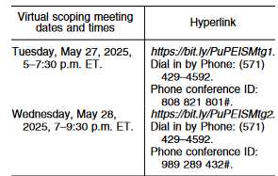
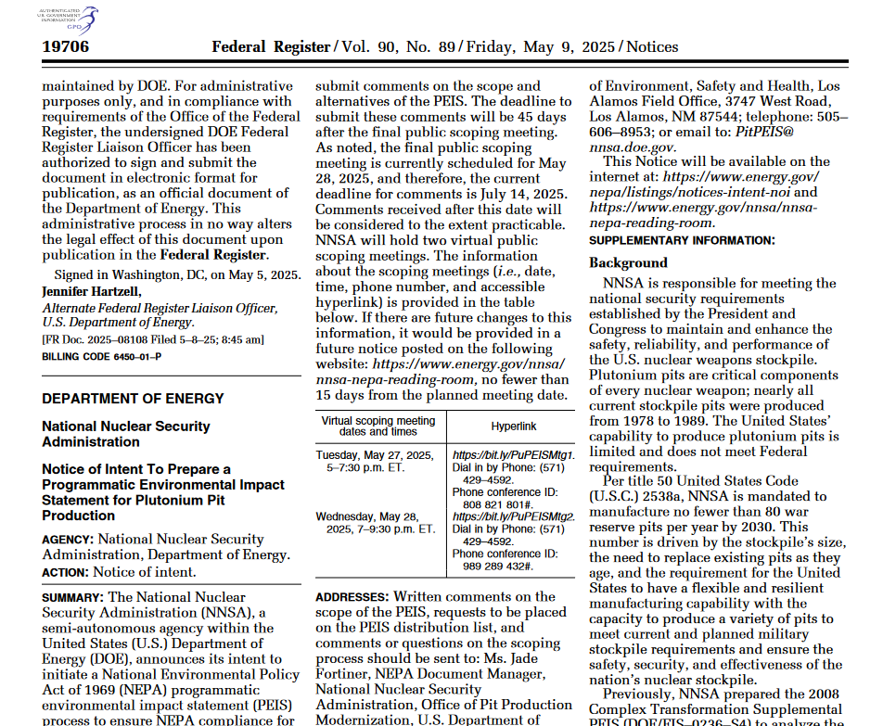
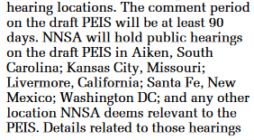
Plutonium pit PEIS preparation – Federal Register, May 9

Slide 43
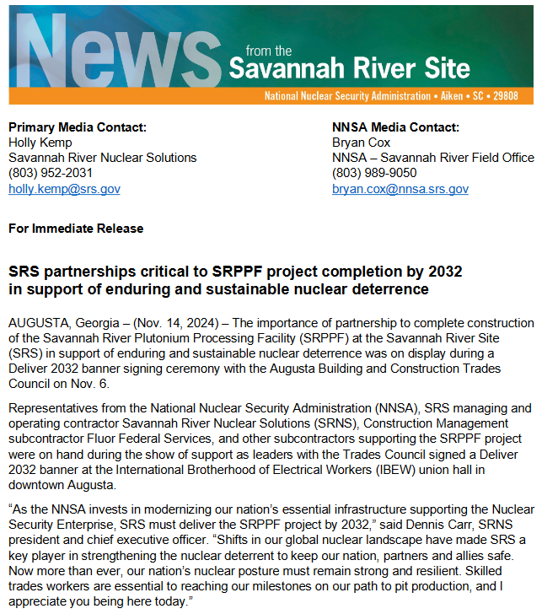
Hard to tell DOE, contractors and boosters apart – who authorized contractors to make national policy?
In a contractor - Savannah River Nuclear Solutions, SRNS - /DOE/NNSA joint news release of November 14, 2024, the contractor speaks for the government: “As the NNSA invests in modernizing our nation’s essential infrastructure supporting the Nuclear Security Enterprise, SRS must deliver the SRPPF project by 2032,” said Dennis Carr, SRNS president and chief executive officer. “Shifts in our global nuclear landscape have made SRS a key player in strengthening the nuclear deterrent to keep our nation, partners and allies safe. Now more than ever, our nation’s nuclear posture must remain strong and resilient.” (= spend more money & faster)
“Also on the panel [on pits, on Nov. 13, 2024 ] was Bob Peters, a deterrence research fellow from the conservative Washington think tank Heritage Foundation, who said that the National Nuclear Security Administration (NNSA) should ramp up from its current “glacial pace” to a “wartime footing for building warheads to compete with Russia and China.”
(= spend more money & faster, while damaging national security)

Slide 44
https://www.congress.gov/117/crpt/hrpt397/CRPT-117hrpt397.pdf
NATIONAL DEFENSE AUTHORIZATION ACT FOR FISCAL YEAR 2023 - R E P O R T
OF THE COMMITTEE ON ARMED SERVICES HOUSE OF REPRESENTATIVES
Plutonium Pit Production
“…there has not been adequate prioritization of studies and analysis of plutonium aging. The committee believes that given the scale, complexity, and history of plutonium pit production, NNSA must ensure that plutonium pit requirements and plans are fully understood and that past mistakes regarding safety shutdowns, cost overruns, and schedule delays are not repeated.”.
Requires a “master schedule” for pit production, with schedules and costs & plans for studies on pit aging & “a briefing that describes the holistic environmental impact of expanded plutonium pit production, accounting for simultaneous pit production at multiple sites.” Those things do not exist.

Slide 45


DOE refuses to consider reuse of 20,000 stored pits at DOE’s Pantex site in Texas and blocks public access to information about pit reuse and pit aging. A NNSA funded report -“Pit Lifetime” - in 2006 said pits “have credible minimum lifetimes in excess of 100 years as regards aging of plutonium

Slide 46

Congress required a pit aging study in 2020 but NNSA is covering up plans for that research, which should have been done long ago and about which the public must be informed; FOIA being misused

Slide 47

Presidential/DOD’s “Nuclear Posture Review” (NPR) – playbook for nuclear war preparation, feebly disguised as “deterrence” (word used to justify large nuclear stockpile & war preparation).

Slide 48

“Nuclear deterrence is achieved by credibly threatening a potential adversary with the use of nuclear weapons so as to prevent that adversary from taking actions against the United States, its allies, or its vital interests. This is accomplished primarily by maintaining sufficient and effective nuclear capabilities to pose unacceptable costs and risks upon the adversary should it so act.…” Deterrence = 5000 warheads?

Slide 49
The trend at SRS toward cleanup and fewer risky projects has now been reversed and could be at further risk with budget cutting, which will bring more environmental and health risks to SRS.
One thing is clear, DOE and SRS contractors have pushed SRS back to being the “Bomb Plant,” as it was called back in the early days and it is now a key to the new nuclear arms race with China and Russia.

Slide 50

Some claim that planning for nuclear war is blessed by their god
Stratcom chapel: “We dedicate these windows to their memory and ourselves to the ideals which they represented. Like them, we stand in the light of God and like them we pray that we may have resoluteness of purpose and courage of conviction to answer the challenge by saying, “Here am I! Send me.”

Slide 51

In reality, the Obama/Trump/Biden $2-trillion plan to rebuild the DOD/DOE nuclear weapons complex and build new pit facilities are part of enduring US plans to fight a full-scale nuclear war, while harming national security and creating environmental and health risks.
How can the public oppose this madness that harms efforts for world peace while some get wealthy?

Slide 52
Take action against the SRS pit plant!
Send in a brief letter to Rep. Joe Wilson or Rep. Jim Clyburn and Senators Graham, & Scott & other Members of Congress – I do not support the SRS plutonium pit plant, the economic cost of it, pit production at SRS takes way from most urgent mission: clean up, and I’m against the new nuclear arms race with China and Russia and the SRS role in that.
Write a letter to The State (Columbia, SC) or other papers: https://www.thestate.com/opinion/letters-to-the-editor/submit-letter/
Participate in and lead public participation in the draft PEIS meetings in 2026 & submit comments for the record. Would be good to hold a rally outside meeting sites across the country.
Other action?
Who or what group will take the lead on monitoring SRS?

Slide 53

Tom Clements
Director, Savannah River Site Watch
Columbia, SC www.srswatch.org https://www.facebook.com/SavannahRiverSiteWatch srswatch@gmail.com tel. 803-834-3084
SRS & other nuclear victories since 1970s: https://srswatch.org/wp-content/uploads/2024/11/Savannah-River-Site-public-victories-October-2024.pdf & https://tinyurl.com/5f2zrw27

Slide 54


Slide 55
Citizens say “No!” to the proposed New Production Reactor, aka New Pork-barrel Reactor (NPR) - Oink! - May 1991 & They Won!

Slide 56
The NPR, proposed for $R$, would have produced tritium for all US nuclear warheads. Around 2001, the same people WON AGAIN against a new plutonium “pit” plant proposed for SRS – the Modern Pit Facility (MPF). So, victory against the nuclear war machine is possible.

Slide 57


No Restart of K-Reactor, to produce tritium, 1991 in Aiken –
We won again! SRS tour 2005

Slide 58


